Slide 1

New Core Curriculum
Approved!
Fall, 2014

Slide 2
Component Coding

Slide 3
Communication – 010
Mathematics – 020
Life & Physical Sciences – 030
Language, Phil & Culture – 040
Creative Arts – 050
American History – 060
Gov’t/Poli SCI – 070
Social & Beh SCI – 080
Component Area Option – 090
Notes:
Each component is coded similarly to how it is now. COMM = 010, MAT = 020, etc
Talk about 090 a bit.

Slide 4
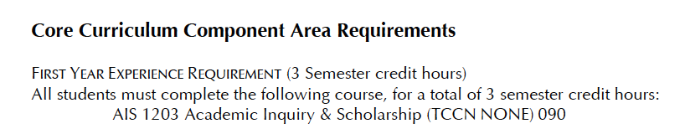
Notes:
List of CC re-formatted in the catalog to make it more clear. This is at the top of the list.
No longer listed with the LPC component. More clear now that AIS = 090. Per recent meetings/input with y’all.

Slide 5
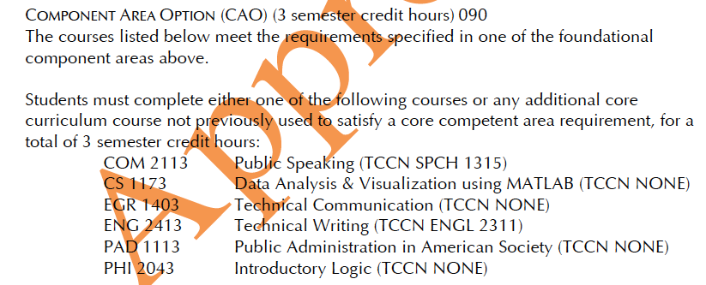
Notes:
Rest of 090 courses are listed at the end of the CC list.
NOTE: “. . . Or any additional CC course not previously used . . . “

Slide 6
A word about “double coding”

Slide 7
Communication – 010
Mathematics – 020
Life & Physical Sciences – 030
Language, Phil & Culture – 040
Creative Arts – 050
American History – 060
Gov’t/Poli SCI – 070
Social & Beh SCI – 080
Component Area Option – 090

Slide 8
Communication – 010
Mathematics – 020 & 090
Life & Physical Sciences – 030 & 090
Language, Phil & Culture – 040 & 090
Creative Arts – 050 & 090
American History – 060 & 090
Gov’t/Poli SCI – 070
Social & Beh SCI – 080 & 090
Component Area Option – 090 ONLY
Notes:
Most CCs are coded in 2 ways.
COMM & Poli SCI – 6 SCH requiremts and have 2 courses so they are only coded as 010 & 070, respectively.

Slide 9


Slide 10
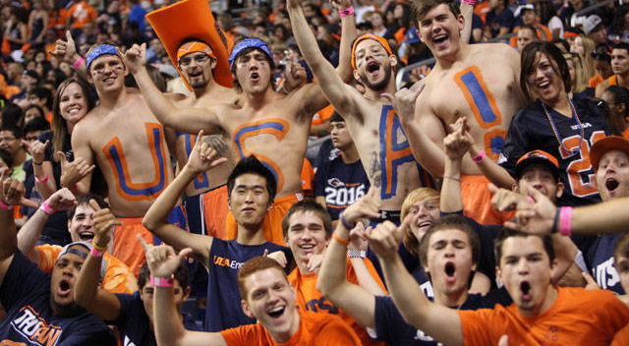
We can’t forget students who are already here.
Notes:
How could we?

Slide 11
Memo to Advisors
April 17, 2014

Slide 12
Students Wanting To Change To New Core Curriculum
= Change of Catalog
“Package Deal”
Notes:
All new major requirements, etc.

Slide 13
Current Core Science Requirement
Level I & Level II
Notes:
Stds in 12-14 catalog or previous catalog & have not completed SCI component . . .

Slide 14
Any 6 SCHs of Core SCI will satisfy the core requirement listed regardless of the level.
Notes:
Adds a little flexibility for stds.

Slide 15
AIS 1203 Academic Inquiry & Scholarship
Sophomore-Senior Level & Not Core Complete
Currently or previously enrolled UTSA
Transfer
In 2012-14 (or previous) Catalog
Substitute any core course for
AIS 1203
Notes:
We don’t want them. The course is not designed for them & we have plenty of freshmen needs to address so . . .
They COULD take AIS if they insist, but we really want to discourage them.

Slide 16
UTSA Freshmen in 2012-14 Catalog
Submit a petition for
Waiver of University Requirements to
Dr. Wyatt, Assoc Dean University College
Policy is for 2014-15 AY only.
Re-visit/revise in 2015-16.
Notes:
Has the std been in regular college for at least 1 regular semester? (more than AP/Dual Credit. More than summer school right after HS) If not, then they most likely need to take AIS.

Slide 17


