Slide 1

University Health Professions Office
Orientation 2015
Multidisciplinary Studies (MS) 3.02.10
(210) 458-5185
hpoffice@utsa.edu
Dr. Alan Vince, Director
Dr. Roxanna Nelson, Assistant Director
Angie Zulaica, M.Ed., Health Professions Advisor
Lupe Wilbon, Administrative Assistant
@utsauhpo

Slide 2
Our Purpose
Guidance and Tools
Student Support
Special Programs
Health Professions Goal Setting
Preparation for Health Professions Applications
Entrance Exam Information
@utsauhpo

Slide 3








Our Services
Orientation Advising
Special Events
Application Services
One-on-one and group advising
Workshops and Information Sessions

Slide 4
Special Programs
JAMP: Joint Admissions Medical Program
Dental Early Admissions Program

Slide 5

Choosing a Major
@utsauhpo

Slide 6
Health-Related Majors
Medical Humanities
Health
Biology
Public Health
Psychology
Kinesiology
Anthropology

Slide 7
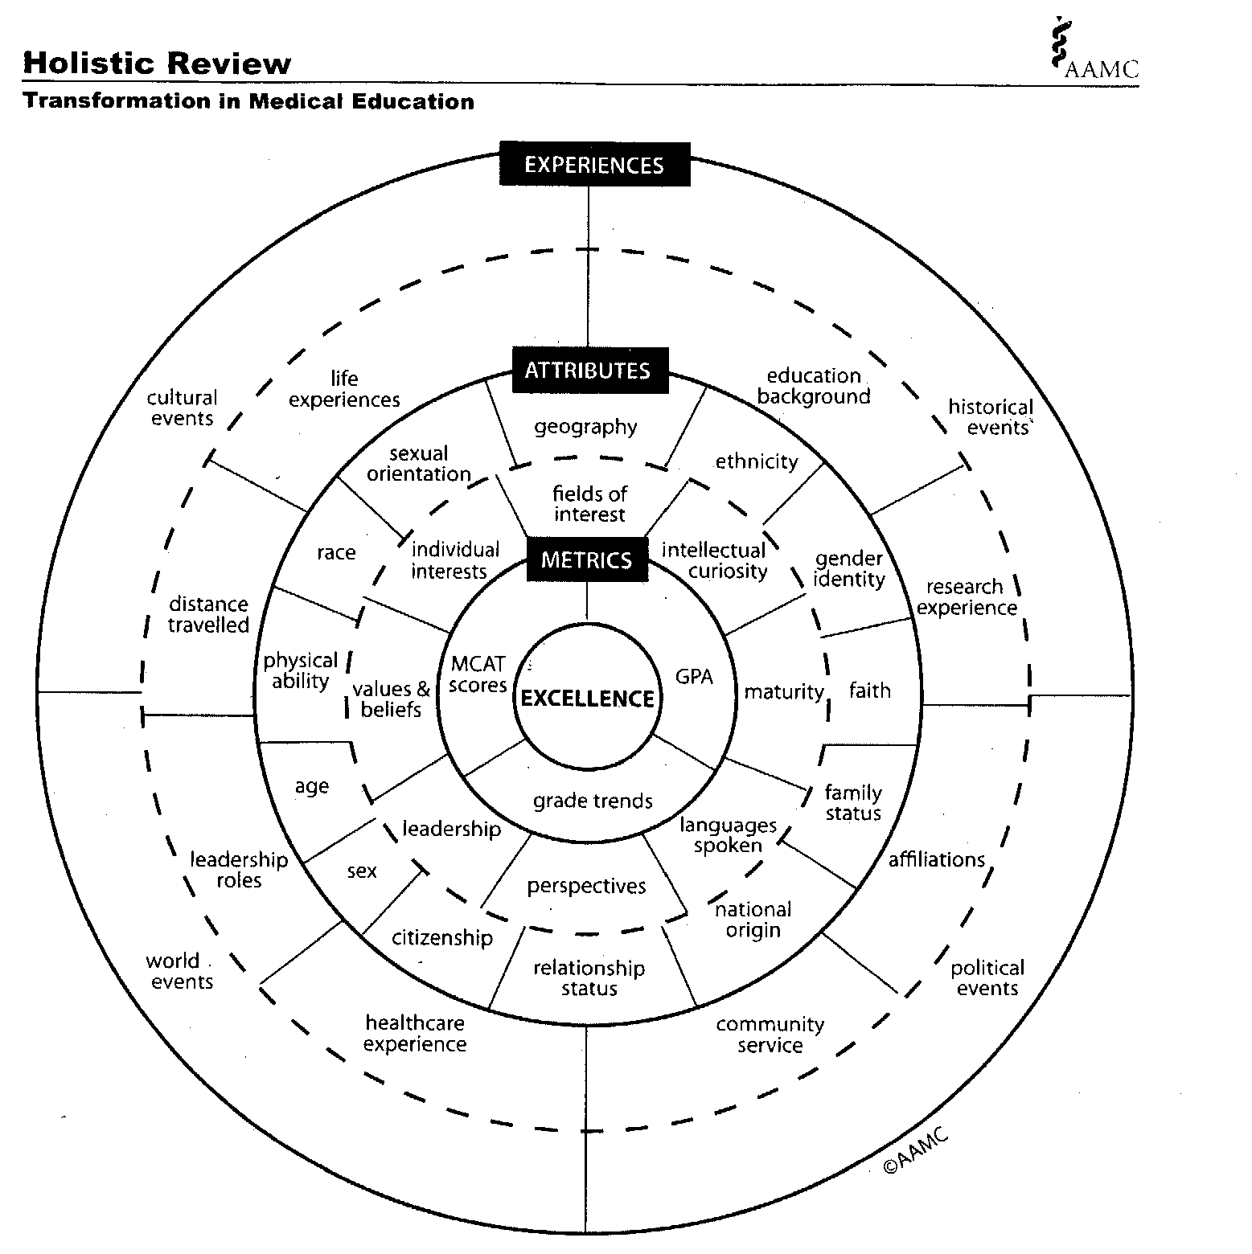
How Health Professions Applicants are Viewed

Slide 8





Health Professions Students are BUSY!

Slide 9

Becoming a Competitive Applicant
Involvement
Exposure to Medical Field
On-Campus
Resources
Academic Foundation
Network Building
Professionalism

Slide 10

Do I really have TWO advisors?
Primary Advisor
UHPO Advisor

Slide 11
Registration Information
WRC 1013: Freshman Composition I**
AIS 1203: Academic Inquiry
MAT 1073: Algebra for Scientists/Engineers*
CHE 1073: Basic Chemistry*
Introductory Major Course (non-Science) or UTSA Core Curriculum Course**
Note:
*Depending on major, you may place into a higher level course, if necessary.
**If you already have credit (via AP or Dual Credit) for one or more of these courses, work with your advisor to find other coursework.
@utsauhpo

Slide 12

Questions?
@utsauhpo

