Slide 1

Orientation Overview

Slide 2

Common Terms
Summer Orientation
  -Orientation for students starting summer 2015
Fall Orientation
  -Orientation for students starting fall 2015
CAP
  -Coordinated Admission Programs with UT-Austin

Slide 3
Common Terms
FAME
  -Facilitated Acceptance to Medical Education
Downtown (DT)
  -Downtown :)
Orientation and Family Programs (OFP)

Slide 4
Test Scores
We are no longer accepting THEA, Accuplacer, Compass, or Asset scores.
We are only accepting TSI-A scores.
If a student brings in an unofficial TSI Assessment score report, Susan Sandoval has the ability to retrieve the scores from the database. She will need four pieces of information which can be found on the score report.
  Last name
  Date of Birth
  Institution where they tested
  The ID number assigned to them when they tested

Slide 5
Test Scores
Susan can only retrieve the scores if the student took the exam at a college, or university, not at a high school. If the student provides unofficial TSI Assessment scores from a high school, they will need to have the high school provide those scores officially. You may use those scores for the initial registration but not remove the TSI hold.
Don’t forget the unofficial score process (SOAHOLD comment, SPACMNT-especially important when she creates the 35 report, not entering unofficial scores in SOATEST).
Even though you are scanning documents in Global, make sure you forward all official score reports/transcripts to Admissions.

Slide 6
TSI-A Scores
Test Code Test Section # of digits for score Example score
TSI1 Reading 3 364
TSI2 Math 3 345
TSI4 Writing 3 378
TSI5 Essay 1 5

Slide 7
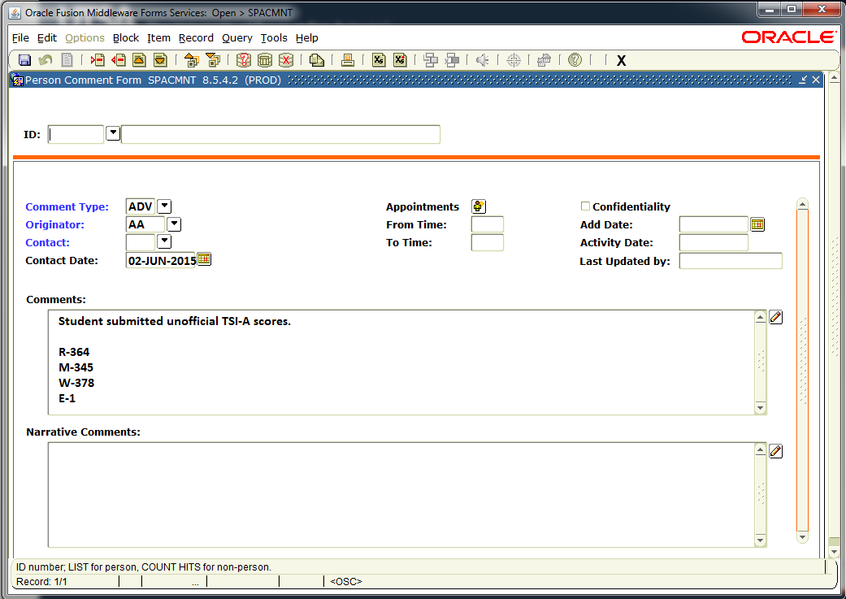
Unofficial Transcripts
Document scores in SPACMNT
Give appropriate override(s) in Banner
Scan document to Global

Slide 8
Official Transcripts
Official scores must be in a sealed envelope
Official scores must be opened by advisor
Advisor is to sign and date the back of envelope

Slide 9
Official Transcripts
Give appropriate override(s) in Banner
Scan official transcript to Global
Forward official transcript with signed and dated envelope to Admissions

Slide 10
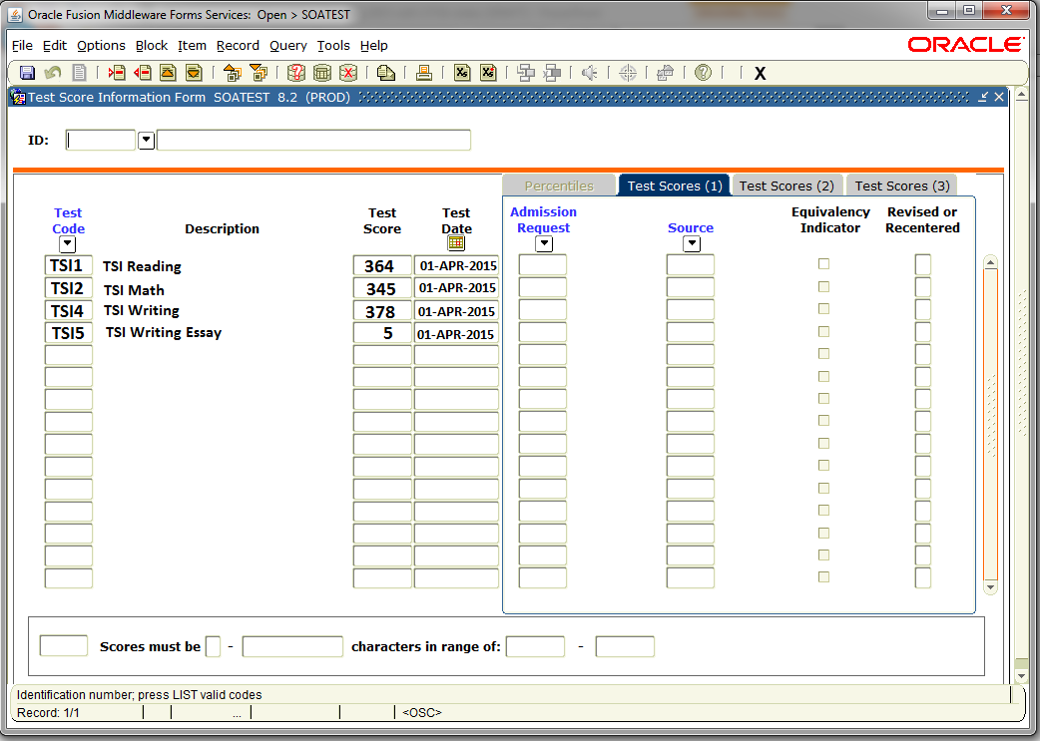
Entering Official TSI-A Scores

Slide 11
AP and Dual Credit
AP score reports for exams taken during the senior year are not available until July.
  If they say they took AP exams during their senior year, but don’t have a report, advise around those courses if possible.
    Example: Student took AP US History during senior year. Don’t advise for History.
  If a student passes the AP Government, they must successfully complete POL 1133 at UTSA before the POL 1013 credit will appear on their transcript. POL 1013 will be awarded within 2 weeks after semester grades roll.
AP list of scores
www.utsa.edu/testing

Slide 12
Standard Pre-Advising Content
ASAP Navigation
    explain course schedule, numbering system, upper/lower division
    give quick examples of the types of information that can be found in ASAP such as financial aid, billing summary, holds, etc.
    introduce the existence of the UTSA catalog and Information Bulletin, which are also found on the ASAP home page
Explanation of the advisor’s role, as opposed to the role of a high school counselor
Take specific steps to build a foundation for the relationship with the student’s assigned advisor and center – ideas are games, store contact info on phones, introductions, open ended dialogue, etc.
Gateway course

Slide 13
Standard Pre-Advising Content
Review contents of www.utsa.edu/advise/orientation
Review core/University College/major requirements.
Give an overview of what the advising session will entail.
Accept any transcripts or scores the student may have at that time.
Assign homework.
  Students need to come to appointment with a set of courses they would like to take in the fall.

Slide 14
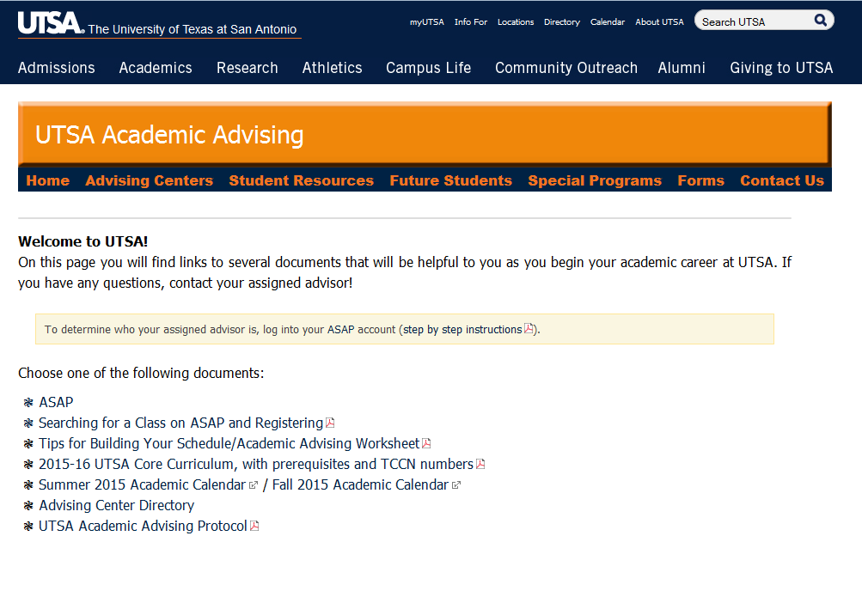
Common Forms Website
www.utsa.edu/advise/orientation
Notes:
Will add updated screenshot once website is updated.

Slide 15
Individual Advising Session
FRESHMAN
Appointment Times
8:00AM 1:30PM
8:45AM 2:15PM
9:30AM 3:00PM
10:15AM 3:45PM
11:00AM 4:30PM
11:45AM
Students are randomly assigned to one of these 45-minute appointment times by center
Lunch
12:30-1:30
Freshman appointment cards will be distributed by each center during the Pre-Advising Session

Slide 16
Individual Advising Session
FRESHMAN
Review materials located on the common forms website
Promote registering for 15 credit hours to finish in 4
Be sure to notate in Global if student chooses not to take minimum of 15 hours
Students need to register for AIS 1203 or UPM1000, Writing, Math in fall semester.

Slide 17
Individual Advising Session
FRESHMAN
Do your best to give any overrides or approvals needed during session. If you run out of time, Dainon and Shannon will set when student comes to the lab
Students can register in the advising center or the computer lab on the 3rd floor of the JPL
OFP will have a table set up in the Sombrilla to help guide students to the JPL computer lab
  Student MUST visit the computer lab to close out orientation (survey and Rowdy Link)

Slide 18
Individual Advising Session
TRANSFER
(June 11 and June 25)
Appointment Times
1:00PM
2:00PM
3:00PM
4:00PM
5:00PM
Students are randomly assigned to one of these 1 hour appointment times by center
Transfer appointment cards will be distributed by USSTS staff at check-in

Slide 19
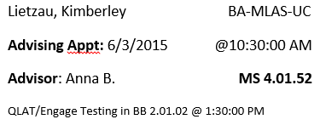
Label Information
Avery 5160 label
Appointment cards will be distributed by each center during the Pre-Advising Session

Slide 20
QLAT/ENGAGE Testing Time
If a student has an advising appointment between 12p-5pm must attend 8:30am test
If a student has an advising appointment between 8a-12pm must attend 1:30pm test
Students are being encouraged to complete ENGAGE prior to attending orientation. If they have NOT completed it prior to, they will take it with their QLAT.

Slide 21
Family Pre-Advising
Dainon and Shannon will be presenting to the families about advising. This is a fairly general session due to time constraints.
  Texas Success Initiative
  Core
  AP/Dual Credit/Transfer work
  University College
  Pre-Majors vs. Majors
  High School Counselor v. Academic Advisor
  Advising Appointment

Slide 22
Spanish Family Pre-Advising
There will be two dates where family members have the option to attend presentations that are presented in Spanish.
  June 15-17
  July 27-29
These sessions will be identical to the English version.
Thank you to Melisa Martinez and Alicia Salinas for presenting these sessions!

Slide 23
Working with Families
You may have family members in your advising appointments at times
FERPA
  Talk to student first, complete form, bring family member(s) to office
Listen to their concerns and then move to solution

Slide 24

Please talk with your director if you have questions. If needed, call Dainon at
458-7284.

