Slide 1
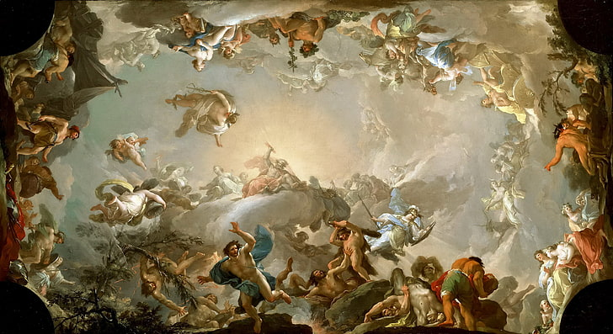
CLA 2323 - Classical Mythology
This course will introduce you to some of the most popular stories of the Ancient Mediterranean, tales filled with heroes and villains, gods and monsters, love, betrayal, death, glory, and adventure.
Join me?

Slide 2

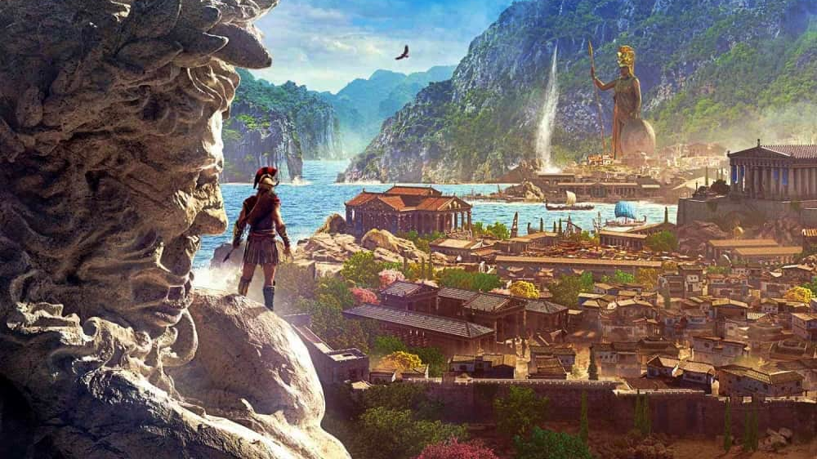
Introduction to Ancient Greece
CLA 2013
2 extra credit points on the first day of class if you can name the source of this picture.
By Dain Wood
This course provides a broad overview of the history and culture of the ancient Greeks, from their arrival on the Greek peninsula in the prehistoric Bronze Age (beginning ca. 3000 BCE) through Alexander’s conquest of the Eastern Mediterranean and the subsequent rise of the Roman Empire (3rd-1st c. BCE).
Over the course of our study, we explore…
Early Mediterranean Civilization
Greek History and Civilization
Greek Warfare and Strategy
Politics and Rival City States
Ancient Religion and Local Lore
The Modern Implications of Ancient Society

Slide 3
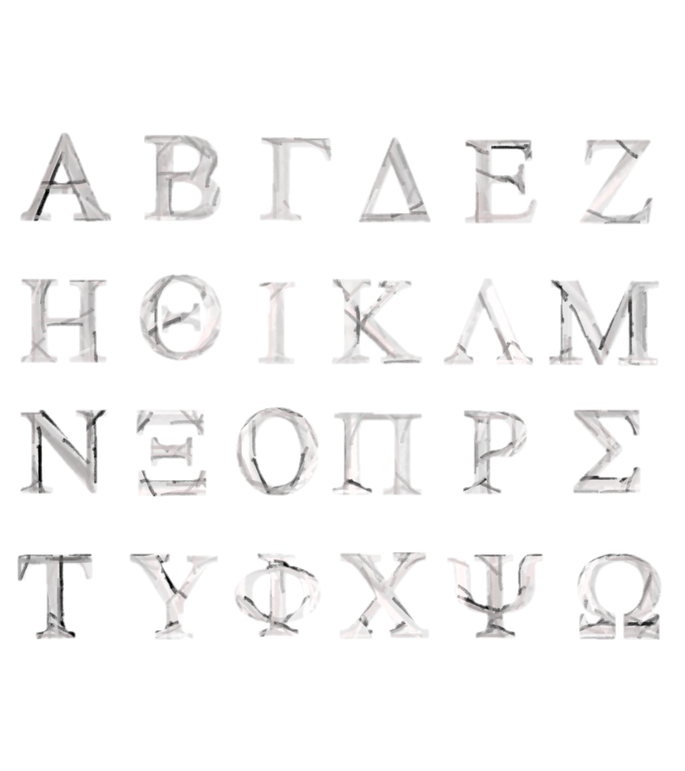

Greek 1114
Greek Language 101
An introductory course which teaches the basics of the Greek language and starts you off on your journey to be able to read and write in Classical and New Testament Greek.
This is not an easy course. Languages can be tough, ancient languages especially. It takes work, I am not going to lie, but we will have a lot of fun learning together and it’s a skill you will never regret taking the time to acquire.
There is no other set of languages which teaches you how to talk about taking revenge on your enemy or describes the way a family dog takes on a wolf to protect his boy.

