Slide 1


Slide 2

Wednesday, March 27
10AM-2PM
Convocation Center
More info. at:
BIT.LY/MAJORSEVENT

Slide 3

Wednesday, March 27
10AM-2PM
Convocation Center
More info. at:
BIT.LY/MAJORSEVENT

Slide 4
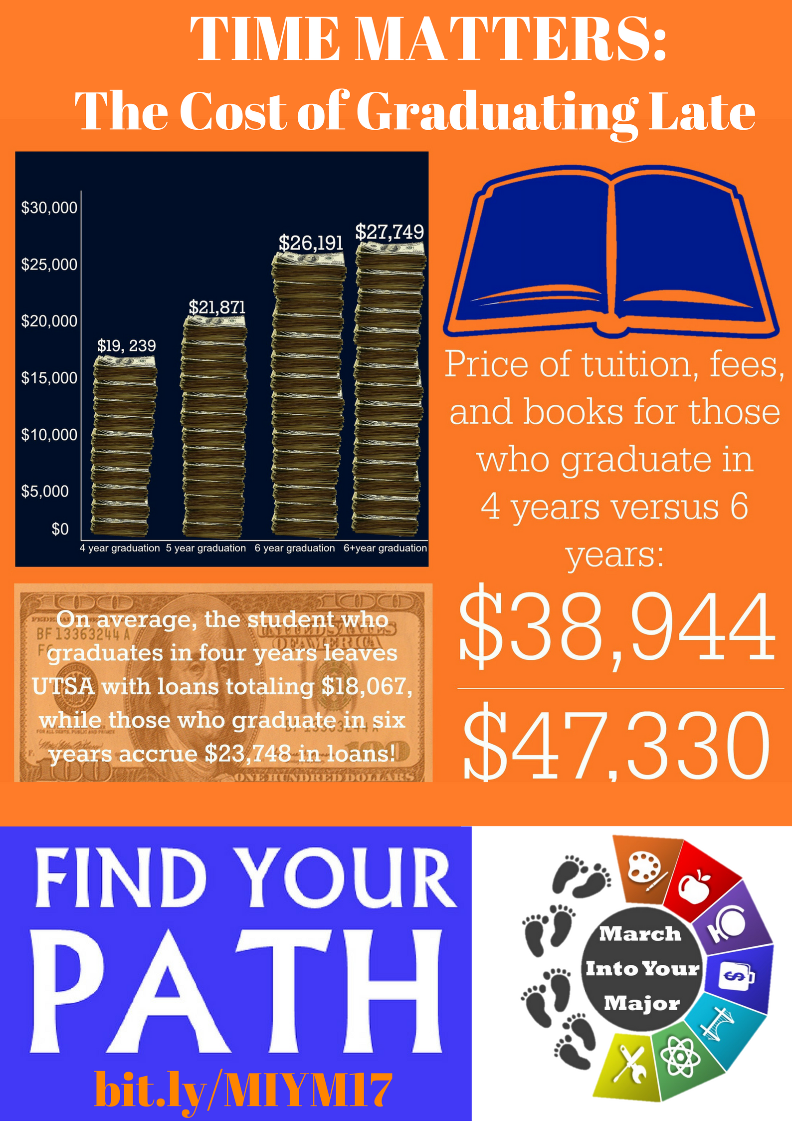
BIT.LY/MAJORSEVENT

