Slide 1


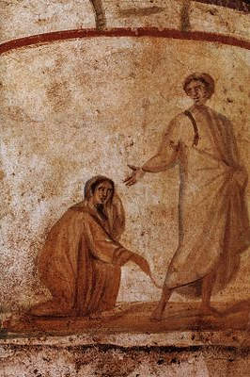
CLA 3513:
Early Christianity & the Fall of the Roman Empire
Prof. Jessica L. Wright
jessicalouise.wright@utsa.edu
MH 3.04.08 | TR 4–5:15pm
Fall 2020

Slide 2
Course Description
Where did Christianity come from? Who were the early Christians anyway? And why did the rise of Christianity coincide with the fall of Rome?
This course introduces students to early Christianity and the fall of the Roman Empire. Through examination of ancient texts, images, and objects, we will discuss themes such as martyrdom, politics, and heresy, as well as critical historical questions, such as why Christianity—among all ancient Mediterraneans—became so powerful. This course is an opportunity to learn about the roots of a major world religion, and to reflect on how its origins shape its role in present-day culture.

Slide 3
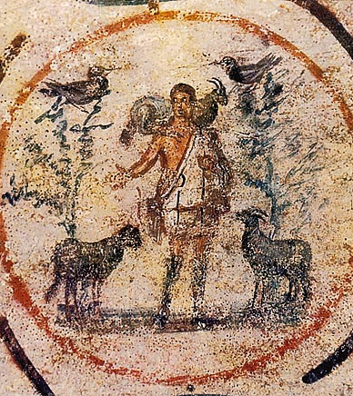
Key Questions
Where did Christianity come from? Who were the early Christians?
How different was Christianity from other ancient religions?
How did Christianity grow into a major world religion?
Why did the Roman Empire collapse?

Slide 4
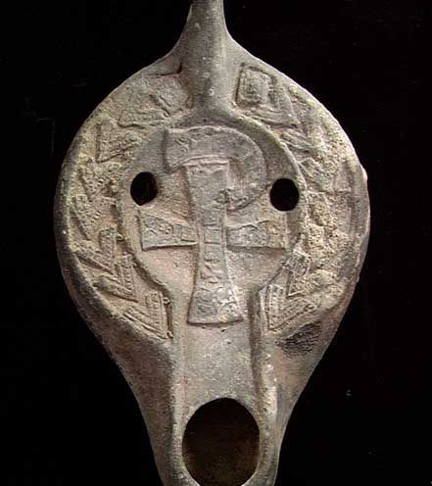
Students will …
read the earliest writings by Christian women;
study Christian art objects;
analyse The Life of Brian;
debate different explanations for the fall of the Roman empire;
explore gender, sexuality, and ethnicity in early Christianity.

Slide 5
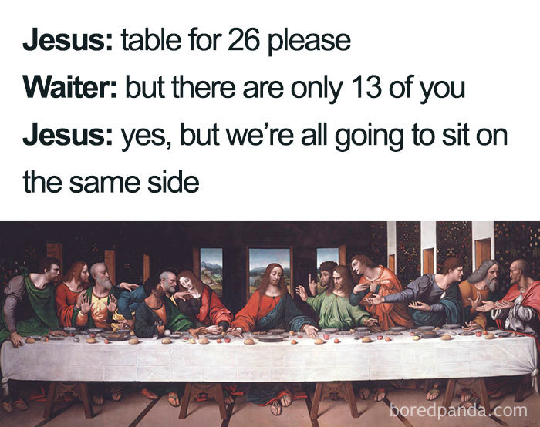
Course Perks
ALL texts will be provided without cost
Small, discussion-focused class
Opportunities to develop independent research projects
Optional creative project

Slide 6
For More Information …
Feel free to email the course instructor (Prof. Jessica Wright) at jessicalouise.wright@utsa.edu.

