Slide 1
Blackboard Integration with Taskstream LAT
Colleen Arrey, M.Ed.
Director, Campus Solutions
Taskstream

Slide 2
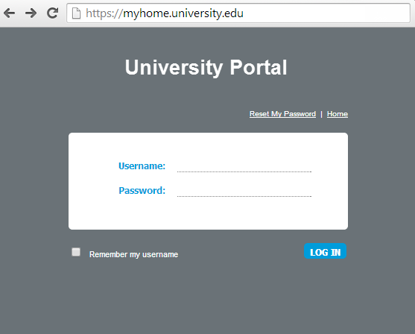
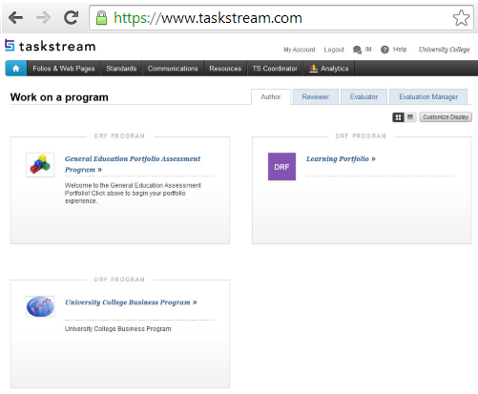
Enable Single Sign-On (SSO)
Access Taskstream from other systems without having to re-enter a username and password.
LTI  Shibboleth  SAML  CAS  Token-based Authentication

Slide 3
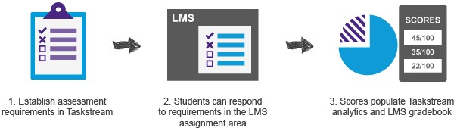
Integrate with Your LMS
Notes:
3

Slide 4
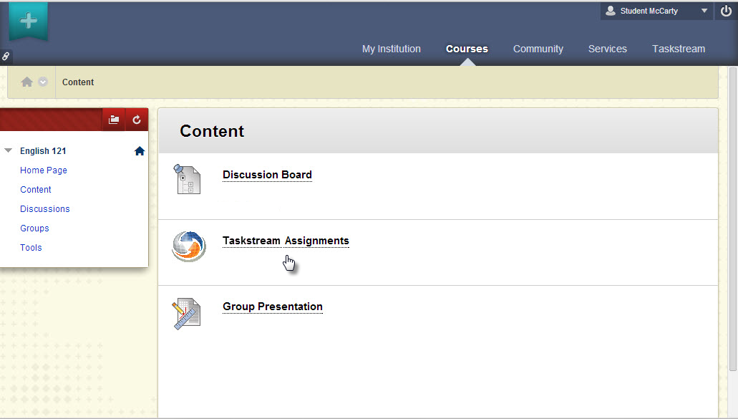
Embed Key Assignments

Slide 5
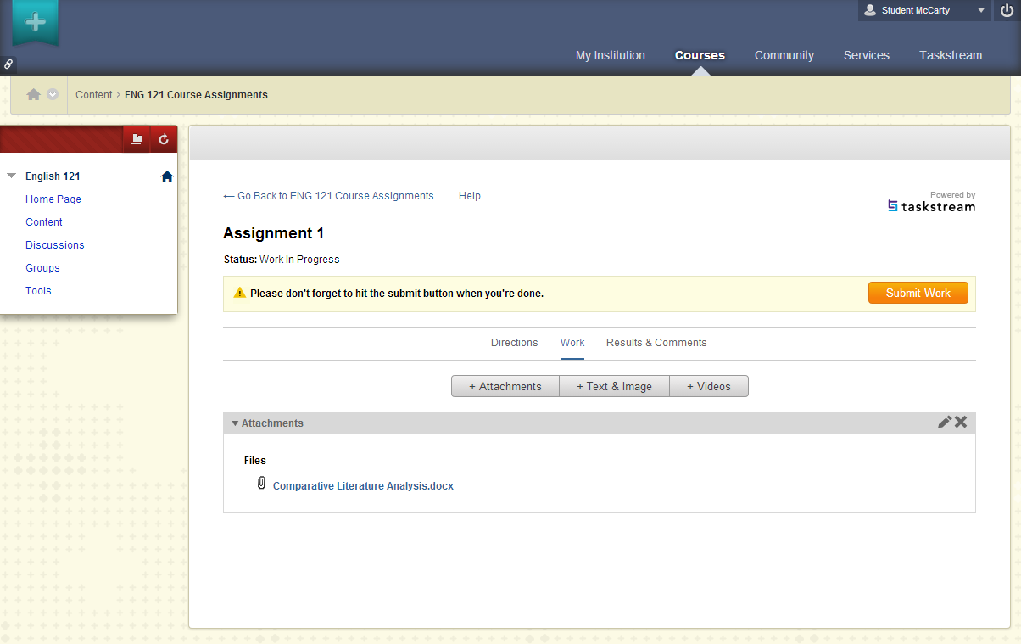
Students Upload Work

Slide 6
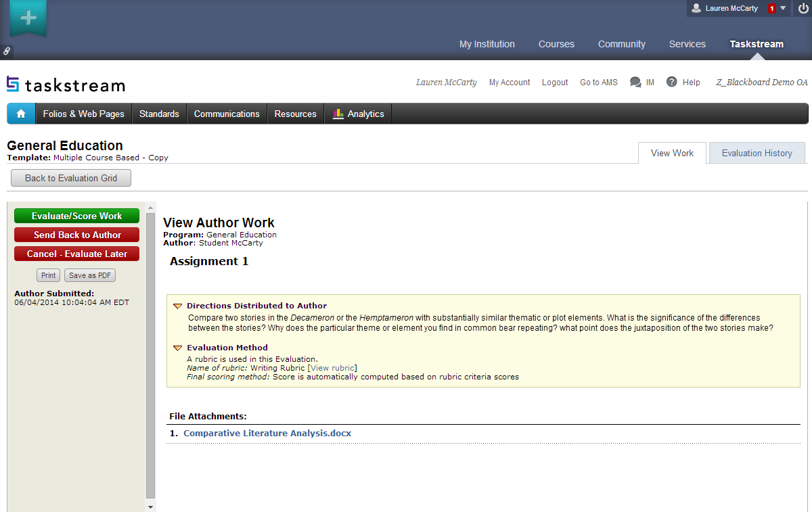
Instructor Scores Work

Slide 7
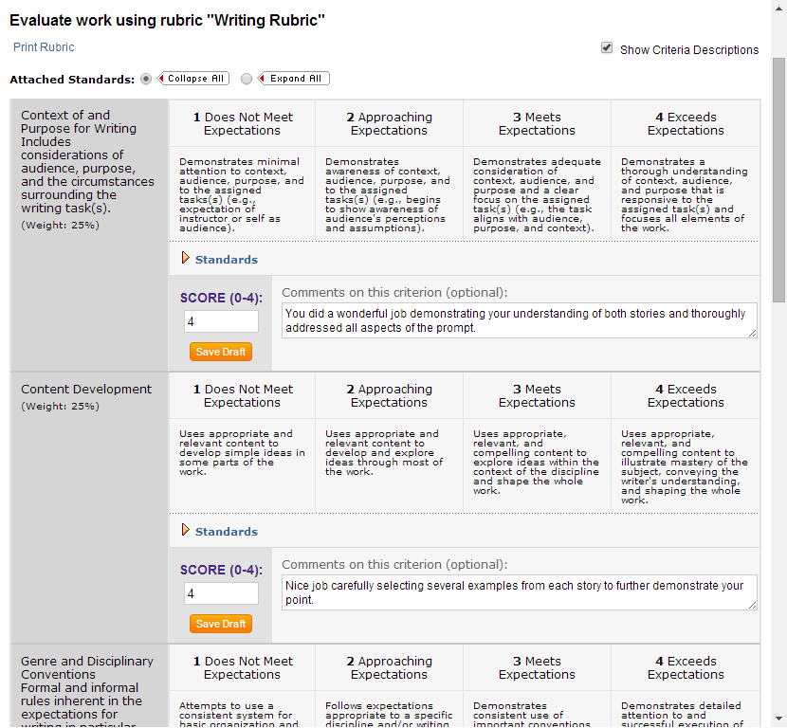
Instructor Scores Work

Slide 8
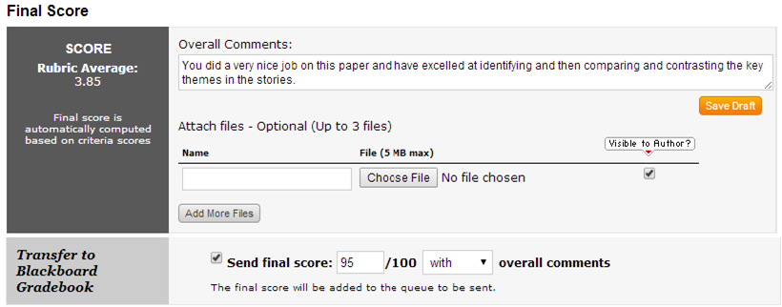
Instructor Sends Score to LMS Gradebook

Slide 9
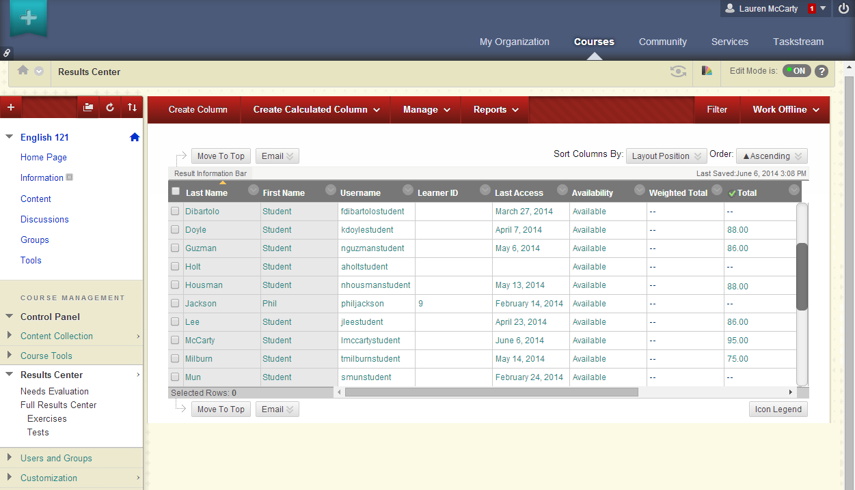
Scores Available in LMS and Taskstream

Slide 10
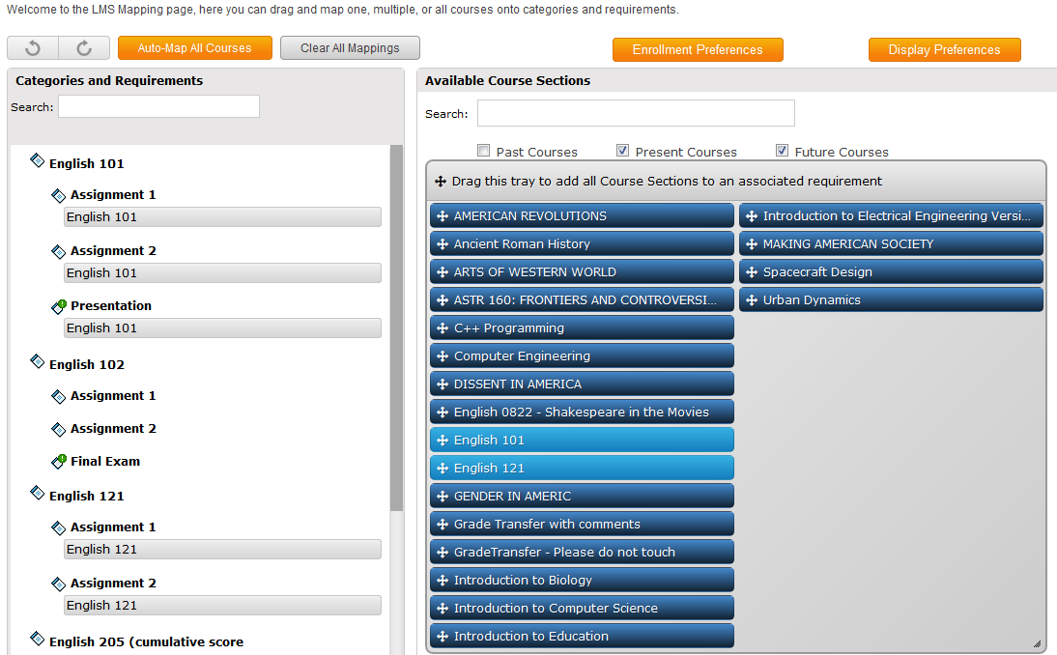
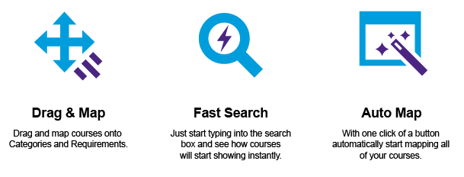
Auto Mapping Requirements & Courses
Notes:
Copy rubrics at a program level to multiple course sections. Goal is to avoid having to assign rubrics to each course manually.
IDEAS:
One template for course and distributed to multiple
DRF for course and mapping in BB (screenshot of fancy mapping)
LIVE SITE:
Log-in as mike :
you can log in as me: mchan/taskstream1
goto Z_blackboard oa.
There’s a General Education drf. you’ll see the LMS Mapping button under the DRF template tab of the drf program.
if going to System Admin, you can log in as taskstream1/taskstream1.

