Slide 1
COEHD Lunch & Learn Series
September Topic: Course & Research Buyout Policy
September 21, 2023

Slide 2
What is a Course Buyout?
A course buyout is when the faculty receives a course release and the grant “buys” a portion of their salary so that the equivalent amount of effort can be applied to working on the grant.
Grant-active tenured and tenure-track faculty are eligible to receive a percentage of recovered salary funds from course buyouts for use toward other research activities. To qualify, the following criteria must be met:
A buyout worksheet must be submitted by a faculty member prior to the start of the semester in which the course or research release will be taken. The buyout must be approved by the faculty member’s supervisor.
For course releases (1 course is equal to 10% of 9 months or 20% of 4.5 months). This should be budgeted in the grant.
If a course buyout is taken, you cannot elect a 12-month spread.

Slide 3
What is a Research Buyout?
A research buyout is without a course release and gives a faculty member the option to “buy” out a portion of their research time.
Faculty can buy up to 100% of their research time (depending on workload and funds) but are expected to teach courses as assigned in the workload agreement.
The same requirements apply including:
The buyout worksheet must be submitted by a faculty member prior to the start of the semester in which the course or research release will be taken.
The buyout must be approved by the faculty member’s supervisor.

Slide 4

What does the course/research buyout worksheet
look like and where can I find it?

Slide 5
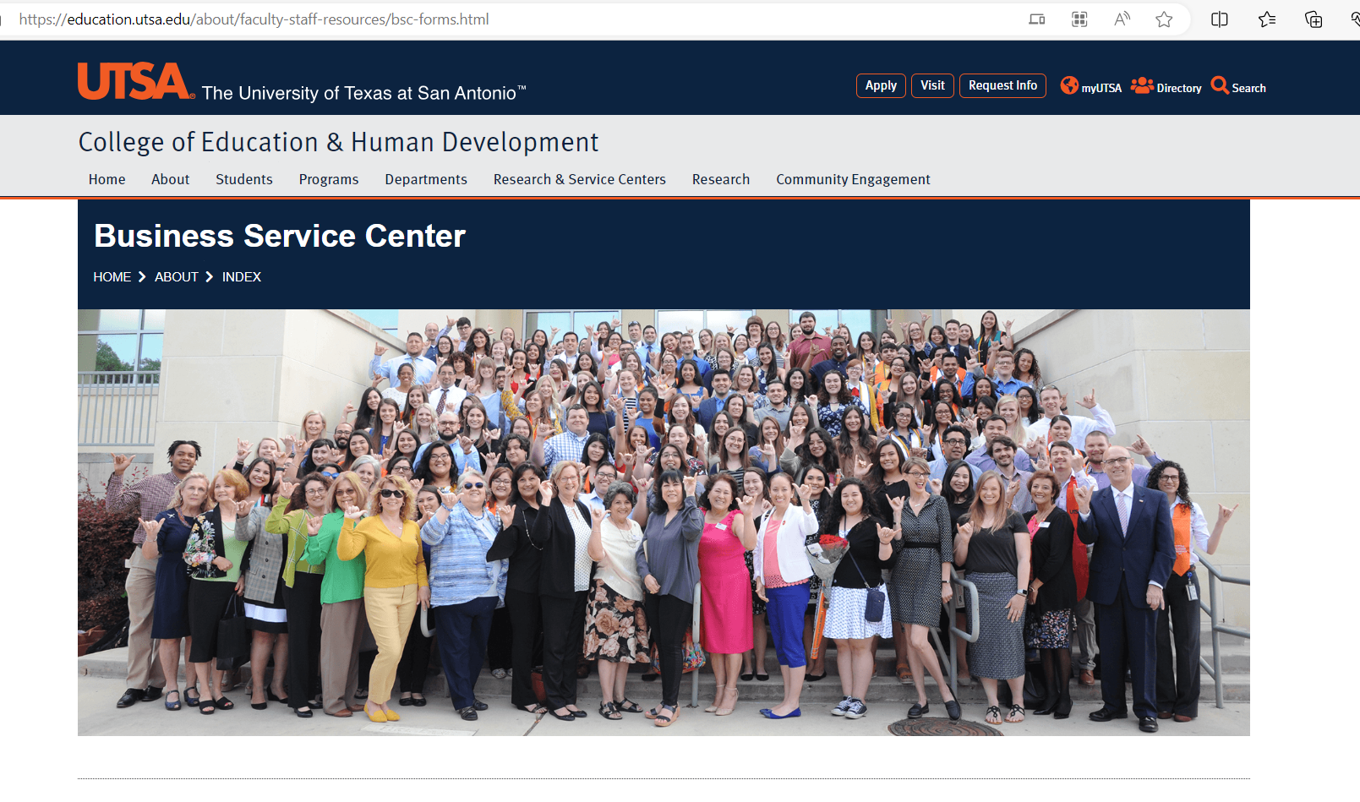
https://education.utsa.edu/about/faculty-staff-resouces/bsc-forms.html

Slide 6
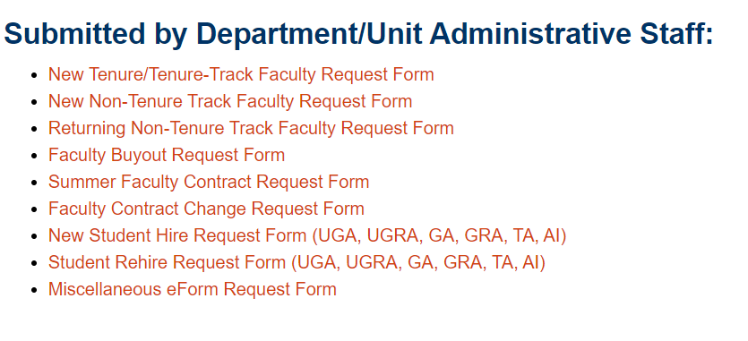

Slide 7
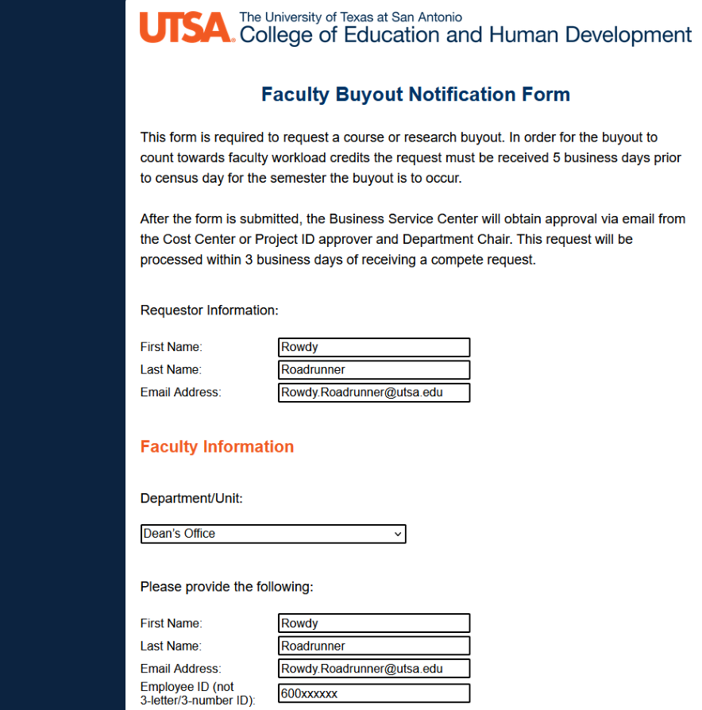
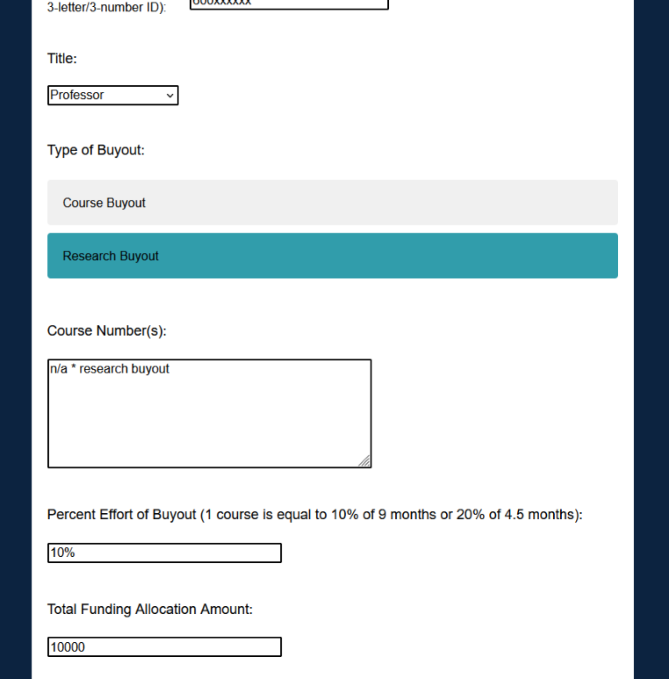

Slide 8
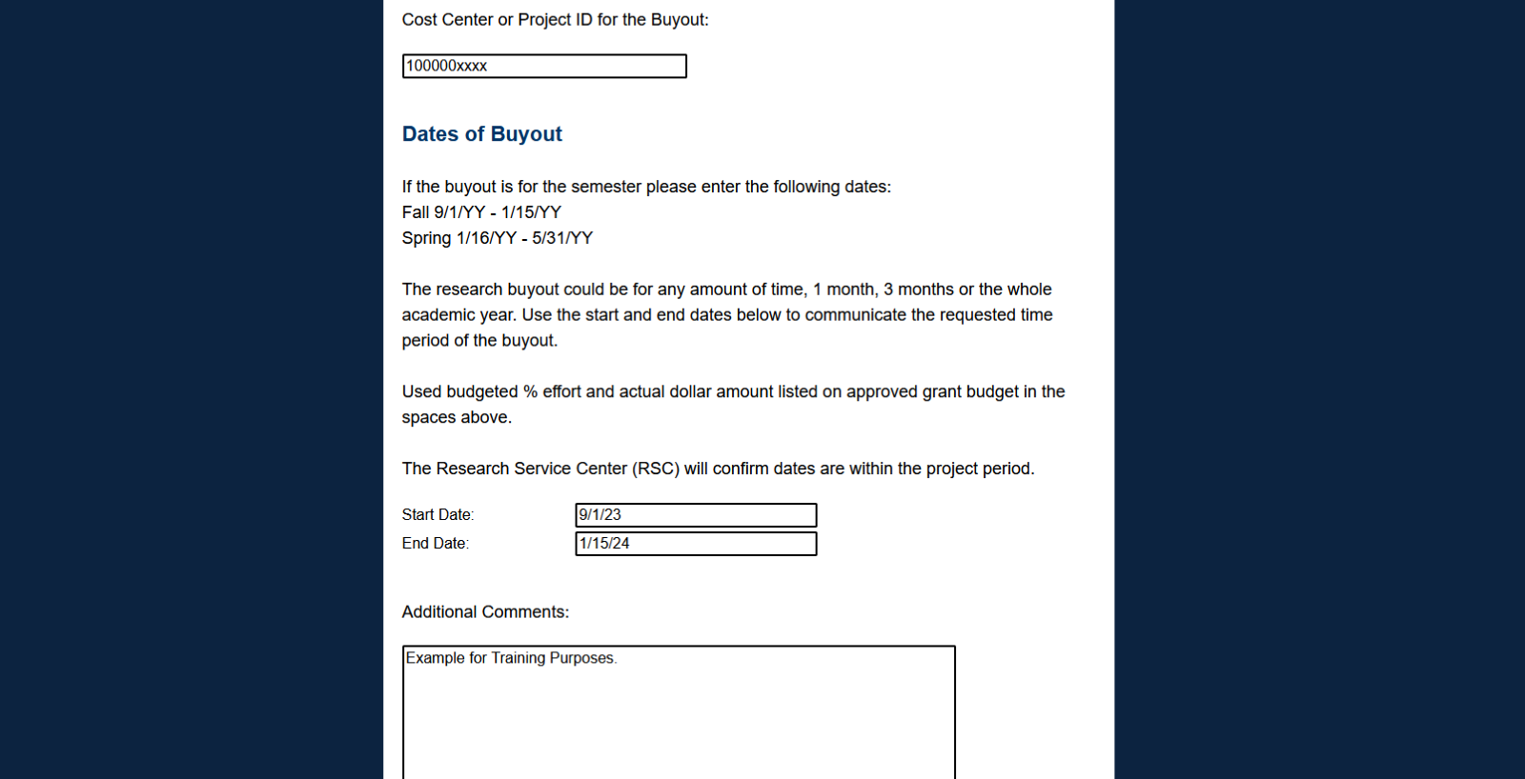

Slide 9
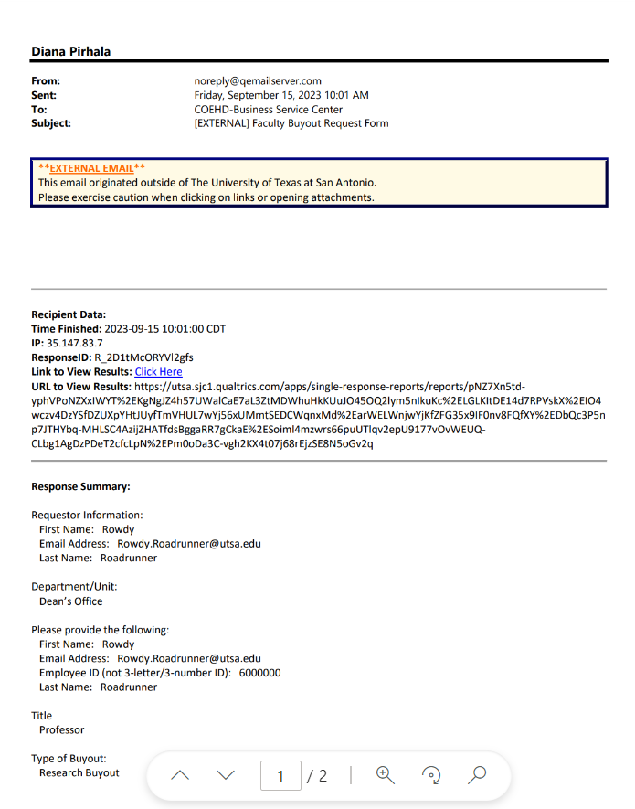
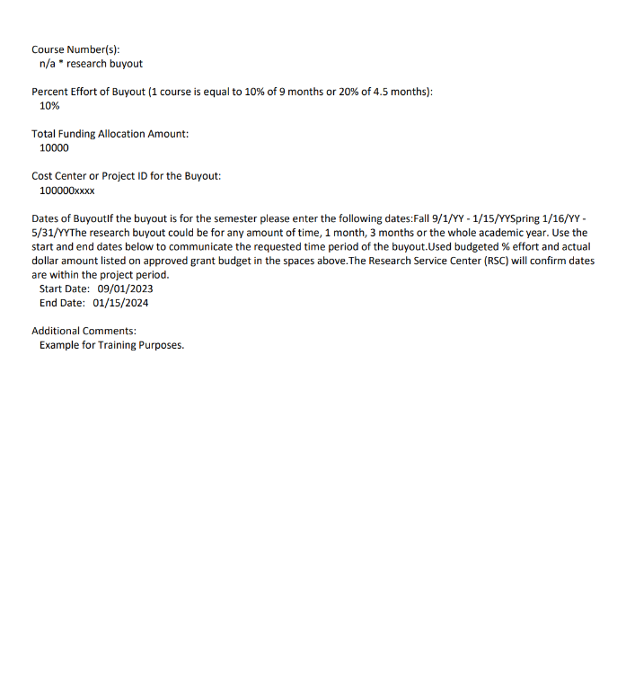

Slide 10
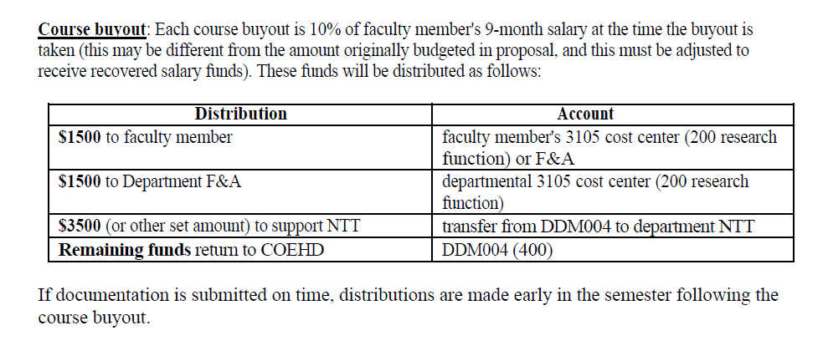
How is the Course buyout distributed among cost centers?

Slide 11
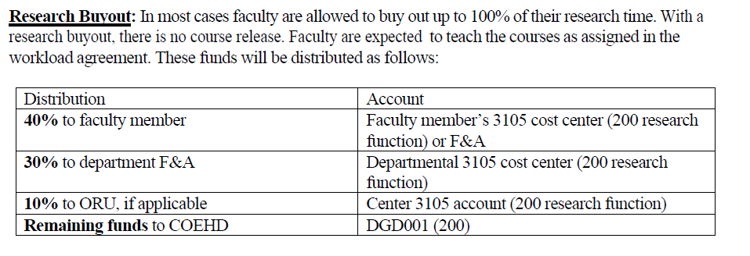
How is the Research buyout distributed among cost centers?

Slide 12
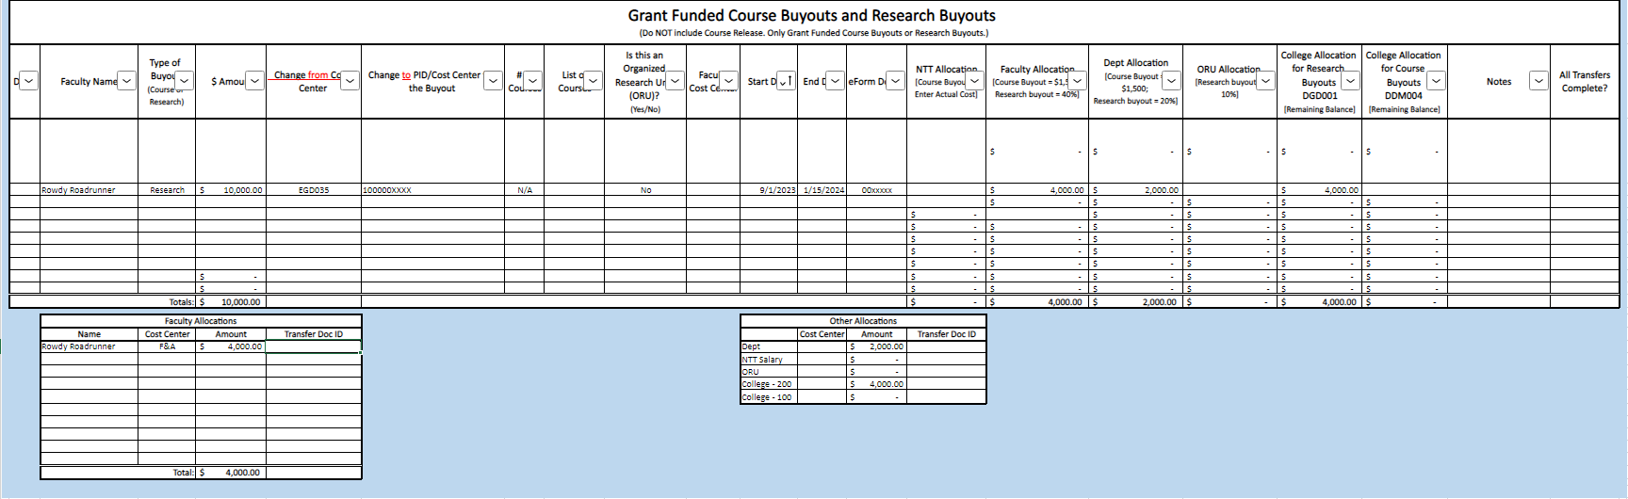

Slide 13
Roles & Responsibilities
Task | Responsible Person | Due Date
Request a Course or Research Buyout | Faculty Member | Prior to start of semester (in which course or research release will be taken), submit request to Department Administrative Officer
Complete Course or Research Worksheet | Department Administrative Services Officer | Working with Faculty member, complete worksheet. After completing, obtain approval from Cost Center or Project ID approver and Department Chair
Submit Course or Research Buyout Worksheet | Department Administrative Services Officer | Prior to start of semester (in which the course or research release will be taken) Fall | Due by August 1st Spring | Due by January 5th
Process Course or Research Buyout request | BSC | After receiving a completed course / research buyout request, BSC will review for accuracy, request revisions (if any) and will process request

Slide 14
Questions?

Slide 15
Next Month's Topic:
Summer Planning

