Slide 1
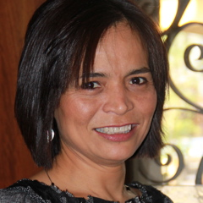
FACULTY SUCCESS
Dr. María Guadalupe Arreguín-Anderson
American Educational Research Association (AERA). Recipient of 2014 Bilingual Education Research SIG Early Career Award.
President Elect of the Texas Association for Bilingual Education.
Research Focus:
Science education in dual language settings
Dyad learning and dialogue
Language and social justice
Science learning in informal environments
Dr. María G. Arreguín-Anderson
Assistant Professor of Early Childhood and Elementary Education.
Department of Interdisciplinary Learning and Teaching

Slide 2
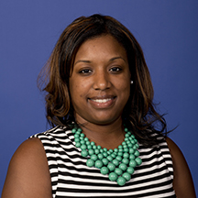
FACULTY SUCCESS
Dr. Janeé R. Avent is currently researching:
The role of religion and spirituality in African American undergraduate students’ mental health help-seeking behaviors and perceptions of counseling (Funded by COEHD Faculty Research Award and Office of the Vice President of Research INTRA Award)
Research Focus:
Multicultural issues in counseling
Adaptive and maladaptive religious coping
The role of the Black Church in African American mental health help-seeking behaviors
Dr. Janeé R. Avent
Assistant Professor
Counseling
Notes:
Dr. Janeé R. Avent is currently researching the role of religion and spirituality in African American undergraduate students’ mental health help-seeking behaviors and perceptions of counseling. This project is funded by the COEHD Faculty Research Award and Office of the Vice President of Research INTRA Award.

Slide 3
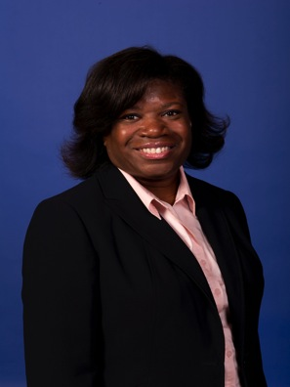
FACULTY SUCCESS
Dr. Theodorea Regina Berry is currently researching:
The lived experiences of African American women as education doctoral students/recipients
The historical relationships between race, violence, and schooling in the South
Research Focus:
Critical examination of race, ethnicity, and gender for teaching and teacher education
Explorations in Race and Curriculum Theory
Qualitative Research Methodology and Intersectionality of Identity
Dr. Theodorea Regina Berry
Associate Professor
Interdisciplinary Learning and
Teaching
Notes:
Dr. Theodorea Regina Berry is currently researching the lived experiences of African American women who are pursuing or have pursued doctoral degrees in the field of education. Additionally, she is exploring via historical and archival research the relationships between race, violence, and schooling in the American South.

Slide 4
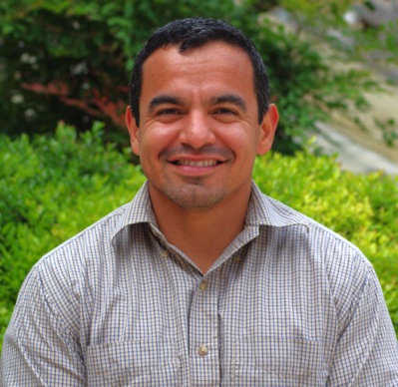
FACULTY SUCCESS
Dr. Alberto Cordova is currently researching:
Ecological Buffer in Video Game Stressors
Motor Imagery and Planning among Aging Populations to Aid in Movement Execution
Quantifying Physical Activity Levels of Children with Autism
How Locus of Control and BMI Affect Mental Health
Mental Transformation
Feedback Reliance for Planning
Research Focus:
Developmental Motor Cognition/Action Planning/Cognitive Development
Environmental Influences of Development
Dr. Alberto Cordova
Assistant Professor;
Kinesiology, Health and Nutrition Department

Slide 5
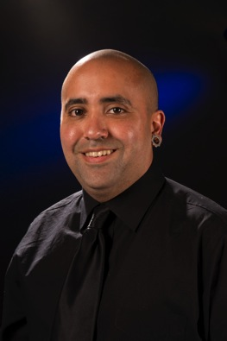
FACULTY SUCCESS
Dr. Abraham DeLeon is currently researching:
The rise of machines and the consequences of technological innovation. The title of the book is Machines and will be published by Information Age Publishing tentatively in the Fall of 2014.
Strategies for social studies teachers to address key problems raised by not only technology, but also the larger ideologies that guide these types of paradigms.
Research Focus:
Critical Pedagogy & Social Theory
Archival Research
Developing a critical approach to the possibilities found within social studies education and the Foundations of education
Dr. Abraham P. DeLeon
Associate Professor
Educational Leadership & Policy Studies
Notes:
Dr. Misty Sailors is currently researching the improvement of the reading instruction of teachers and the reading achievement of young children in Malawi as a result of the Read Malawi program. Additionally, she is exploring the cost effectiveness and short- and long-term cost benefit of the program.

Slide 6
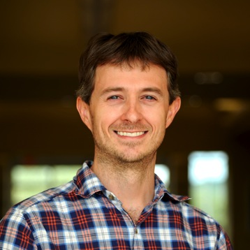
FACULTY SUCCESS
Dr. Dennis Davis is currently researching:
Variations in reading comprehension instructional practices and how they relate to student outcomes (with funding from the National Academy of Education)
Teachers’ specialized knowledge of reading comprehension (with funding from the Spencer Foundation)
Research Focus:
Reading comprehension
Upper-elementary and middle grades literacy instruction
Classroom assessment practices
Dennis Davis, PhD
Assistant Professor;
Interdisciplinary Learning and
Teaching Department

Slide 7
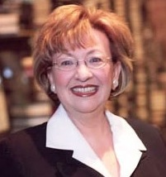
FACULTY SUCCESS
Dr. Rosalind Horowitz is currently researching:
National Academy of Education, Fellow
American Education Research Association, Chair, Research in Reading and Literacy
Research Advisory Board to the President, Member, UTSA
Research Focus:
The Achievement Gap in Literacy—advancing high levels of literacy for the 21st century
Border Literacy—U.S. Mexico Borders and International Borders
Discourse and Literacy in Cognitive Development
Research and Academic Reward Structures in Higher Education
Dr. Rosalind Horowitz
Professor; Interdisciplinary Learning and
Teaching Department
Distinguished Alumni, University of Minnesota—Twin Cities Campus (among 100 alumni selected from 1905-2015)
Notes:
Dr. Misty Sailors is currently researching the improvement of the reading instruction of teachers and the reading achievement of young children in Malawi as a result of the Read Malawi program. Additionally, she is exploring the cost effectiveness and short- and long-term cost benefit of the program.

Slide 8
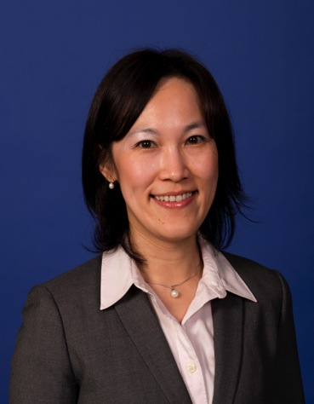
FACULTY SUCCESS
Dr. Becky Huang is currently researching:
Language and literacy outcomes of English as a second language (ESL) students in an immersion context
Language, cognitive, and social-cultural outcomes of English as a foreign language (EFL) students in a formal instruction context
The impact of familiarity with accents on listeners’ judgments of non-native speech
Research Focus:
Second language acquisition
Language assessment
English language learners
Dr. Becky H. Huang
Assistant Professor
Department of Bicultural-Bilingual Studies

Slide 9
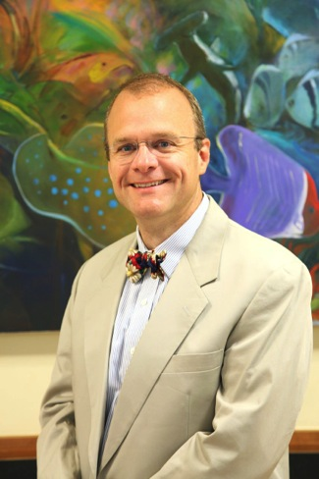
FACULTY SUCCESS
Dr. Michael J. Karcher
Handbook of Youth Mentoring (co-editor)
Collaborates internationally (with Big Brothers Big Sisters of America and Canada to improve mentor training and the use of activities by mentors) and locally (with San Antonio Mayor’s Office and the UTSA-based Mentoring Forum)
Research Focus:
Currently conducting two federally funded studies of the use of activities mentoring
His cross-age peer mentoring program (e.g., the “Velocity” program at Harlandale High)
Measuring school connectedness and the effects of school-based mentoring programs
Dr. Michael J. Karcher
Professor
Department of Educational Psychology
Notes:
Dr. Ravi Sandhu’s is founding Executive Director of the Institute for Cyber Security at UTSA. He pursues a diverse portfolio of basic and applied research in collaboration with multiple UTSA researchers, and numerous external academic and industry partners.

Slide 10
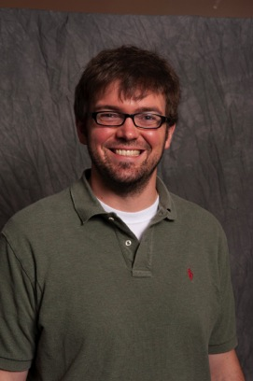
FACULTY SUCCESS
Dr. Lee Mason is currently researching:
The transformation of stimulus function across converging relations
Strengthening the divergent control of verbal stimuli through transitive relations
Research Focus:
Referent-based verbal behavior instruction
Conditioning reinforcers through game-based learning
The discriminative control of exteroceptive stimuli
Behavioral phenomenology and explanatory fictions
Dr. Lee Mason
Assistant Professor of Special Education;
Director of the Teacher Education: Autism Model (TEAM) Center
Interdisciplinary Learning and
Teaching Department
Notes:
Dr. Misty Sailors is currently researching the improvement of the reading instruction of teachers and the reading achievement of young children in Malawi as a result of the Read Malawi program. Additionally, she is exploring the cost effectiveness and short- and long-term cost benefit of the program.

Slide 11
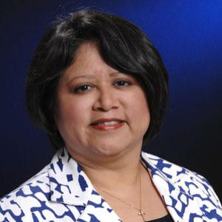
FACULTY SUCCESS
Dr. Maricela Oliva is conducting research on:
Support for college that students receive in high school from school personnel (ongoing).
Qualitative research in Mexico. A special issue of the International Journal of Qualitative Studies in Education (IJQSE) has been accepted and will be published in fall 2014.
Research Focus:
College Access for underrepresented students
Educational Policy
School to University Transitions
Multicultural/Cross-cultural Competence
Dr. Maricela Oliva
Associate Professor
Educational Leadership & Policy Studies
Notes:
Dr. Maricela Oliva is currently researching the adult guidance for college that students receive while in high school. This includes how school leaders think about, articulate, and staff for postsecondary access and success. Whether and how personnel attend to college readiness and access has implications for achieving the state’s goals in Closing the Gaps by 2015 . Serving as guest editor for IJQSE brings new research to US readers and thus extends scholarly understanding of educational issues in Mexico. This enhances the multicultural and cross-cultural competence of US educators.

Slide 12
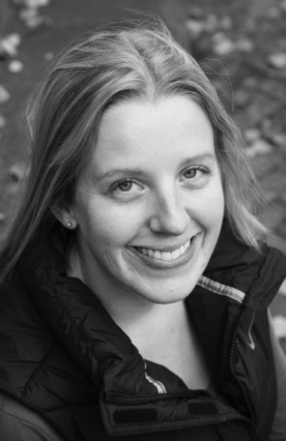
FACULTY SUCCESS
Dr. Billie Jo Rodriguez is currently researching:
Strategies to improve school-based behavior assessment and intervention development techniques
Strategies to improve positive behavior support services provided to students with challenging behavior and disabilities in schools
Research Focus:
Multi-Tiered prevention systems to improve school climate and academic outcomes
Integrating academic and social behavior interventions in schools
Functional behavior assessment and intervention
Dr. Billie Jo Rodriguez
Assistant Professor;
Educational Psychology

Slide 13
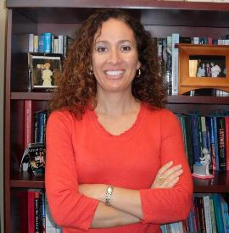
FACULTY SUCCESS
Dr. Patricia Sánchez is currently researching:
The migratory experiences of Mexican youth in the US, Canada, as well as their return to Mexico as NAFTA approaches its 20-year anniversary
Bilingual teachers’ access to and use of technology in their public school classrooms
Research Focus:
Immigrant education (students’ and families’ adaptation to the US)
The processes of globalization and transnationalism on Latina/o immigrants
Models of successful bilingual teacher preparation
Dr. Patricia Sánchez
Associate Professor;
Bicultural-Bilingual Studies
Notes:
Dr. Patricia Sánchez is currently researching the migratory experiences of Mexican youth in the US, Canada, as well as their return to Mexico as NAFTA approaches its 20-year anniversary; she is part of a trinational research team supported through a grant from Mexico. She is also working on a study that examines bilingual teachers’ access to and use of technology in their public school classrooms.

Slide 14
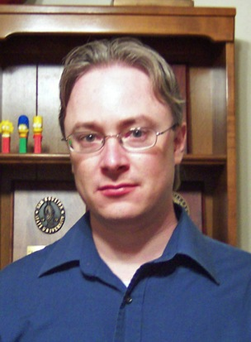
FACULTY SUCCESS
Dr. Jeremy Sullivan is currently researching:
Academic and psychosocial impact of exposure to neurotoxins among children and adolescents
Best practices in the supervision of practicum students and interns in the field of School Psychology
Research Focus:
Psychological assessment and psychometrics
Training, supervision, and professional issues in School Psychology
Ethical decision-making
Dr. Jeremy Sullivan
Associate Professor;
Department of Educational Psychology

