Slide 1

COEHD Town Hall
9/20/2017
Sponsored Projects Administration
Basic Process Flow
F&A
Operational and Financial Visibility
Can (John) Saygin
AVP-Research, Sponsored Project Administration

Slide 2
Office of Sponsored Project Administration
Revised 9/1/2017
Associate VP for Sponsored Project Administration
Can Saygin
Sr. Admin. Associate
Sylvia Rayko
Research Service Centers (RSC)
Contracts &Industry Agreements (CIA)
Grants & Contracts Financial Services
Information Systems and Technology (IST)
RSC-Education
RSC-Downtown
RSC-Ins for Econ Dev
Director
Juliet Ray
Director
Theresa Bailey
Director
Vacant
Director
Stacy Williams
Director
VACANT
Director
Jessica Fernandez
Sr Res Award Crd.
Jesse Hernandez
Sr Res Award Crd.
Angelika Rocha
Sr Res Award Crd.
Ramiro Cantu
Asst Director
Angie Lopez
Software System Specialist III
Yu Ning
Contract Negotiator
VACANT
RAA Post-Award I
Justin Marmolejo
RAA Post-Award II
Jennifer Latta
RAA Post-Award III
Alicia Bernal
Grant Accountant II
Nora Taylor
IT Assoc II/Help Desk
Victor Smith
Contract Negotiator
VACANT
RSC-Sciences
RSC-Arts, Business, Honors
Grant Accountant II
VACANT
Data Analyst
VACANT
RSC-Engineering
Director
Amy Ossola-Philips
Director
Mimi Garza
Grant Accountant II
Elizabeth Pettit
Director
Jennifer Silver
Sr Res Award Crd.
Miriam Colunga
Sr Res Award Crd.
Nanette McKinney
Sr Res Award Crd.
VACANT
Grant Accountant II
Lucy San Ramon
RAA Pre-Award III
Ernesto Tusa
RAA Pre-Award II
Nancy Markum
RAA Post-Award III
Margot Oviedo
Sr. G&C Specialist
Cindy Goins
RAA Pre-Award I
Melanie Register
RAA Post-Award II
Mary Reidel
RAA Pre-Award II
Kerri Glaspie
Grant Accountant II
Irma Arney
RAA Pre-Award I
Cedric Williams
Grant Accountant II
Monica Fuentes
Grant Accountant II
Carmen Montalvo

Slide 3






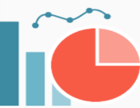


Basic Process Flow
OSPA
Department
College
Centers & Institutes
FACULTY
Verify Expenditures
Research Service Center
(RSC)
TEAM
Appointments
F&A Return
Processing Outside PeopleSoft
ADMIN
Fiscal
Capacity & Capability
Burn Rate Report
Monthly Account Reconciliation
1
Proposal
Award
Expenditure
Faculty/Personnel Contracts (Appointments)
Summer & Academic Year
Grant
Contract
Visibility
Proposal
Dashboard
F&A Return
Expenditure Data
Expenditures
PI/Co-PI Info
Shared Credit %
Dept
College
Center/Institute
4
6
Affiliation
Proposal Data
Award Data
PeopleSoft
8
9
2
Electronic Routing Form
Proposal
Award
Project
5
7
Account Set Up
Expenditures
Invoicing
Technical Reports
Financial Reports
Close Outs
Grants and Contracts Financial Services (GCFS) TEAM
Award
3
OSPA
CAYUSE
4
Invoices & Reports
& Misc Requests
10
FUNDING
SOURCE
(Agency)
Quality Assurance and Risk Management Queries
OSPA

Slide 4

“Account” in PeopleSoft
All (externally) sponsored grants and contracts are set up as “Projects” → Project ID
Internal accounts and cost sharing for sponsored projects are set up as Cost Centers
Source of Fund
Main Function
Allowable Budget Categories:
Expense Accounts

Slide 5
“Account” in PeopleSoft
Source of Fund
Main Function
EXTERNAL
5100 - Federal
5200 - State
5300 - Local
5400 - Private & Industry
5500 - Development & Gifts
5600 - Development & Gifts for Endowments
INTERNAL
2100 - General Funds
2110 - Research Development
2115 - Special Items (ex.SALSI)
2120 - State Pass Through
3100 - Organized Educational Activities
3105 - Designated Tuition
3200 - Net Service Funds
100 - Instruction
200 - Research
300 - Public Service
400 - Academic Support
997 - Scholarships and Fellowships
700 - Institutional Support
Allowable Budget Categories:
Expense Accounts
50101 Salary & Wages Faculty
53201 Salary & Wages Student
62104 Travel
64601 Scholarship
74010 F&A Cost
(There are 282 of these in Psoft)

Slide 6
“Shared Credit”
SHOW Shared Credit Memo
What it affects:
Proposal Credit
Award Credit
Expenditure Credit
F&A return distribution
Fixed Price Contract balance distribution after close out
Items 1,2,3 are provided to colleges & departments for annual evals and P&T

Slide 7
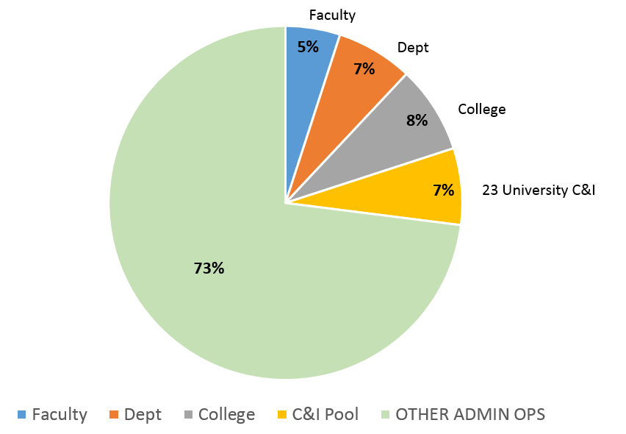
F&A Return Distribution

Slide 8
Operational Awareness through Metrics across Life Cycle of Proposals, Awards, Expenditures
Proposal
Award
Expenditure
Research Dashboard
Expenditures Dashboard
Burn Rate Dashboard
Five Basic Principles
Limit Sharing of Data; Share Information: Subsets of Data/Information/Metrics are shared with people based on their roles and responsibilities.
Content and Frequency of Sharing: Give people enough time to review and provide feedback. Facilitate accountability.
Design Effective Dashboards: Institutional View; Trends and Directions; Deep Dive into Data
Timeliness of Data/information/Metrics: Enable timely, data-driven decision making.
Always use data/metrics/information as a means to educate people and create “data assets” awareness.

Slide 9
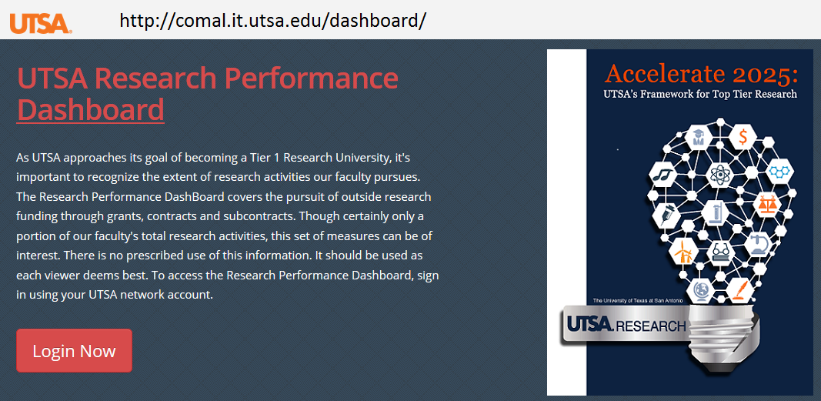
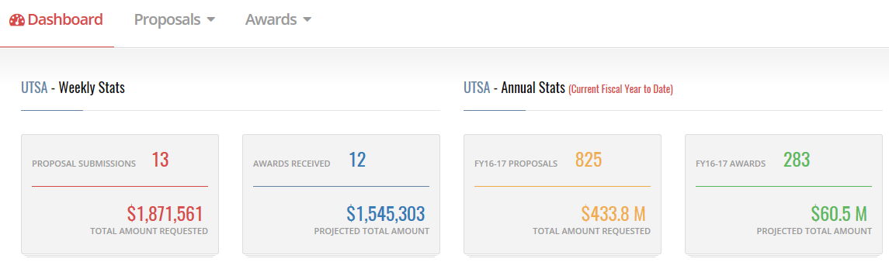
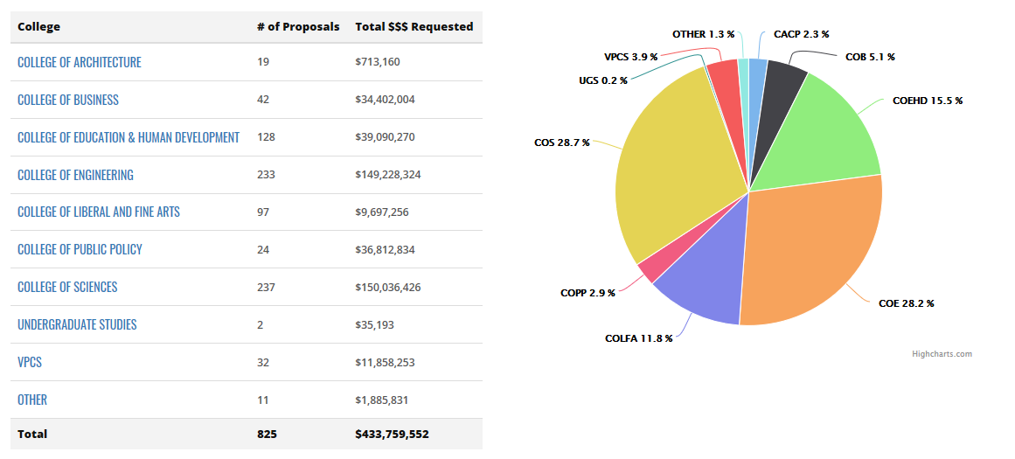
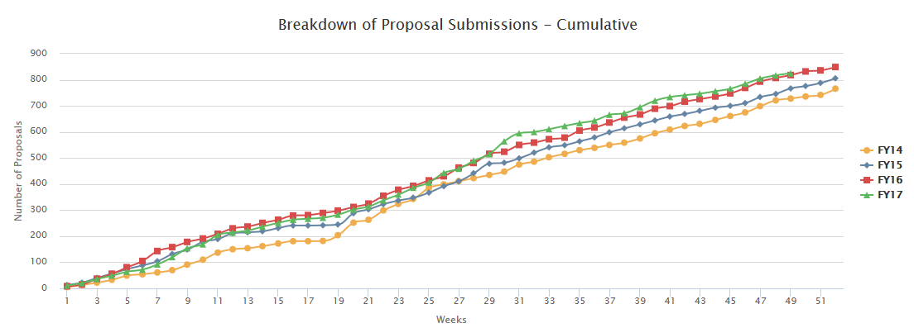
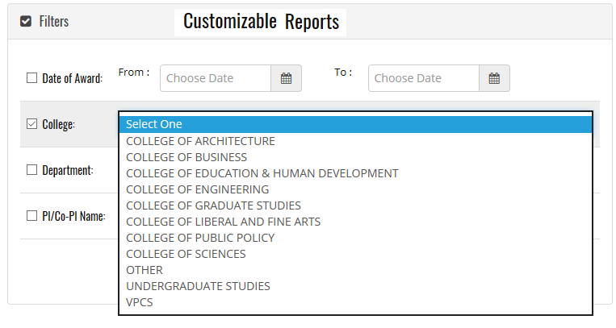
Research Dashboard: Proposals & Awards
Institutional View
Trends and Directions
Deep Dive into Data

Slide 10
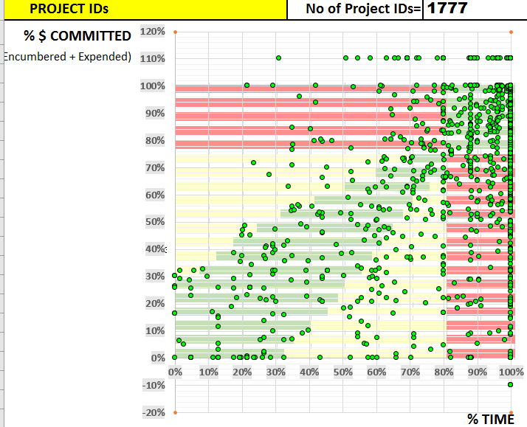
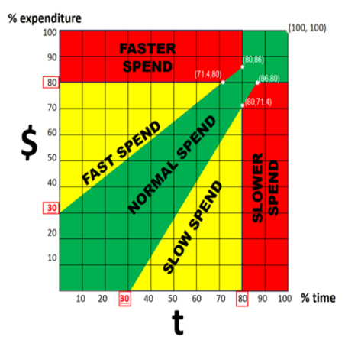
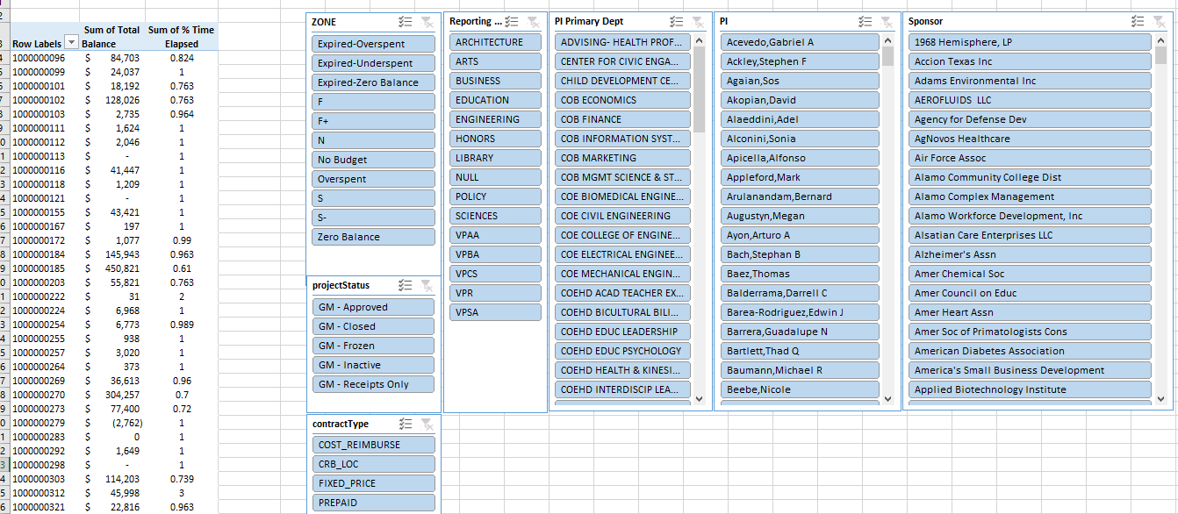
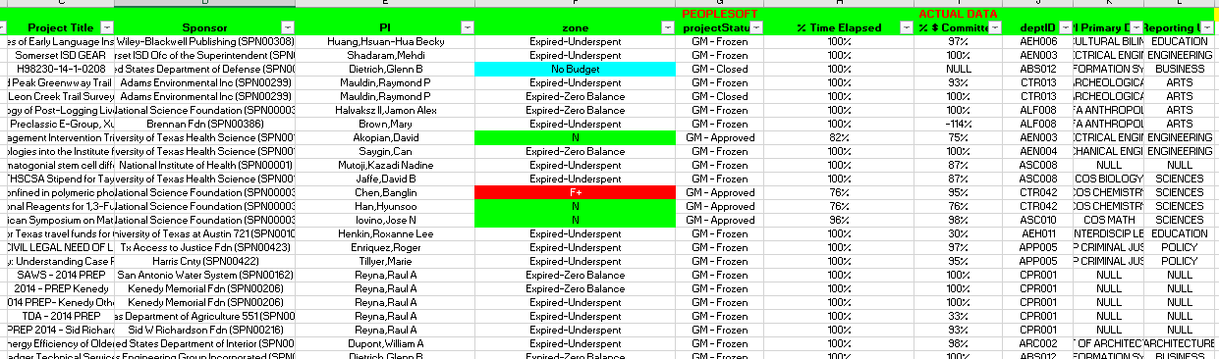
Burn Rate Dashboard
Institutional View
Trends and Directions
Deep Dive into Data

Slide 11
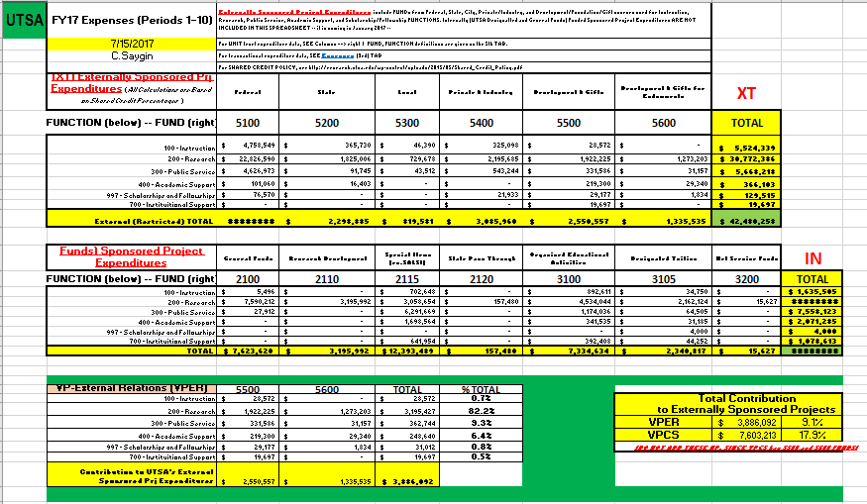
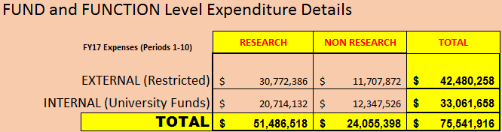
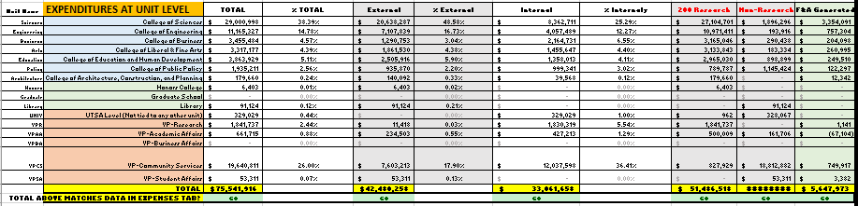
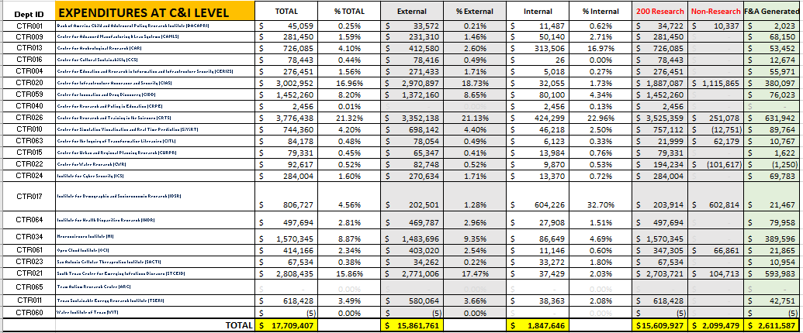
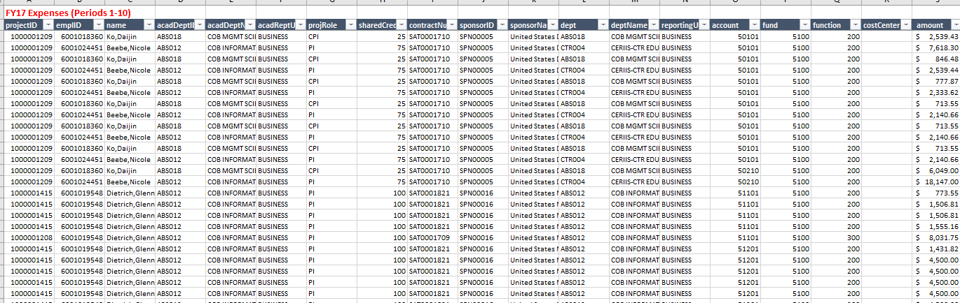
Expenditures Dashboard
Institutional View
Trends and Directions
Deep Dive into Data

