Slide 1


The University of Texas at San Antonio
Student Affairs

Slide 2
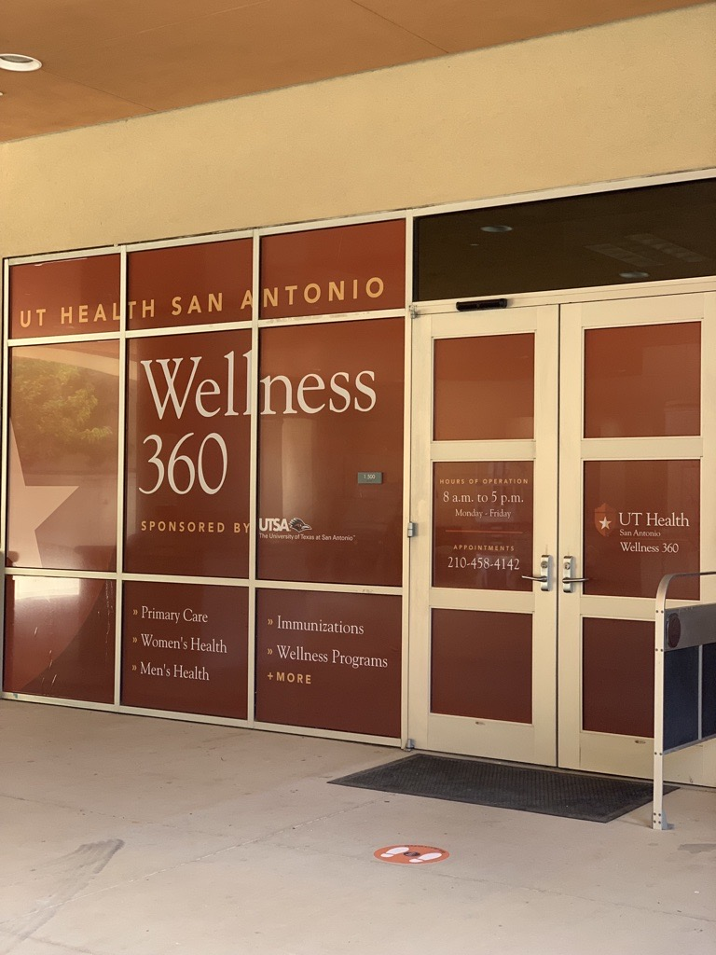
Wellness 360
Clinic & Counseling Hours:
Monday – Friday
  8am – 5pm
Location
  RWC 1.500
Notes:
Student Health Services:
Nationally Accredited Ambulatory Care Clinic staffed with medical doctors, physician assistants, registered nurses, licensed vocational nurses, and administrative staff to provide quality medical care to currently enrolled UTSA students.
Location:
Main Campus- Recreation Wellness Center
Downtown Campus- Buena Vista Building
Medical Emergency – 911 or 4911 (UTSA PD)
After Hours- visit our website for list and locations of Urgent Care/ER/Hospitals
What to do after-hours:
Medical Emergencies:
Call 911
Non-emergencies:
Visit website for urgent care in area

Slide 3
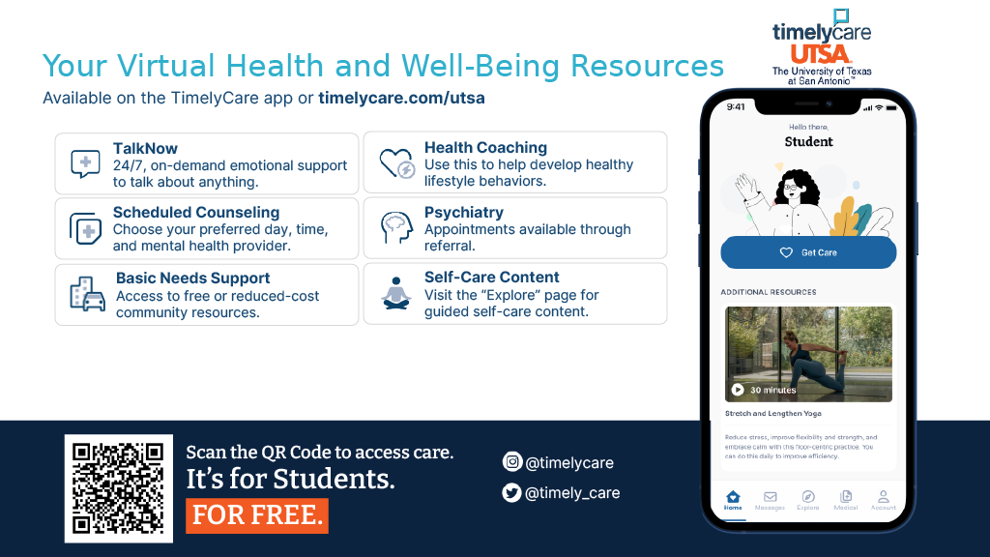

Slide 4


