Slide 1

My Projects
PI Portal

Slide 2
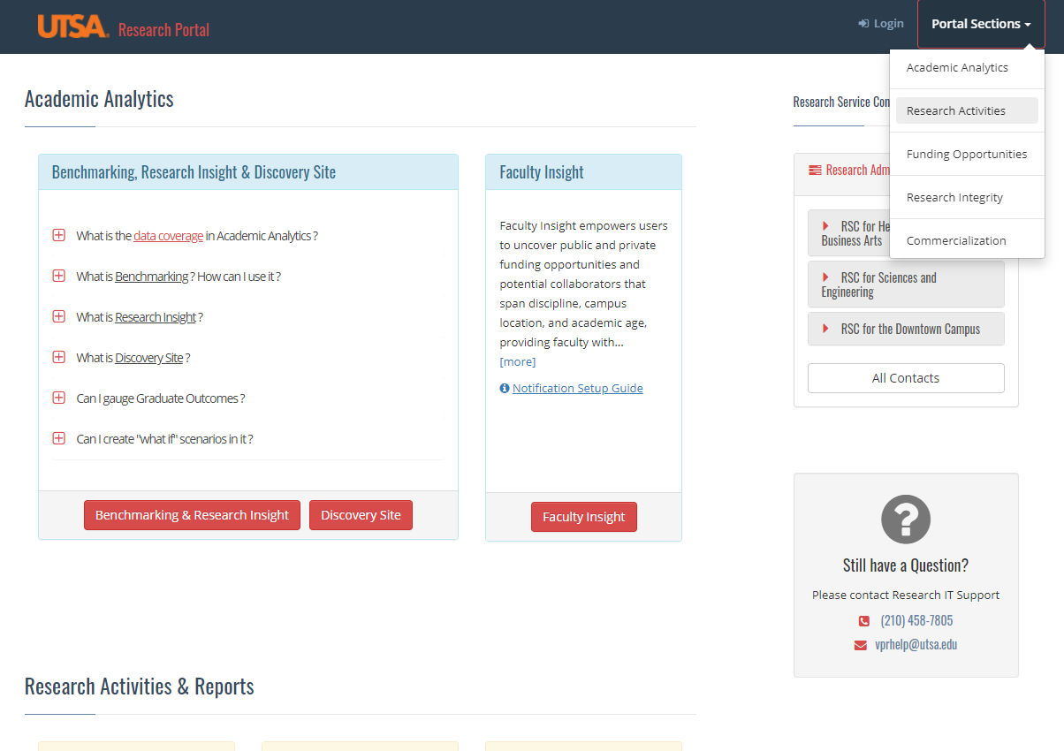
Step 2:
Visit the UTSA Research Portal at:
http://research.utsa.edu/portal
Select Research Activities
Step 1:

Slide 3
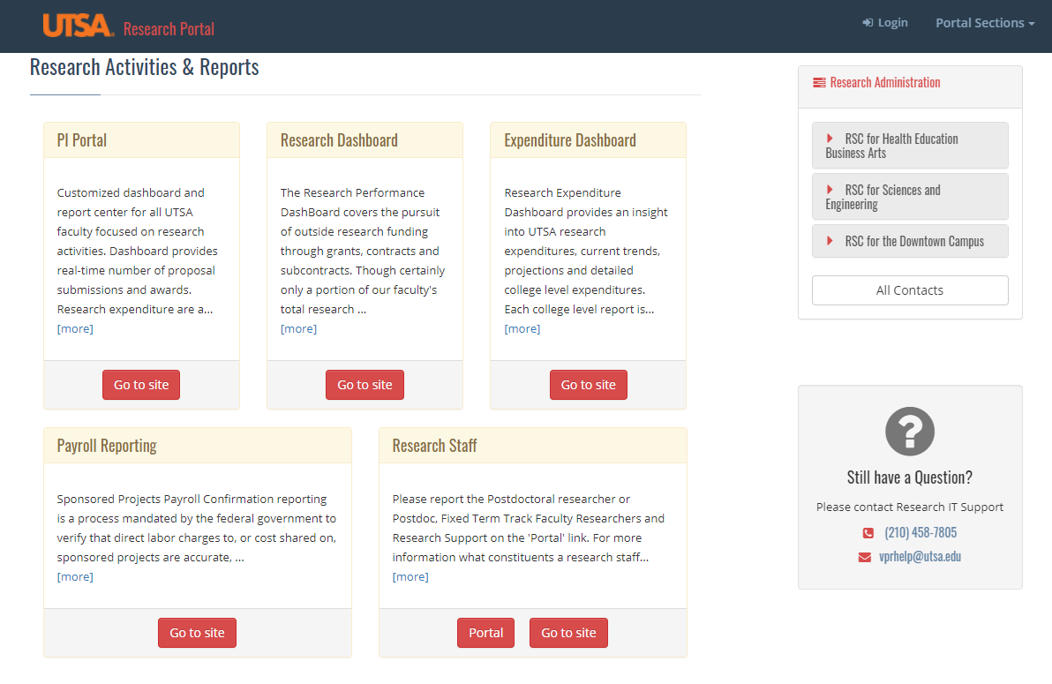
Step 1:
Click on PI Portal link
Step 3:

Slide 4
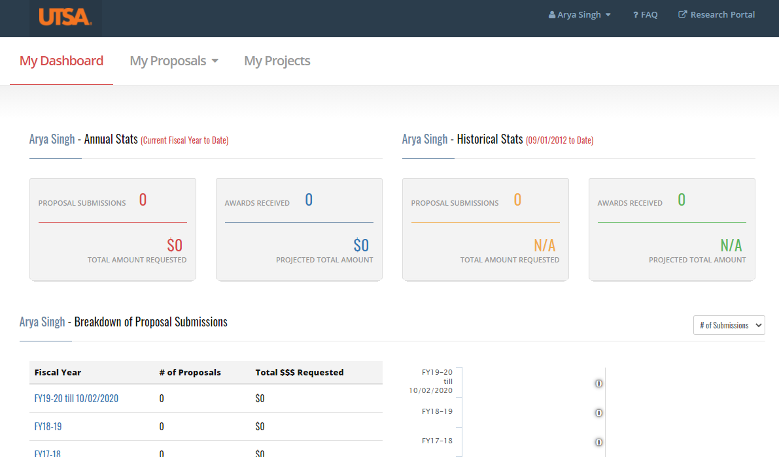
Step 1:
Step 4:
Click on
‘My Projects’

Slide 5
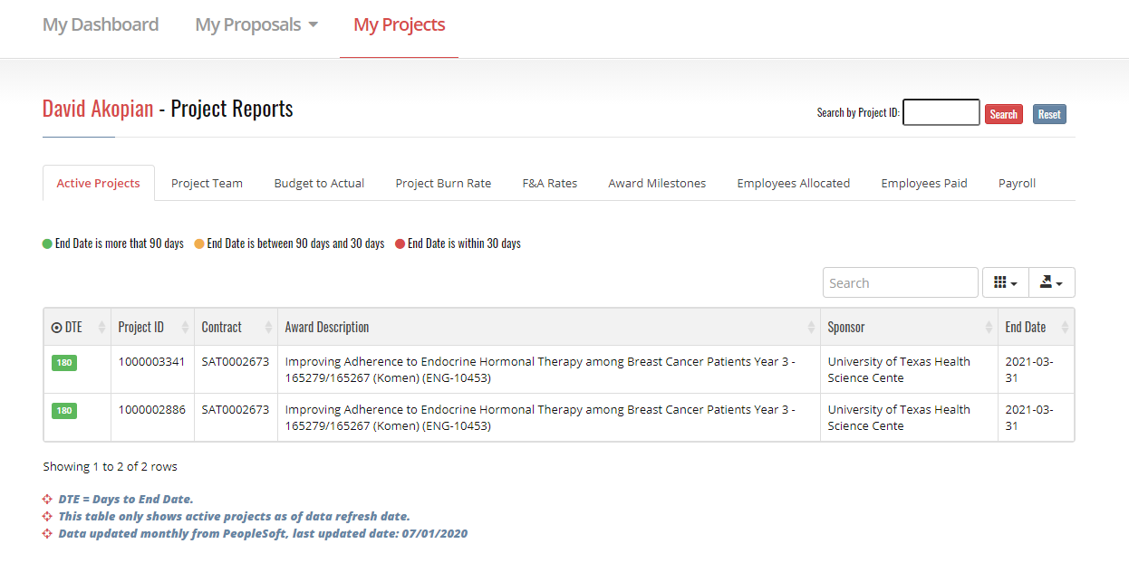
Projects can be easily searched using projectIDs
(e.g. 1000003341)
There are 8 sponsored reports available.
Data schedule:
Active Projects | Monthly (nightly update coming soon)
Project Burn Rate Report | Nightly update
Budget to Actual | Nightly
Project F&A Rates | Monthly
Award Milestones | Monthly (nightly update coming soon)
Employees Allocated on Projects | Monthly
Employees Paid on Projects | Monthly
Project Team | Monthly (nightly update coming soon)

Slide 6
Questions?
Reach us at vprhelp@utsa.edu / arya.singh@utsa.edu

