Slide 1

COEHD Partnerships Meeting
March 8, 2017

Slide 2

COEHD Partnerships

Slide 3
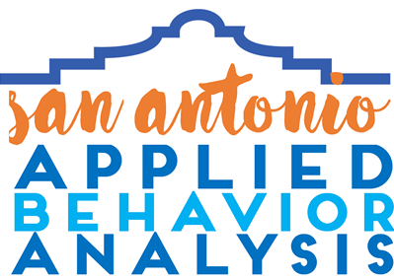



Contact:
Leslie.neely@utsa.edu
SAABA Objectives:
• Provide evidence-based comprehensive services to individuals with disabilities
• Train UTSA graduate students as Board Certified Behavior Analysts (BCBA®)
• Train parents of children with autism and other disabilities
• Conduct meaningful and impactful research
31
Individuals with disabilities
28
UTSA Graduate
students
147
Parent Training Hours
$522,536
In funded granting activities
Notes:
Joint Project Between the Children’s Hospital of San Antonio, Autism Treatment Center, and UTSA Department of Educational Psychology. I lead the project on behalf of the Department and we have Dr. Melissa Svoboda (Developmental Pediatrician/Pediatric Neurologist) and Ivy Zwicker (Director of ATC – San Antonio).
Goals of this project are to address a real need for San Antonio which is to expand services for individuals with Autism and other developmental disabilities. Kronkosky organization funded a scoping assessment of San Antonio services and released a report that indicates we need a minimum of 40 Board Certified Behavior Analysts to serve the immediate needs of San Antonio and two additional Developmental Pediatricians and Diagnostic Teams. Current wait lists for diagnosis are about a year and we have children on wait lists to receive therapy for 2-3 years. Our waitlist is 600 + individuals.
Opportunities for Collaboration: Collaboration with Medical personnel and Licensed Psychologists to expand diagnostic services. Ongoing research projects that may be of interest to other faculty members. In the interest of time, have faculty contact me.

Slide 4
Empower Behavioral Health
9314 Ryder Rd., San Antonio | 3 Commercial Pl., Schertz
Empower Behavioral Health (EBH) provides Applied Behavior Analytic services to children with autism and other developmental disabilities. The partnership between EBH and UTSA has established a paid internship for students pursuing Board Certification in Behavior Analysis (BCBA) through UTSA’s approved course sequence. Graduate student interns receive a bi-weekly salary and tuition reimbursement while accruing fieldwork hours supervised by BCBAs employed by EBH, with additional quarterly feedback provided by university faculty, and have an opportunity to participate in applied research.
This partnership is supported through a yearly, renewable contract between EBH and UTSA.
Opportunities to become involved include invitations to sponsor or host community education seminars or events. EBH BCBAs are also happy to speak at professional events to discuss the services they offer or educate healthcare providers, students, and/or consumers (parents/caregivers) about behavior analysis and its utility.

Slide 5
Longitudinal ethnographic study of children’s language use, ideologies, and identities and how they affect their educational outcomes including language learning/maintenance
Support sources: Pending (San Antonio Area Foundation)
Opportunities to become involved:
  Quantitative methodology
  Partnership with schools
Role of a Cultural Afterschool Program in Language Learning/maintenance
(UTSA-GCAC partnership
Location: GCAC Center on 723 S Brazos St, San Antonio, TX 78207)
PI: M. Sidury Christiansen (BBL)

Slide 6
Center for Military Families: Partnerships
Family Endeavors,
KLRN,
Military and Family Services Flight,
Military Child Education Coalition,
USO,
VA Hospital

Slide 7


Communities in Schools of San Antonio
Preservice educators provide content-area instruction to K-12 English learners during 10-hour field experiences (ESL 3023, 3063)
Provide approx. 1500 hours of service/semester
Support from UTSA field experience coordinator and CIS-SA; no external funding
Any class with a field experience that focuses on at-risk or ELLs could become involved
Primary UTSA Contacts: Kristen Lindahl, Kathryn Henderson, Ron Thomas

Slide 8
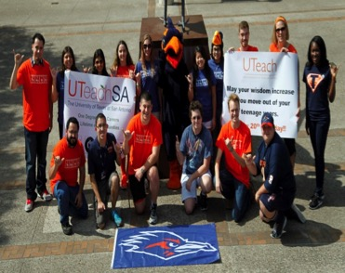
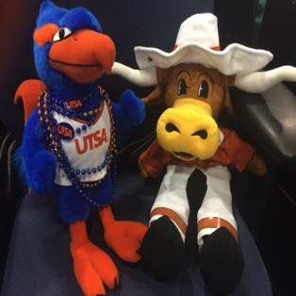








One Degree • Two Careers • A Lifetime of Opportunities
Program & Partnership:
Partnership between UTSA and the UTeach Institute in Austin - national network
Collaboration at UTSA between COS & COEHD
Designed to train highly qualified STEM teachers in inquiry- and project-based instructional approaches
Student earn a math or science degree AND secondary teacher certification in as little as four years
Free introductory courses- tuition reimbursed
Immediate fieldwork and experience in K-12 classrooms
Support sources:
NSF Noyce grant- ACCD transfers
Pat and Tom Frost Foundation
Ewing Halsell Foundation
Armed Forces Communications and Electronics Association (AFCEA)
Dirk and Annie Elmendorf
Evelyn Mortola
Melinda Jayne Villegas Endowment
Involvement Opportunities:
COEHD faculty needed for pedagogy classes & course development
Learn More: Carey Walls carey.walls@utsa.edu 210-458-4082

Slide 9
Partnership and Networking Meeting
Name of Partners/location: Educational Testing Service (ETS), Princeton, NJ.
2. Nature of the partnership: I received two years of postdoctoral training (2010-2012) at their English Language Learning and Assessment Research Division, during which I investigated the reliability and validity of speaking assessments. I continued working with my ETS colleagues on related topics, and was just awarded a research grant to examine the validity of their new English language proficiency test, the TOEFL Junior test (for students ages 11+).
3. Support sources: TOEFL® Young Students Series Research Grants
4. Opportunities for others to become involved: Collaborate on assessment-related research projects
Notes:
Let me start by talking about the motivation of the current study. The majority of oral language assessments use raters’ subjective judgment to determine test takers’ language proficiency. So, Rater effects, defined as the construct-irrelevant variation associated with rater characteristics, are thus critical to the reliability, validity, and fairness of the speaking assessment (Bachman, Lynch, & Mason, 1995; Kunnan, 2000).

Slide 10
ELPS Partnerships
Partnerships
San Antonio ISD
South Bexar districts
Northside ISD
North East ISD
Nature of work
We work with districts to identify and recruit program participants (principal and alumni nominations)
Courses taught 60% UTSA TT Faculty and 40% District Executives
On site delivery within district
District supported projects (Equity Audits, School Improvement Project)
Extended Internship (at least 2 semesters)
Connections to district developed leadership training (NISD)
Funding
Internal Provost Funds
Lab School Grant
Family Foundation
Opportunities
Evaluation of District Leadership programs (NISD)
Bridge for entrée in district
Ability to work with district research departments

Slide 11
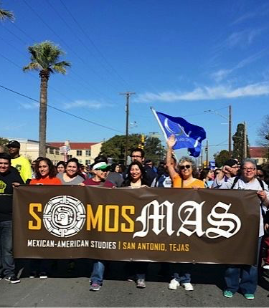
Mexican American Studies at UTSA
Partnership with Somos MAS (Mexican American Studies) made up of community members in San Antonio with Mexican American Studies faculty at Palo Alto Community College, Northwest Vista Community College, Saint Phillips Community College, San Antonio Community College, Our Lady of the Lake University, and Trinity University. Its mission is greater visibility of programs; development of programs to departments, encouraging higher education.
Send email to Director of MAS Program for meeting times, and activities.
Marie.Miranda@utsa.edu
Or
SomosMAS on Face Book

Slide 12
Department of Counseling Partnerships
San Antonio Municipal Court
AVANCE - Early Head Start Program
Judson ISD – Sarabia Family Counseling Center Satellite
Bexar County District Attorney’s Office
Northside ISD-M. Ed. School Counseling Cohort Program
Center for Health Care Services
Notes:
San Antonio Municipal Court
401 S Frio St, San Antonio, TX 78207
Sarabia Family Counseling Center (SFCC) provides individual, couples, and family counseling to adjudicated youth and their families who are referred by the judge and caseworkers. SFCC also provides psychoeducational groups to teens and their parents when referred by the judge.
Support Sources: None
Opportunities for others: Unknown
AVANCE - Early Head Start Program
903 Billy Mitchell Blvd., Suite 100, San Antonio, TX 78226
Sarabia Family Counseling Center students and staff provide educational outreach programs on parenting and mental health/wellness in addition to providing counseling services to referred families.
Support Sources: None
Opportunities for others: Unknown
Judson ISD – Sarabia Family Counseling Center Satellite
8012 Shin Oak Drive, Live Oak, TX, 78233
The purpose of the UTSA/JISD Counseling Center is to provide prevention and intervention counseling and human development services to JISD’s military-connected students, their families, and their peers. Student interns are placed at identified schools to provide clinical mental health counseling services under the supervision of the director of guidance and campus counselors.
Support sources: None
Opportunities for others: Unknown
Bexar County District Attorney’s Office
101 W Nueva St, San Antonio, TX 78207
The Sarabia Family Counseling Center provides counseling services to jury members. The judges and staff of the district court distribute our flyers and encourage jurors to seek our counseling services if needed. The district attorney’s office shares our flyer with all jurors by e-mail.
Support sources: None
Opportunities for others: Unknown
Northside ISD-M. Ed. School Counseling Cohort Program
5900 Evers Road, San Antonio, TX 78238
The M.Ed. School Counseling Cohort Program is offered to eligible Northside ISD (NISD) personnel to enable greater ease in completing requisite course work, including field placement requirements. Through UTSA’s school counseling cohort program, future NISD school counselors are knowledgeable and capable of delivering State required school counseling program content to the Northside community. The course of study is the identical CACREP accredited 48-hour program offered to students in the on-campus program.
Support sources: None
Opportunities for others: Unknown
Center for Health Care Services
527 N Leona St, San Antonio, TX 78207
Dr. Lloyd-Hazlett established a service-learning partnership with the CHCS as part of the Consultation and Program Evaluation course. To date, more than 70 students have participated on empirically-driven service-learning teams. Student consulting projects emphasize practical strategies to increase health literacy for Hispanic clients being treated in integrated health care settings. The results of these projects were presented at the 2016 and 2017 UTSA Civic Engagement Summits.
Support sources: None
Opportunities for others: Unknown

Slide 13
UTSA School Psychology Practicum and Internship Placement Partners
Dr. Castro-Villarreal, PhD, Licensed Specialist in School Psychology
Graduate Advisor of Record, The University of Texas at San Antonio
Practicum Partners
Alamo Heights ISD
San Antonio ISD
AIM-Assessment Intervention Management
Laurel Ridge Residential Treatment Facility
East Central ISD
Atascosa-McMullen Co-Operative
Edgewood ISD
South San ISD
BASIS Charter School
IDEA Public Schools
Internship Placements
Houston Area
Dallas-Fort Worth Metroplex
San Antonio
Laredo
Coastal Bend
Florida
Denver Public Schools
California
Kansas
Chicago
Practicum Experience
School Psychology Practicum partnerships have developed over the past 5 years
UTSA School Psychology students are matched to a practicum site
Students are enrolled in a practicum course along with the field experiences
Students complete 300 hours over two long semesters
Students adhere to an activity/experience checklist and operate under the close supervision of a Licensed Specialist in School Psychology
Faculty also provide university faculty supervision
Students engage in assessment, therapy, and consultation activities
Internship Experience
UTSA School Psychology students find their internship with the help of university faculty
The School Psychology internship is a full time 1200 hour internship
Students can complete the experience anywhere across the nation
Students are enrolled in an online university supervision course during internship

Slide 14

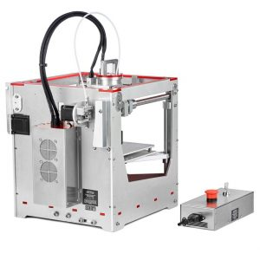
BoXZY
BoXZY is built for educators, engineers, and the “makers” in all of us. It is the leading All-in-One 3D printer. It includes tool heads for:
3D printing,
CNC carving, and
laser etching.
Seton Home has been providing services to pregnant teens and their children since 1981. Now located on eight acres at 1115 Mission Road, Seton Home includes three cottages, a state licensed Child Development Center, chapel, the Dr. Leslie Parks Education Center, a sports court and administrative buildings. Today Seton Home serves 24 families who have been removed from their homes due to abuse, neglect and sexual assault and are placed by Child Protective Services.
They are interested in partnering with UTSA in the following areas:
Evaluation of programs
Development of best practices tailored to unique population of two generations
Professional development for early childhood teachers
Grantwriting
www.boxzy.com
www.setonhomesa.org

Slide 15
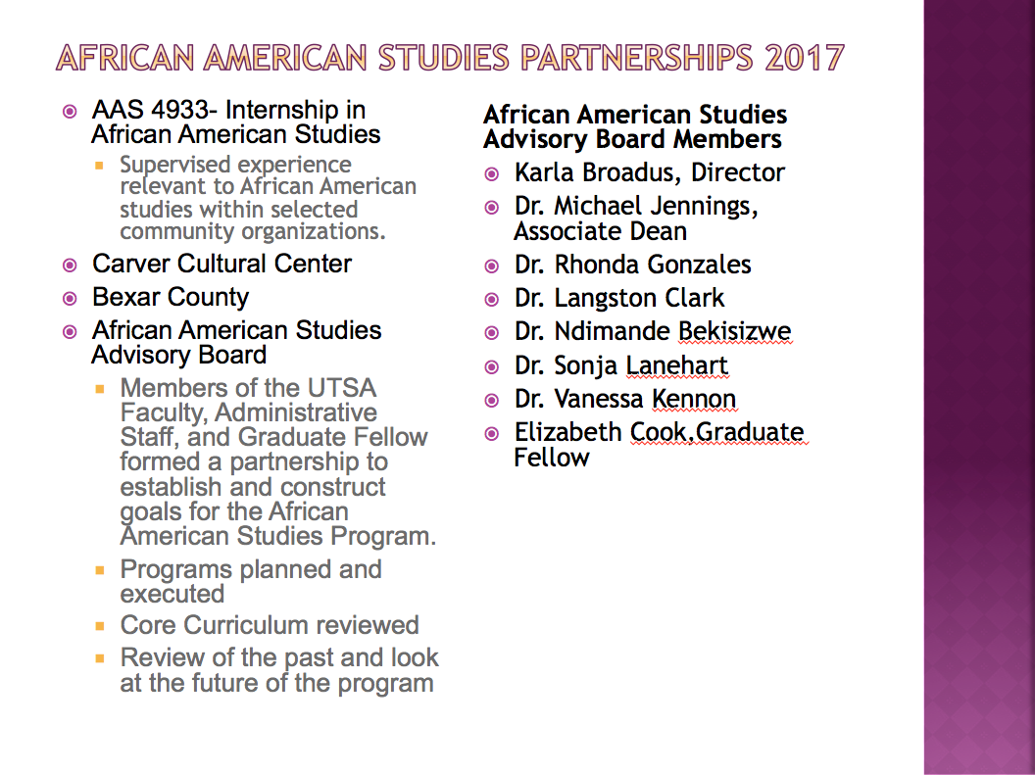

Slide 16

The South Texas Consortium for HIV & STI Research
The PRIDE Center San Antonio, Equality Texas & Trinity University
CBPR Project: Coalition of AIDS Service Organizations, Community Clinics and San Antonio Metropolitan Health District.
The goals are to:
  facilitate community collaborations with university partners .
  Increase the speed of dissemination and implementation of findings.
  Collaboratively apply for large grants
Several projects with a multiple community collaborators.
Current Funding: Substance Abuse and Mental Health Services Administration, The Henry M. Jackson Foundation for the Advancement of Military Medicine.
Potential Funding: Gilead Inc., Department of Health & Human Services, Office of Minority Research, CONTEX, PCORI
Project to address individual and community resilience, specifically among gender and racial minority LGBTQ+ people.
Submitted funding from Robert Wood Johnson Foundation to:
  Build a community coalition focused on LGBTQ+ health.
  Collect 75 interviews and conduct a community needs assessment to develop programs and services for San Antonio, but also improve measurement of resilience at the community and individual level.
  We will use this data to work with HRC, EQ TX and The Pride Center National Network to create policy-level change that impact LGBTQ+ individuals in Texas.
Perry Street Software, Inc. & Hunter University
We often think of community partners as those that are geographically close to us.
SCRUFF – “hook-up” smartphone application created by Perry Street Software. Community?
Launching (3/31)a nationwide assessment related to PrEP-uptake. Helped PSS develop in-app survey capabilities. Received almost 70K respondents
We will also be design sexual health info graphs to be used in-app based up on survey responses.
Phillip W. Schnarrs, Ph.D.
Assistant Professor, Department of Kinesiology, Health & Nutrition
Co-Director, The South Texas Consortium for HIV and STI Research

Slide 17

The TEAM Center:
  Conducts research on verbal behavior assessment and intervention for children with autism and other language disorders
  Serves as a ShaperSpace for training behavior analysts and special education teachers through project-based learning
  Provides free and low-cost behavior-analytic intervention to children with autism in South Texas
Currently funded by the Texas Higher Education Coordinating Board
We are open to collaborating with anyone interested in autism research!

Slide 18

Local
COMMUNITY ORGANIZATIONS
National & International
National Council of La Raza -Líderes Avanzando
Univ. of Oregon-Strategies for Online Academic Research (SOAR)
Berkeley-UC Links: Community After-School Partnerships
Local/State/Regional
Alamo STEM Workforce Coalition
Bat Conservation International
BiblioTech
Hispanic Women’s Network of Texas- Latinas in Progress Program
Martinez Street Women’s Center
My Brother Keeper-(MBKSA)
San Antonio College Access Network (SACAN
San Antonio College Fair
SASTEMIC
Higher Education
Alamo Colleges
UTHSCSA, UT Austin, & UTSA Collaborative Research
UTSA-COE-Mechanical Engineering
Service Learning-Robotics
UTSA-Institute for P-20 Initiatives-Annual Region 20 Parent Summit
UTSA-COS-NSF Noyce project
ISDs PROJECTS
San Antonio ISD
Community Lab Schools
21st Century Learning
Title V i3 & Title V S5
Southside ISD
Title V i3 & Title V S5
INFORMAL LEARNING CLUBS (30)
Edgewood ISD North East ISD
San Antonio ISD Somerset ISD
Southside ISD Southwest ISD

Slide 19
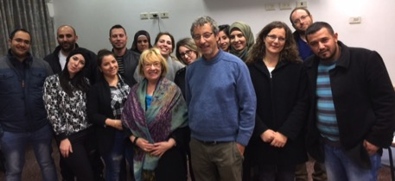
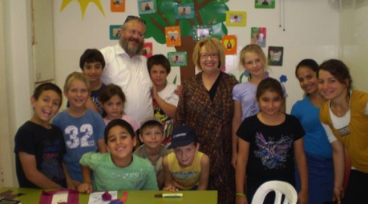
Bilingual, Biliterate, and Binational Collaboration
Dr. Rosalind Horowitz
Extricating Children and Families from Poverty Through Reading
The above photo was taken at Afikim, an educational enrichment center in Jerusalem.
Children in the photo are from Argentina, India, Russia, Romania, Syria and Ethiopia and
many suffer from war and poverty and Post-Traumatic Stress Disorder. Reading and
their interaction with an American professor raised their level of enthusiasm and confidence.
Dr. Horowitz has supported their binational worlds and offers literacy support to the students
and their administrator in the photo.
Afikim Offices exists in South America, the United Kingdom, Switzerland, France and the United States.
Border Discourse and Literacy Development
Dr. Horowitz has developed collaboration and partnership efforts
  Based along the Texas border, primarily with a high school in Laredo.
  In the southern most city in the Negev, bordering Gaza, Beersheba.
A partnership is being developed with Kaye Academic College a teacher training college, and with links to Ben Gurion University. One of the largest and most research oriented schools in Israel.
These schools serve Bedouin populations who live in or around Beersheba. Female students are pursuing teaching and expanding and reforming their identities with the goal of serving multicultural and bicultural populations. Arabic is their first language, Hebrew is their second language and English their third.
Dr. Horowitz met with students in December and will work with a professor at Kaye on introducing border literacy, the reading of texts which characterized living in border lands and the conflicts cross border life presents.
This project includes:
  Cooperation with the Department of English at Kaye Academic College.
  Cooperation with Cognitive Psychologists at Ben Gurion University.
  The writing of autobiographical accounts by prospective teachers who will serve immigrants from multiple nations and religions.
  Scientific study of expectations by preservice teachers for teaching practices on the border.
  Description of cognitive, social and emotional shifts of female Bedouins.
  Comparative study of two border environments for teacher education in literacy.

Slide 20




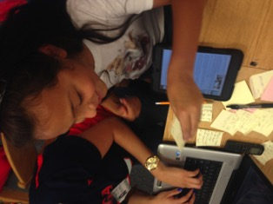
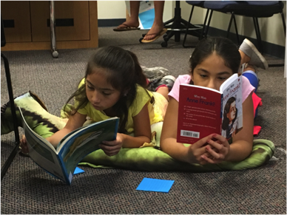


Center for the Inquiry of Transformative Literacies: Partnerships
National Writing Project
ISDs:
Somerset
Harlandale
South San
Good Samaritan Community Services
Mission Branch Library

Slide 21
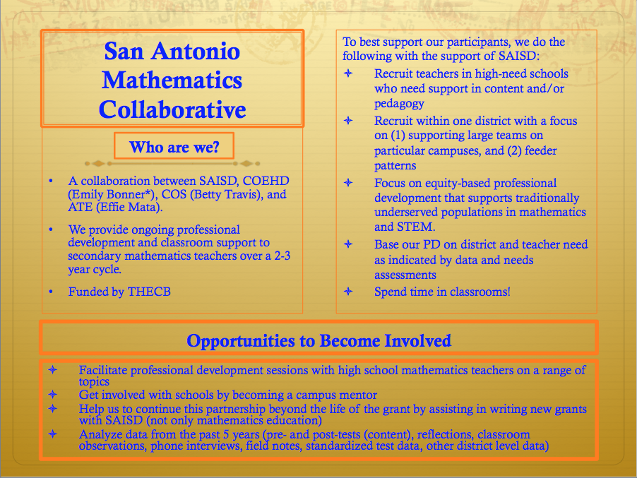

Slide 22
