Slide 1
Getting Started
Proposal Submission Process
Research Service Center
Presented by:
The Research Service Center – UTSA Office of Sponsored Project Administration

Slide 2
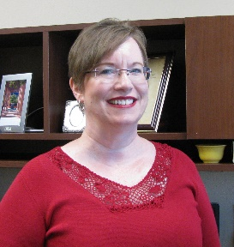
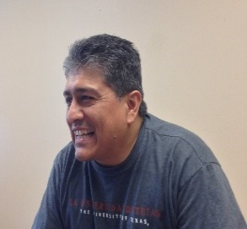
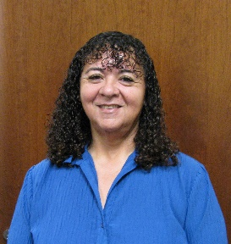
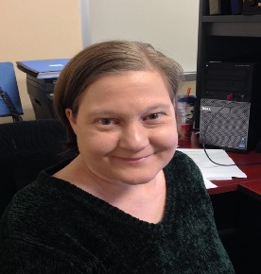
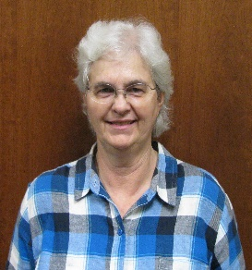
Meet the Team
Research Service Center
Jennifer Silver
RSC Director
jennifer.silver@utsa.edu
(210) 458-4234
Jesse Hernandez
Sr Research Award Coord
jesse.hernandez@utsa.edu
(210) 458-6852
Margot Oviedo
Research Award Admin Post
margot.oviedo@utsa.edu
(210) 458-6376
Amanda Key
Research Award Admin Post
amanda.key@utsa.edu
(210) 458-4384
Kerri Glaspie
Research Award Admin Pre
kerri.glaspie@utsa.edu
(210) 458-5975

Slide 3
Research Service Center for
Arts-Business-Education-VP areas
RSC Proposal INTAKE – Wufoo Form
https://utsaresearch.wufoo.com/forms/colfa-business-coehd/
CAYUSE create a profile in Cayuse:
http://research.utsa.edu/research-funding/cayuse/ (production site)
Once you have logged in (abc123) would you go the people tab, put your name in and click search.
We will need you to link your profile with UTSA institution.
Complete the contact office info: One UTSA Circle
San Antonio, Texas 78249-1164
Office phone number

Slide 4
Cayuse and Routing Form Overview
Electronic Routing Form
  Advisor / Mentor will receive research credit
  Capture documents for activity on faculty dashboard
  Integrates to the UTSA Financial system (PeopleSoft)
  https://comal.it.utsa.edu/routing/login.php
Cayuse - Production Site
  Will retain all proposal documents
  Assist with web-based federal funding via Grants.gov

Slide 5
RSC Pre-award Role
Checklist to assist with Package Proposal
Assist with Budget Expenses
Cayuse Guidance, FastLane, Other Platform
Routing Form for Research Credit, Compliance
Review Proposal, Provide Feedback
AOR Authorized Signature
Just In Time for Award Recommendation
Foundation Grants

Slide 6
Research Service Center
F&A – Overhead—Indirect Costs
UTSA's Indirect Costs are calculated in accordance with the University’s federally negotiated indirect cost rate agreement (Department of Health and Human Services), which is 49% for 9/1/2018-8/31/2019, 49.5% for 9/1/2019-8/31/2020, and 50% for 9/1/2020 until amended. MTDC excludes equipment, capital expenditures, charges for patient care, rental costs, tuition remission, scholarships and fellowships, participant support costs and the portion of each subaward in excess of $25,000.
Minimal Effort Policy
“Each Primary Individual identified in a particular Sponsored Program must commit to and expend Effort of at least 1% on that Sponsored Program over the period of Sponsored Program performance or over a one year period, whichever is shorter.”
Exceptions to the rule: *A Primary Individual may be allowed to commit less than 1% Effort if it is one of the following kinds of Sponsored Programs:
                1. Equipment or instrumentation grants
2. Doctoral dissertation grants
3. Augmentation grants
4. Special institutional or training awards

Slide 7
Research Integrity—Compliance
All UTSA and Outside Researchers are required to file new Disclosure of Financial Interests annually at COI Disclosure for all sponsored projects and research contracts.
COI Training is required every 3 years.
For final approval of IRB or IACUC protocols please contact via email Office of Research Integrity
More details For Researchers

Slide 8
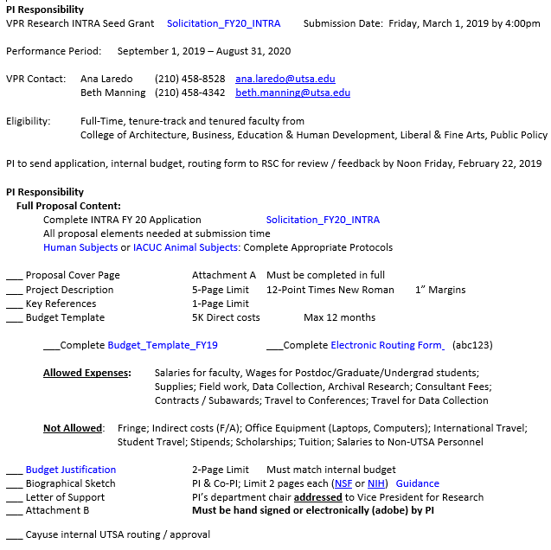
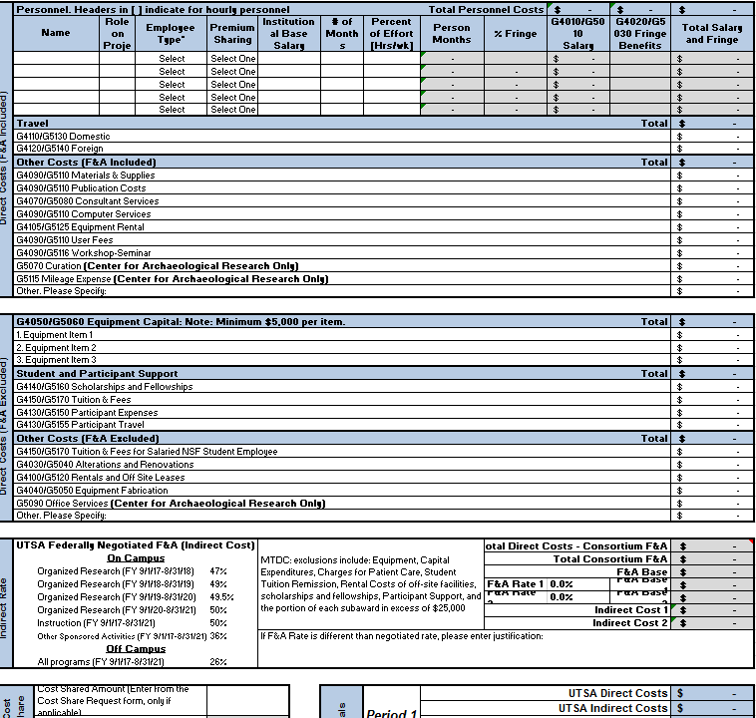
VPR Seed Grant Programs
Intra Seed Grants $5,000 - Provides preliminary data for extramural funding. Deadline 3/01/2019

Slide 9
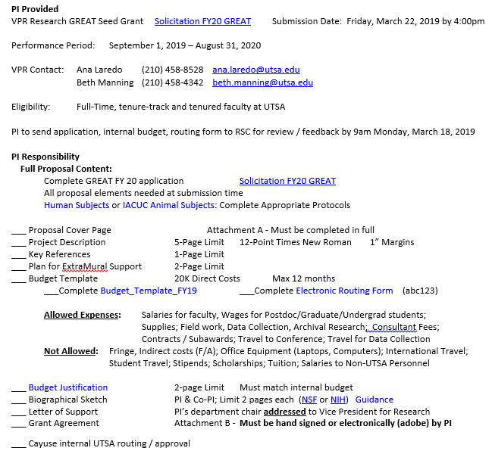
VPR Seed Grant Programs
GREAT Seed Grants $20,000 –
High potential for extramural funding. Deadline 3/22/2019

