Slide 1
Office of the Vice President for Research,
Economic Development, & Knowledge Enterprise (REDKE)
Dr. Can Saygin
Senior Associate Vice President for Research
December 6, 2021

Slide 2
Key Performance Indicators (KPIs)
UTSA’s KPIs | FY18 | FY19 | FY20 | FY21
Number of Proposals | 922 | 1,046 | 1,038 | 1,074
Total Budget in Proposals | $368M | $488M | $466M | $679M
Number of Awards | 308 | 388 | 373 | 367
Total New Awards | $54M | $83M | $68M | $168M
Total Research Expenditures | $70M | $81M | $134M | $140M
Restricted Research Expenditures (RRE) | $44M | $51M | $64M | $68M
Federal Research Expenditures | $29.8M | $34.6M | $34.3M | $43M
NRUF Expenditures | $37.6M | $43.7M | $56.4M | $58M
RRE per T/TT Faculty FTE | $67K | $79K | $103K | $111K
Faculty Awards (CMUP) | 5 | 7 | 4 | 6
National Academy Memberships | 5 | 6 | 10 | 11
Total Patents Issued | 7 | 25 | 22 | 24
Strategic Partnerships | 3 | 38 | 22 | 26
Economic Impact | $2.9B | $2.7B | $2.4B | $3.0B

Slide 3
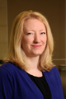
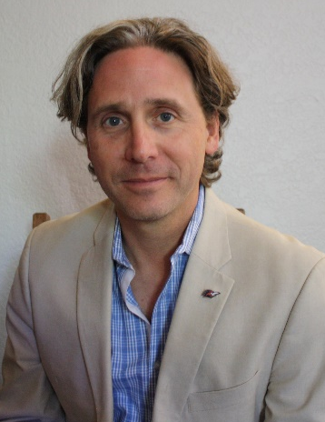
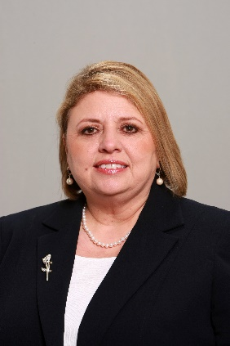
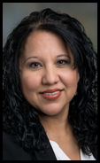


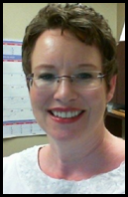
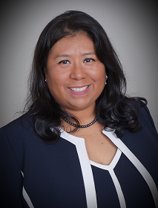
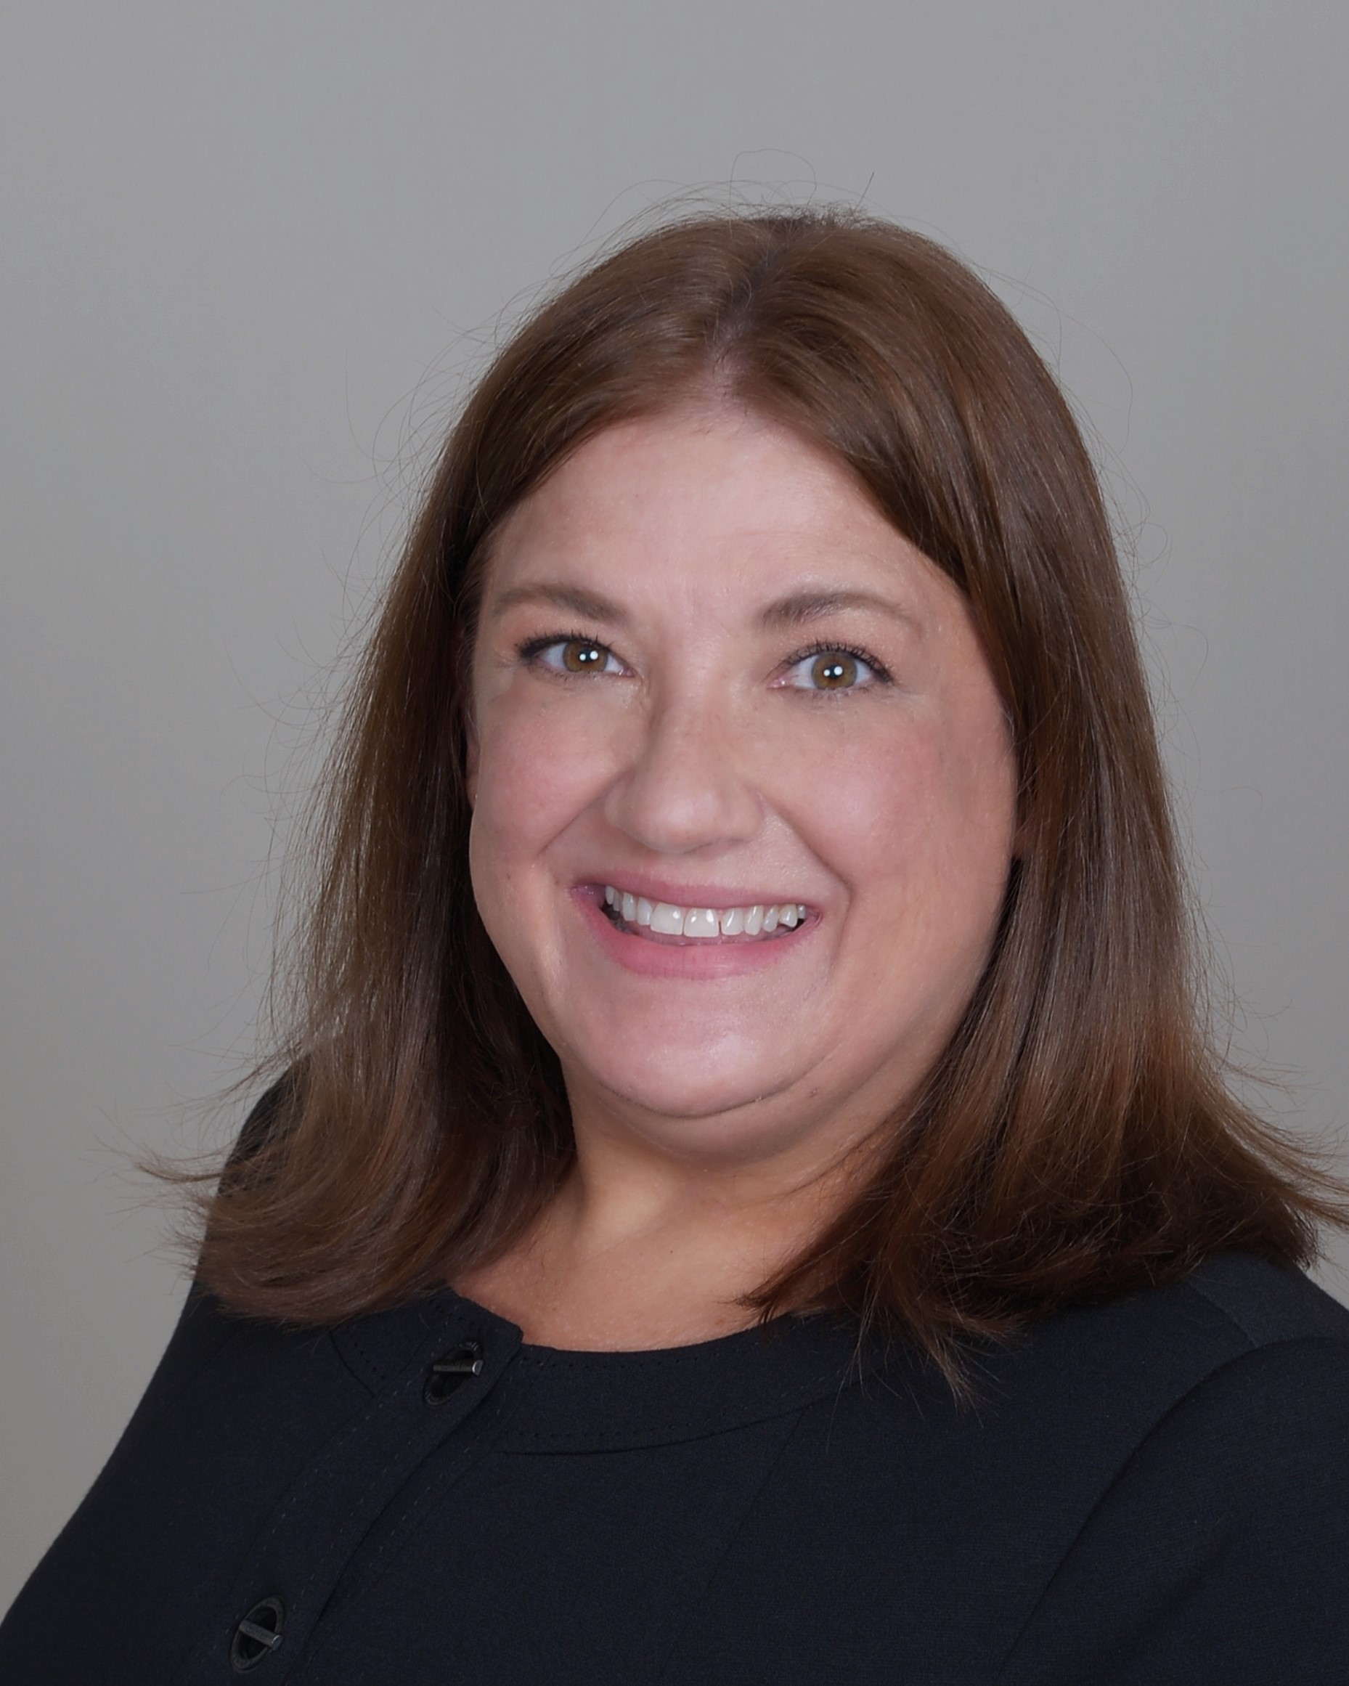
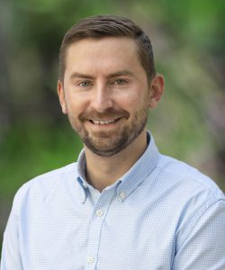
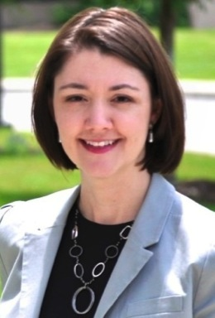
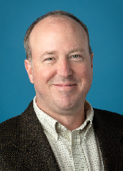
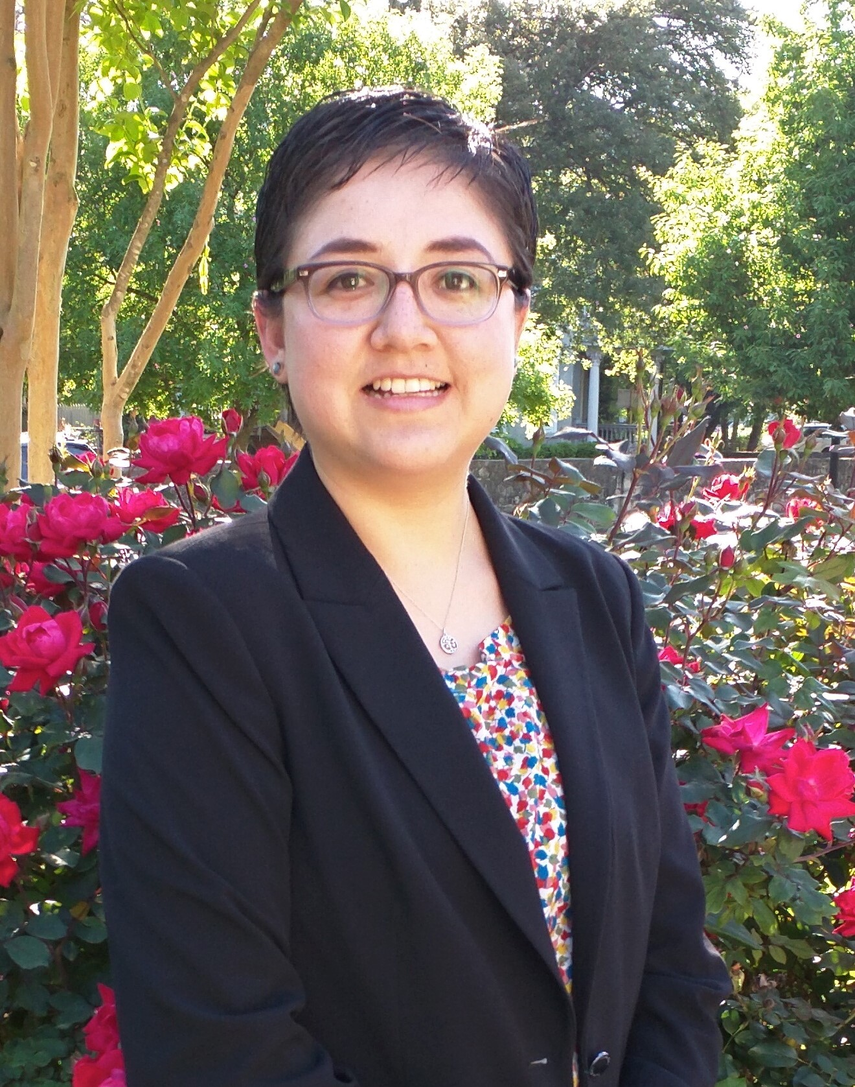
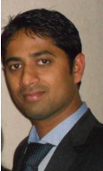

Jaclyn Shaw
Assoc VP
Strategic Initiatives
Shawn Farrell
Asst VP, Corporate
and Foundation Engagement
Dr. Sandra Garcia
Asst VP, Sponsored
Projects Administration
Veronica Stoller
Asst VP, Research
Finance and Operations
Liana Ryan
Director, SCI/EID
Research Service Center (RSC)
Michael Wood
Director, HEBA Research Service Center (RSC)
Jennifer Silver
Director
Post-Award Administration
Vacant
Asst Director,
Post-Award
Administration
Sandra R. Claiborne
Director
Grants and Contracts Financial Services (GCFS)
Ann Simmons
Asst Director
GCFS
Matthew Mueck
Asst Director
SCI/EID RSC
Jesse Hernández
Asst Director
HEBA RSC
Strategic Initiatives
Proposal Development
Project Milestones Management
Funding Opportunities:
Sponsored Projects, Endowments,
and Gifts
Proposal
Assembly &
Routing
Award Acceptance
Set Up ● Modifications ● Billing
Sub-Recipients ● Reporting
Project
Close
Out
Research Support
Cores & Faculty Development
Contracts & Agreements
Project Financial Services
Vacant
Asst VP
Research Support
Business Intelligence & Operational Awareness: Dashboards ● Metrics ● Reports
Research Ethics and Compliance
From Ideation to Project: Sponsored Projects Life Cycle
Saygin 11/30/2021
Dr. Mickey Stevenson
Assoc VP, Research Integrity
Vacant
Director, Research Infrastructure Support
Dr. Dan Riechers
Director, Faculty & Grant Development
Jessica C. Fernandez
Senior Director, Contracts & Industry Agreements
Arya Singh
Director, Research Computing and Business Intelligence

Slide 4
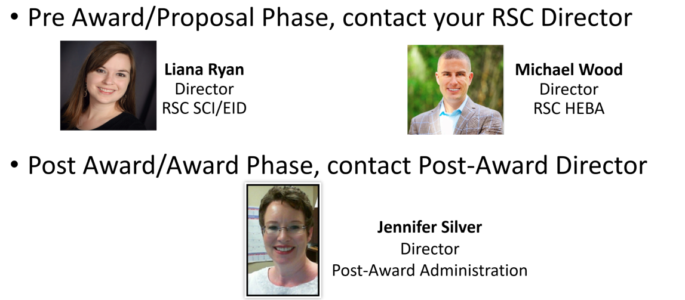
Your REDKE Contacts
RSC SCI/EID
COLLEGE OF SCIENCES
COLLEGE OF ENGINEERING & INTEGRATED DESIGN
RSC HEBA
COLLEGE FOR HEALTH, COMMUNITY, and POLICY
COLLEGE OF EDUCATION & HUMAN DEVELOPMENT
ALVAREZ COLLEGE OF BUSINESS
COLLEGE OF LIBERAL AND FINE ARTS
UNIVERSITY COLLEGE
HONORS COLLEGE
GRADUATE SCHOOL
VPAA, VPBA, VPDAR, VPIA, VPIE,
VPIMT, VPREDKE, VPUR

Slide 5

OSPA Leadership
Dr. Sandra Garcia
Assistant Vice President
Office of Sponsored Projects Administration (OSPA)
Pre-Award (RSCs)
Contracts
(CIA)
Liana Ryan
Director,
SCI/EID RSC
Michael Wood
Director
HEBA RSC
Jessica C. Fernandez
Senior Director,
Contracts & Industry Agreements (CIA)
Matthew Mueck
Asst Director
SCI/EID RSC
Jesse Hernández
Asst Director
HEBA RSC

Slide 6
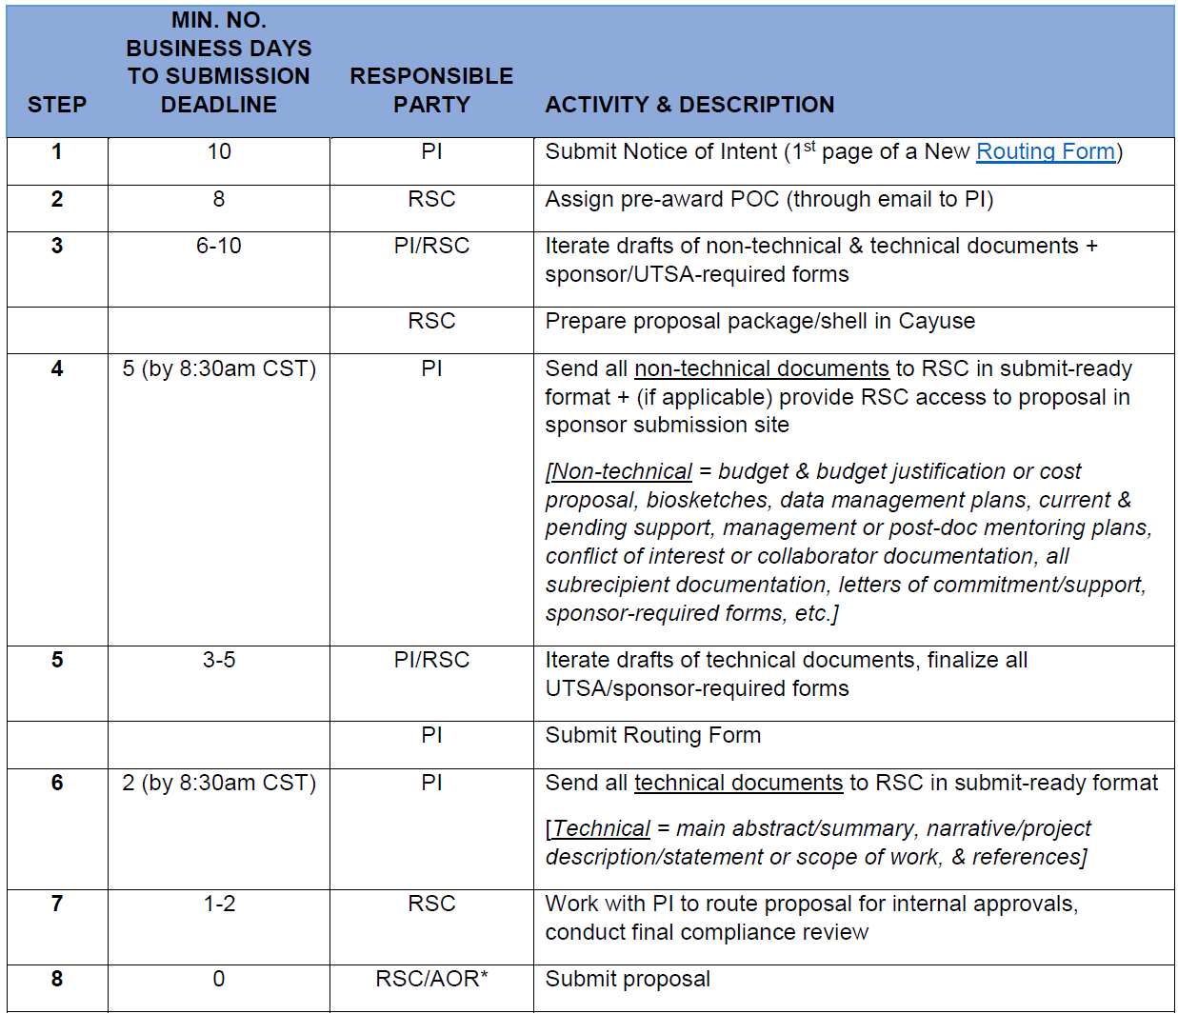
OSPA Metrics and Targets: Proposals

Slide 7
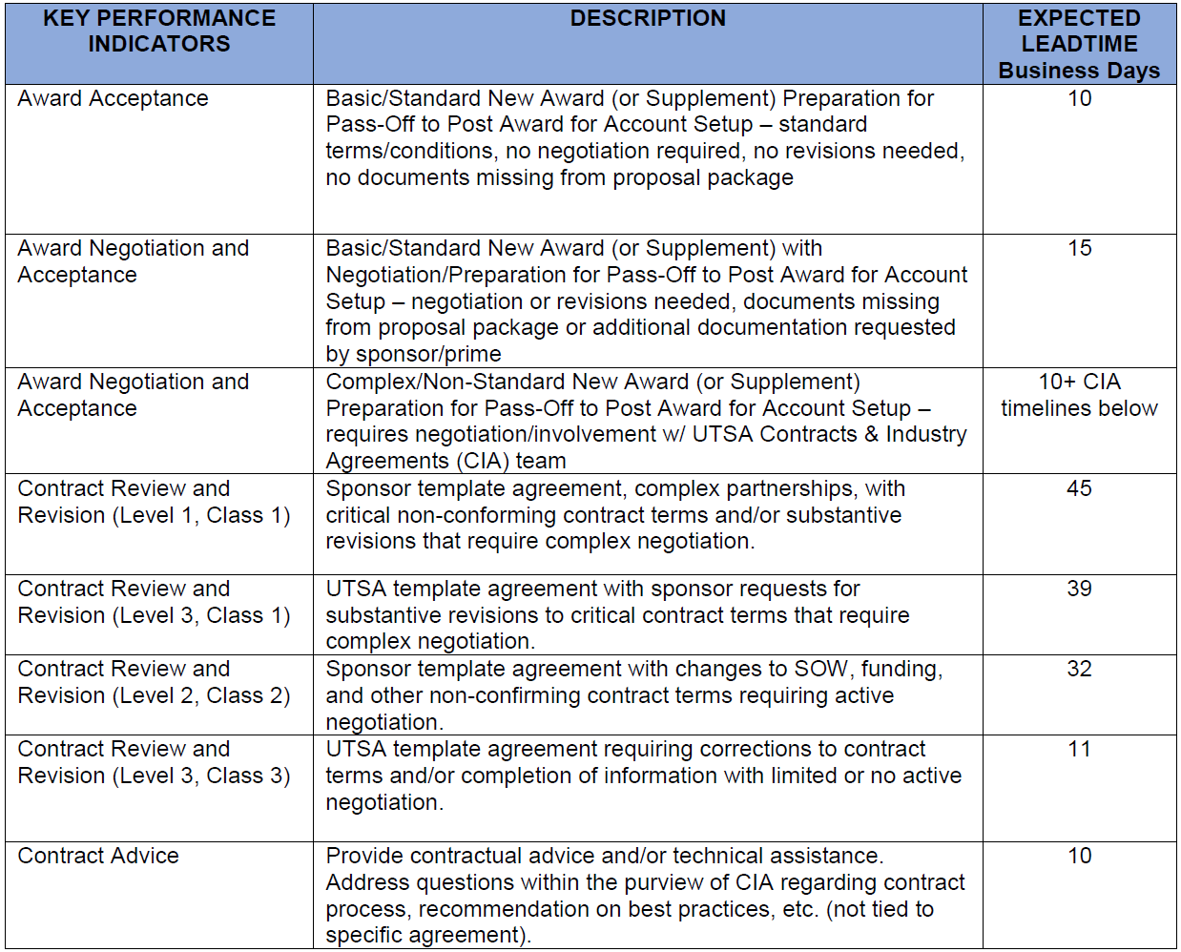
OSPA Metrics and Targets: Awards & Agreements

Slide 8
ORFO Leadership
Veronica Stoller
Assistant Vice President
Office of Research Finance and Operations (ORFO)
Post-Award
Grants Accounting
(GCFS)
Jennifer Silver
Director
Post-Award Administration
Sandra R. Claiborne
Director
Grants and Contracts Financial Services (GCFS)
Vacant
Asst Director,
Post-Award
Administration
Ann Simmons
Asst Director
GCFS

Slide 9
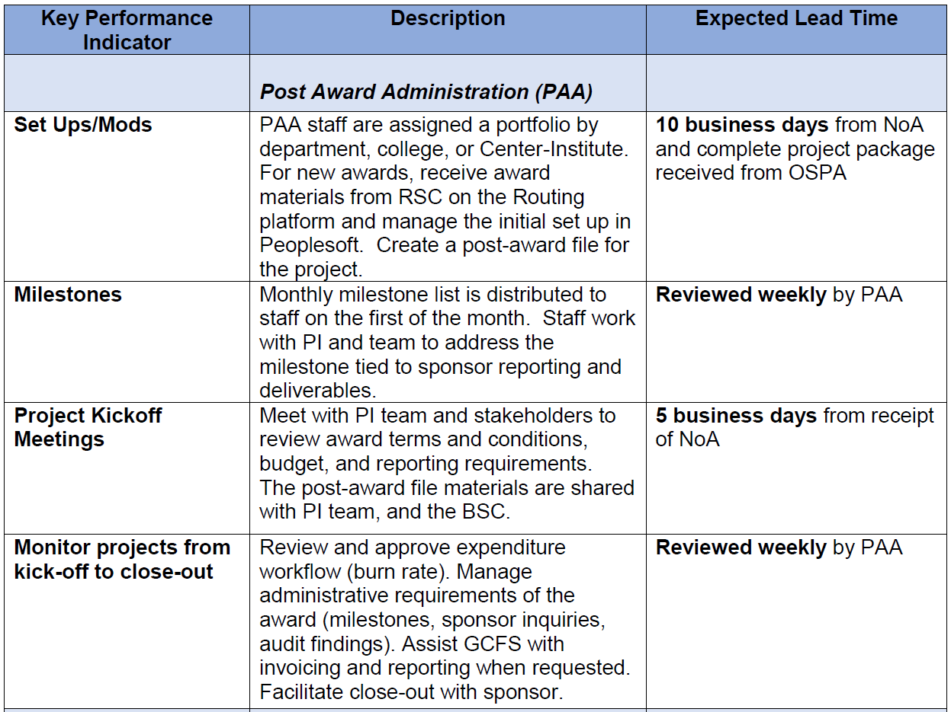
ORFO Metrics and Targets

Slide 10
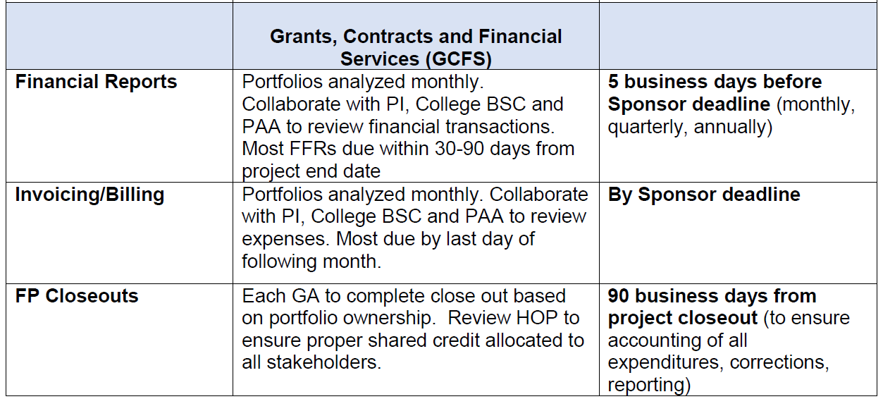
ORFO Metrics and Targets

Slide 11
How are we doing?
Below are the links to Pre-Award (Research Service Centers), Contracts, and Post Awards surveys:
If you are in HCaP, COEHD, ACOB, COLFA (Michael Wood): Pre-Award HEBA - https://utsa.az1.qualtrics.com/jfe/form/SV_bghpRIoZIChZqw6
If you are in COS, CEID (Liana Ryan): Pre-Award SCI-EID - https://utsa.az1.qualtrics.com/jfe/form/SV_cT1ZUbY0UePXQYC
Contracts and Industry Agreements (Jessica Fernandez) - https://utsa.az1.qualtrics.com/jfe/form/SV_eS54PETYYilZZNs
Post-Award (Jennifer Silver, Sandra Claiborne) - https://utsa.az1.qualtrics.com/jfe/form/SV_cImOQpMmDJlSHQi

Slide 12
THANK YOU
Can Saygin
can.saygin@utsa.edu
Senior Associate Vice President for Research

