Slide 1
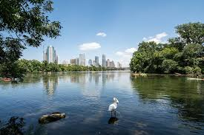
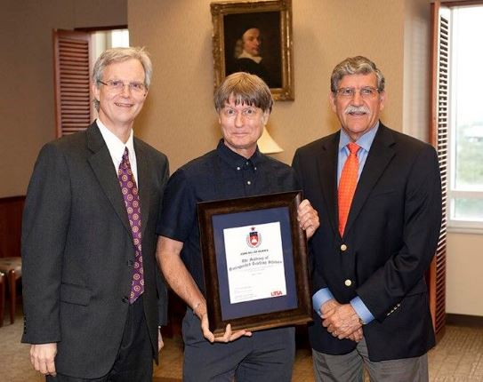
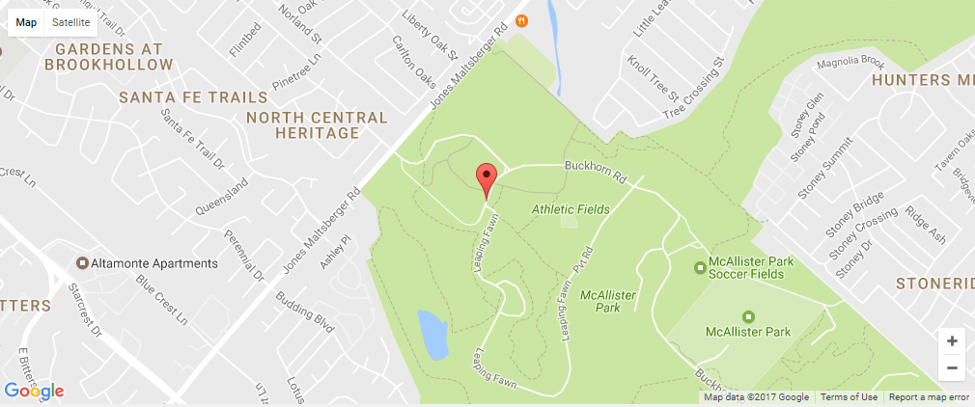
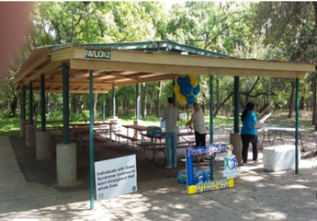
Celebration of Life & Scholarship
Memorial For
Sunday April 2nd, 2017
10 AM
McAllister Park Pavilion # 2, 13102 Jones-Maltsberger Rd.
San Antonio 78247
Come share your memories
Please bring a dish to share!
Dr. John Miller Morris (1952-2017)
Directions: From Jones-Maltsberger Rd., turn into park on Money Tree Drive; proceed to Buckhorn where you turn left; proceed past soccer fields on right to Leaping Fawn; turn right; Pavilion #2 is immediately on left by the stone rest rooms.

