Slide 1
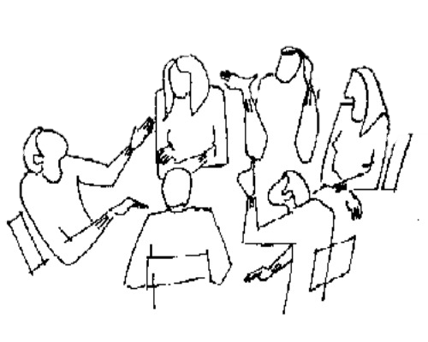
UTSA College of Education and
Human Development
Tenure and
Promotion
Forum
January 14, 2016
2:00 p.m. – 4:00 pm.
Buena Vista Building – BV 1.322
Downtown Campus
Purpose: To achieve greater clarity about the tenure and promotion criteria and process. To plan for action in anticipation of tenure & promotion.
Participants:
Dr. John Frederick, Provost & VP for Academic Affairs
Dr. Betty Merchant, Dean of the College of Education & Human Development
Dr. Maricela Oliva, Associate Vice Provost for Academic & Faculty Support
Dr. Emily Bonner, Associate Professor, Department of Interdisciplinary Learning & Teaching
Dr. Alberto Cordova, Associate Professor, Department of Health & Kinesiology
Dr. Patricia Sánchez, Associate Professor, Department of Bicultural – Bilingual Studies
Dr. Paul Schutz, Professor, Department of Educational Psychology

