Slide 1
Supporting Emergent Bilingual Students Within an MTSS Framework
DRAFT (note: we may want to delete the “academic” EB slides since we have so much to cover)
In-Person Professional Development
New Caney ISD
March 22, 2024

Slide 2
Welcome!

Slide 3
Agenda
Introductions
Project ¡LEER! Overview
Overview of Emergent Bilinguals (EBs)
Overview of MTSS
Assessment for EBs
Progress Monitoring
Practice-Based Coaching
Wrap-Up & Questions

Slide 4
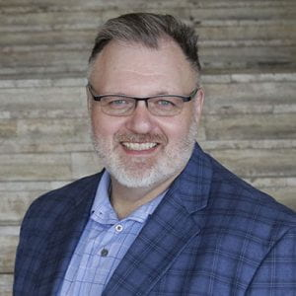
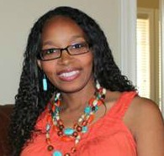
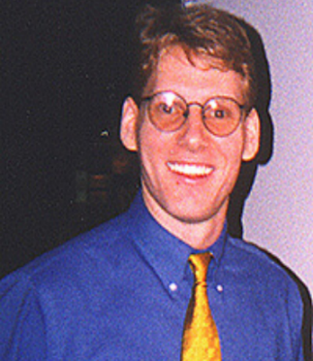
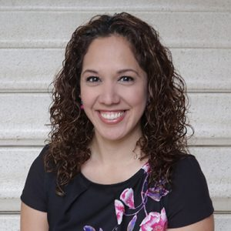
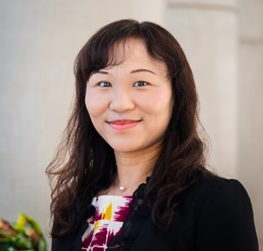
Project ¡LEER! Staff
Dr. Mack D. Burke, Director, Baylor University
Dr. Lisa Bowman-Perrott, Co-Director, Texas A&M University
Dr. Richard Boon, Co-Director, The University of Texas at San Antonio
Dr. Kristen L. Padilla, Co-Principal Investigator, Baylor University
Dr. Fuhui Tong, Co-Principal Investigator, Texas A&M University
Ms. Virginia Reynolds, Project Coordinator, Baylor University

Slide 5
About Project ¡LEER!
Project ¡LEER! stands for:
Literacy, Language, and Social-Emotional Support for English Learners with and Without Disabilities in Inclusive Settings to Improve Reading Outcomes
Project ¡LEER! will develop and provide:
Multi-tiered Systems of Support (MTSS)
ClassWide Peer Tutoring
Professional development to improve the reading outcomes of English learners with and without disabilities in grades K-12
5 Years (2021-2026)
Funded by the U.S. Department of Education, Office of English Language Acquisition

Slide 6
Overview of Emergent Bilinguals (EBs)

Slide 7
Terminologyy
LEP
Limited English Proficient
EL
English learner
ELL
English language learner
EB
Emergent bilingual

Slide 8
Common Terms and Acronyms
Students’ first language
Referred to as…
Native language
Heritage language
Ancestral language
Home language
L1
Students’ second language
Referred to as…
L2

Slide 9
English Learners
English learners (ELs)
Students who are learning English (whose first language is not English)
Also referred to as:
English language learners (ELL)
Second language learners
Emergent bilinguals (EBs; Texas Education Agency)
Students who are becoming bilingual (retain their native language)

Slide 10
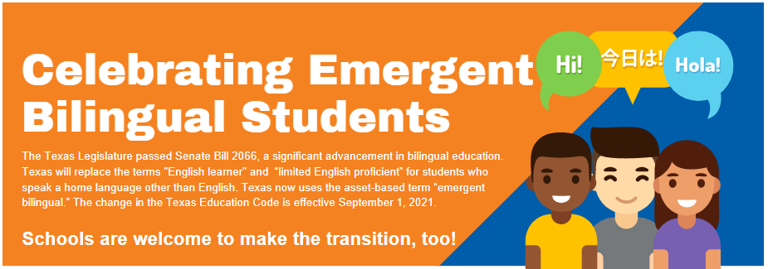
Texas Senate Bill 2066
(Intercultural Development Research Association [IDRA], 2021)

Slide 11
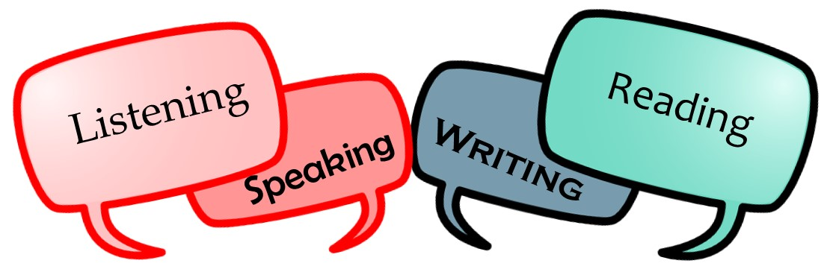
EBs
English language proficiency
Speaking, reading, writing, listening
Heterogeneous group
linguistically and academically
including native language proficiency
EBs often face the dual challenge of learning a new language while they are expected to perform in content areas

Slide 12
EBs
Frequently Used Assessment:
Language Assessment Scales (LAS)
English language proficiency
Speaking, reading, writing, listening
Heterogeneous group
(e.g., linguistically (including native language proficiency) and academically)
EL often face the dual challenge of learning a new language while they are expected to perform in content areas

Slide 13
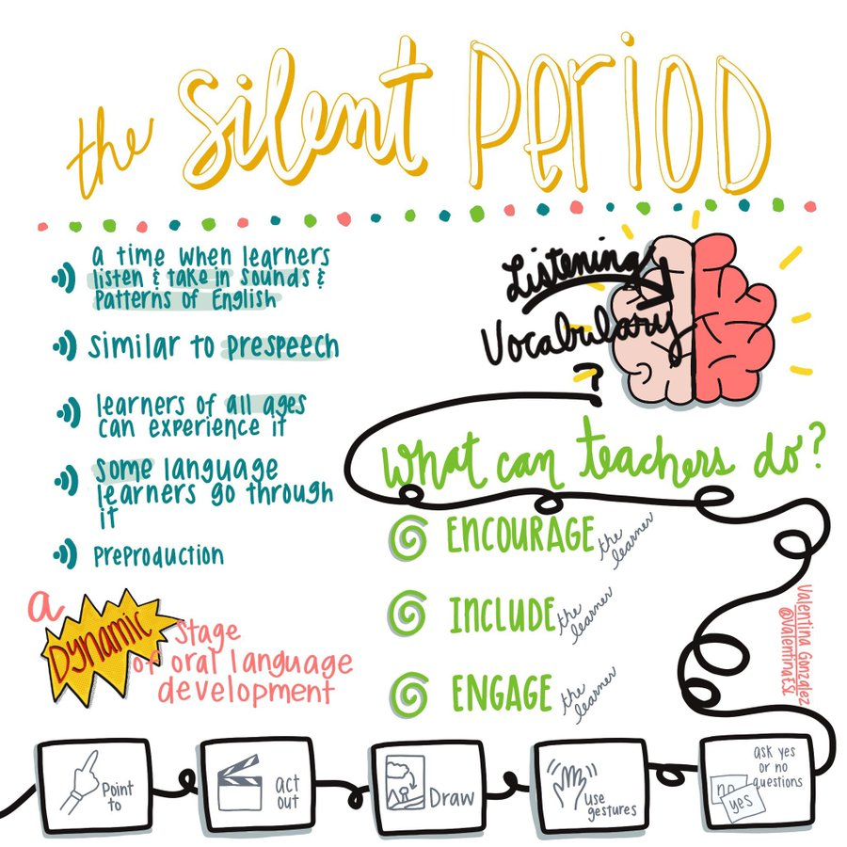
Source: Quizlet

Slide 15
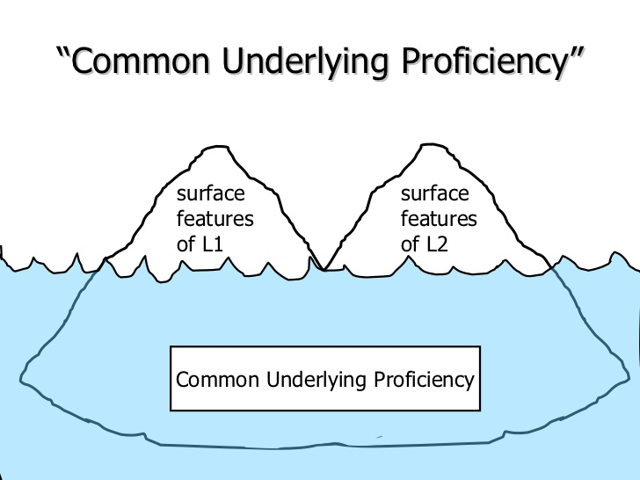
Common Underlying Proficiency (CUP)
Instruction in L1 will benefit the student in acquiring competency in L2
Literacy knowledge transfers across languages

Slide 16
Basic Interpersonal Communication Skills (BICS)
BICS
Social language
Communication used daily in routine communicative exchanges (e.g., while dressing, eating, playing, etc.).
Not cognitively demanding
Social conversation with gestures
Storytelling
Social phone call
Many agree that it takes 1-3 years to acquire

Slide 17
Cognitive Academic Language Proficiency (CALP)
Cognitive Academic Language Proficiency (CALP)
Academic language
Use information acquired to make inferences and draw conclusions
Cognitively demanding
Math lesson (with manipulatives)
Geography lesson with maps
Multiple choice test
Many agree that it takes 5-7 years to acquire

Slide 18
The following are a few ways we can support EBs’ English language development, and support their native languages.

Slide 19
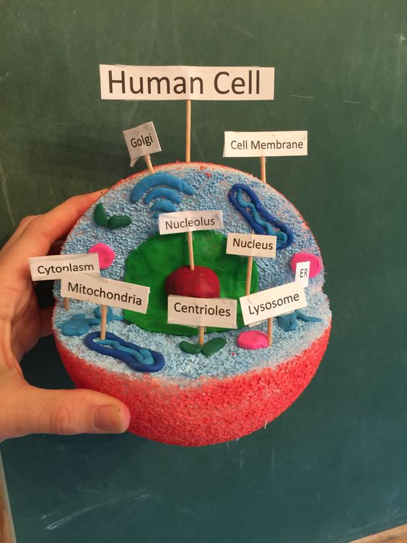
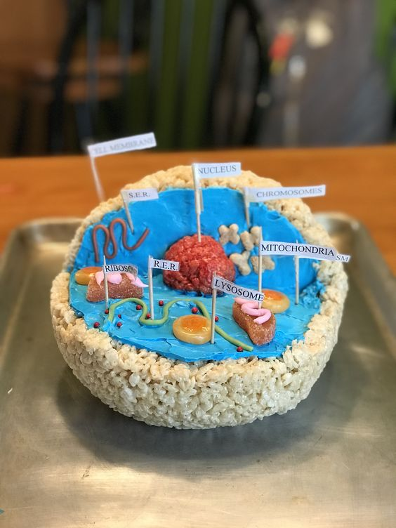
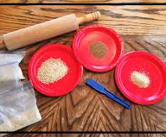
Encourage Active Learning
Visuals
Hands-on activities

Slide 20
Minimize or Exclude the Use of Idioms

Slide 21
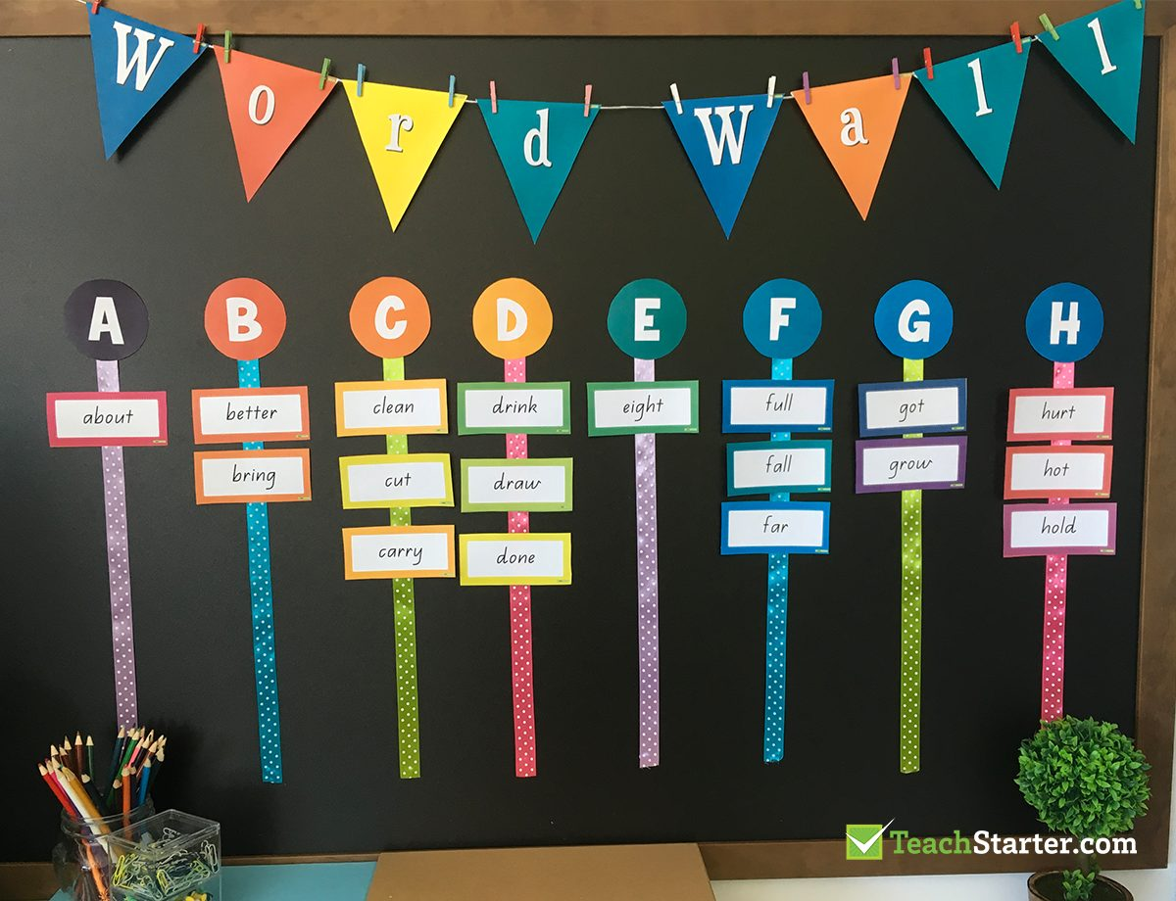
Word Wall Example

Slide 22
Extend the Use of Word Walls
You can ask your students to:
Categorize the words by:
Parts of speech
Subject area
Words that rhyme
Words with multiple meanings
Students can:
Keep a notebook of “word wall words” to review and study at home
Draw or act out words
Unscramble words
Write or rewrite a sentence or paragraph with words from the word wall (e.g., adjectives)

Slide 23
Cognates
Words in two languages that share a similar meaning, spelling, and pronunciation.

Slide 24
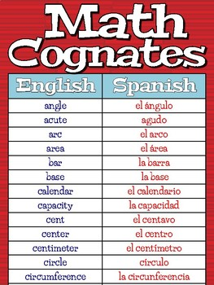
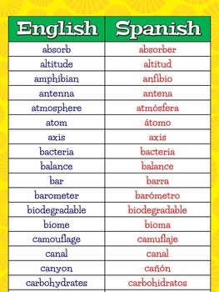
Content Area Cognates

Slide 25
Overview of Multitiered Systems Of Support (MTSS)

Slide 26
Assessment For EBs

Slide 27
Progress Monitoring

Slide 28
Practice-Based Coaching

Slide 29
Thank You!
Questions?

Slide 30
Contact Information
Dr. Mack D. Burke, Director
Baylor University
mack_burke@baylor.edu
Dr. Lisa Bowman-Perrott, Co-Director
Texas A&M University
lbperrott@tamu.edu
Dr. Richard Boon, Co-Director
The University of Texas at San Antonio
richard.boon@utsa.edu

