Slide 1
Engaging Educators Through Virtual Professional Development Workshops
Project Amplify:
Project Directors’ Meeting
May 8, 2024 (12:00pm CDT)

Slide 2
Welcome!

Slide 3
Purpose
The aim of this working group session is to:
(a) Provide an overview of Project ¡LEER!, with specific focus on proving professional development to our district partnerships;
(b) Discuss current challenges to proving virtual professional development;
(c) Discuss effective strategies to improve communication, collaboration, and engagement of virtual professional development workshops for educators; and
(c) Identify resources to bolster learning outcomes.

Slide 4
Agenda
12:00-12:05 Introductions
12:05-12:15 About Project ¡LEER!
12:15-12:25 Discuss current challenges to proving virtual professional development (Small group – Breakout Session)
12:25-12:35 Discuss effective strategies to improve communication, collaboration, and engagement of virtual professional development workshops for educators (Small group - Breakout Session)
12:35-12:55 Discuss (Large group)
12:55-1:00 Identify resources to bolster learning outcomes

Slide 5
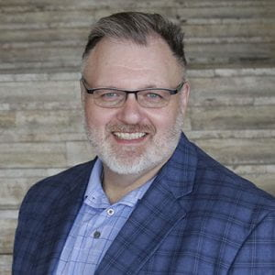
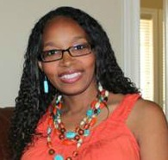
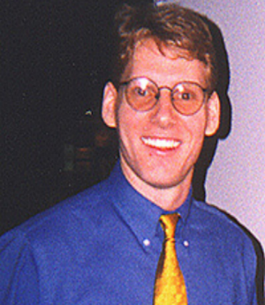
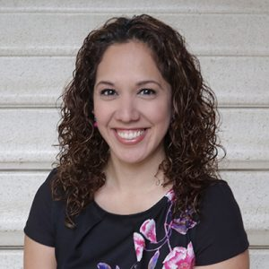
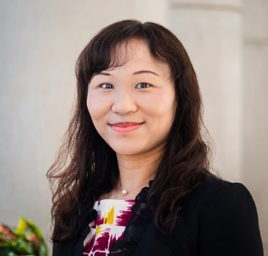
Introductions - Project ¡LEER! Staff
Dr. Mack D. Burke, Director, Baylor University
Dr. Lisa Bowman-Perrott, Co-Director, Texas A&M University
Dr. Richard Boon, Co-Director, The University of Texas at San Antonio
Dr. Kristen L. Padilla, Co-Principal Investigator, Baylor University
Dr. Fuhui Tong, Co-Principal Investigator, Texas A&M University
Ms. Virginia Reynolds, Project Coordinator, Baylor University

Slide 6
About Project ¡LEER!
Project ¡LEER! stands for:
Literacy, Language, and Social-Emotional Support for English Learners with and Without Disabilities in Inclusive Settings to Improve Reading Outcomes
Project ¡LEER! will develop and provide:
Multi-tiered Systems of Support (MTSS)
ClassWide Peer Tutoring
Professional development to improve the reading outcomes of English learners with and without disabilities in grades K-12
5 Years (2021-2026)
Funded by the U.S. Department of Education, Office of English Language Acquisition

Slide 7
Statistics,
Multi-tiered Systems of Support (MTSS),
&
MTSS for English Learners

Slide 8
Statement of the Problem (National)
Today, in the United States, a growing and ever-increasing number of English learners (ELs), are enrolled in our nation’s schools.
In fact, according to recent national data, ELs comprise 10.2% (about 5 million) of the student population in the public schools (National Center for Education Statistics, 2021).
Majority (76.5%) of these students speak Spanish/Castilian as their first and home language (Snyder et al., 2016).
Unfortunately, ELs, either due to a deficient language knowledge or poor learning skills (Goldenberg, 2011), often experience academic difficulties in the classroom, especially in the area of reading (Klingner, Artiles, & Barletta, 2006; Swanson, Orosco, Lussier, Gerber, & Guzman-Orth, 2011).
Reading (At or Above Proficient Level)
Grade 4 39%; 8 37%; 12 40% (Typically Achieving)
Grade 4 12%; 8 9%; 12 13% (Disabilities)
Grade 4 10%; 8 4%; 12 3% (ELs)
Mathematics
Grade 4 41%; 8 34%; 12 24% (Typically Achieving)
Grade 4 17%; 8 9%; 12 7% (Disabilities)
Grade 4 16%; 8 5%; 12 3% (ELs)
(NAEP, 2019)
https://www.nationsreportcard.gov/focus_on_naep/

Slide 9
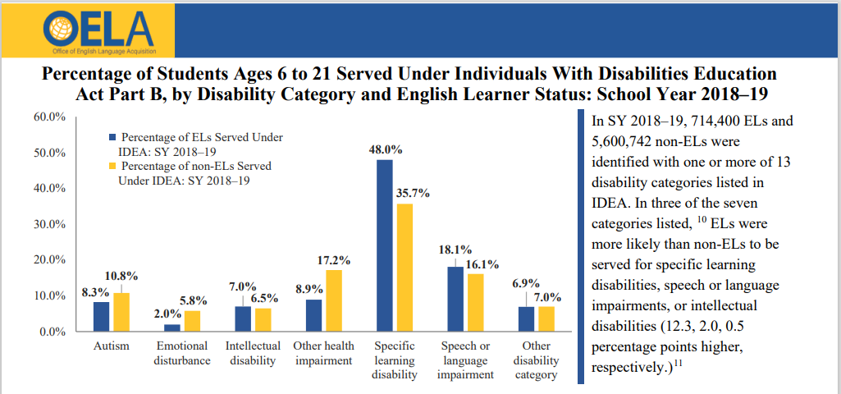
Statement of the Problem (Continued)
As a result of poor academic achievement, ELs are often referred to special education (Solari, Petscher, & Folsom, 2014).
When referred to special education, ELs are most commonly identified with a learning disability (LD; Peña, Bedore, & Gillam, 2011) and struggle in the area of reading instruction (García & Tyler, 2010; Snow, Burns, & Griffin, 1998).
Even though ELs with LD are often challenged by reading, there remains limited research related to literacy instruction and ELs with disabilities (Klingner et al., 2006).
Thus, it is important that both general and special education teachers provide effective, evidence-based practices to support ELs with LD in the inclusive classroom.
(Office of English Language Acquisition, 2021)

Slide 10
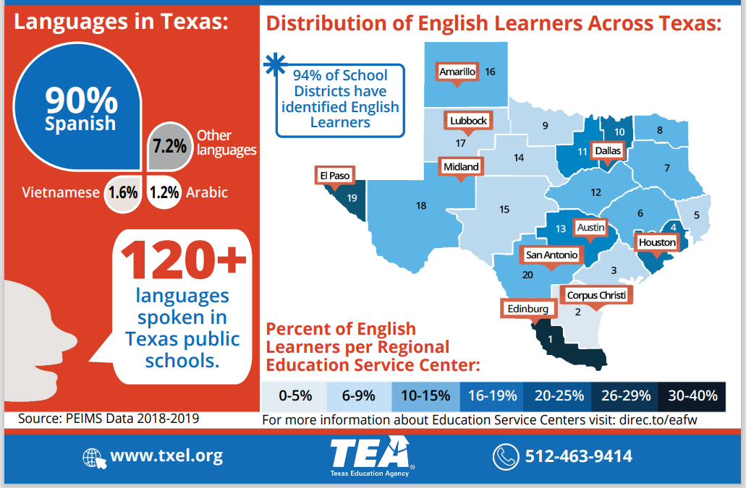
Statement of the Problem (Texas)
(Texas Education Agency [PEIMS Data], 2019)
Public Education Information Management System (PEIMS)

Slide 11
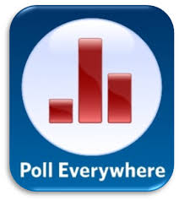
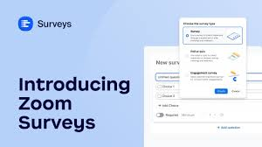
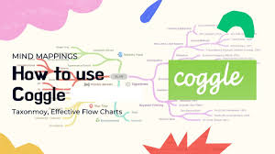
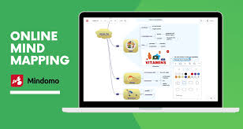
Collaborative Learning Tools
Chat: Discuss material one-on-one, respond to a follow-up question, or provide clarification during the session.
Raise Hand: Ask probing questioning to ensure learning.
Polls: Use as an ice-breaker to get to know everyone in the session. (e.g., What grade level and population of students do you serve?) (e.g., PollEverywhere or Mentimeter)
Surveys: Active prior knowledge of the material to be discussed. (e.g., What do you know about MTSS?)
Breakout Rooms: Provide small group instruction and then provide an opportunity to share-out to the larger group.
Google docs: Notetaking, brainstorming, or for working on a draft with partner.
Padlet: can be used for discussion questions, posting pictures, etc. Can even be used for a KWL chart.
Coggle or Mindomo: A tool used to create a mind map to help learners make connections of the content.

Slide 12
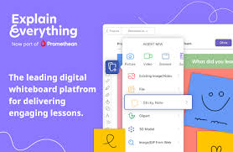
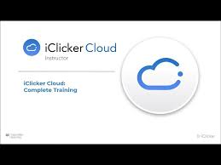
Collaborative Learning Tools (Continued)
Flipgrid: Record, edit, and share videos.
Pear Deck: Google slides add-on adds questions, games etc. to slides.
Nearpod: Create and build engaging lessons has polls, games, collaborative boards built in.
Explain Everything Whiteboard: Import existing presentations or create a new one. Also, you can create collaborative projects and interactions.
Google Jamboard: Interactive white board compatible with most Google products.
iClicker: Initiates a discussion, probes for learning, and fosters engagement during the lesson.
Quizizz or Kahoot: Pre-posttest learners knowledge before, during, and after the session.

Slide 13
Collaborative Learning Tools (Continued)
Baylor?
TAMU?

Slide 14
Thank You!
Questions?

Slide 15
Contact Information
Dr. Mack D. Burke, Director
Baylor University
mack_burke@baylor.edu
Dr. Lisa Bowman-Perrott, Co-Director
Texas A&M University
lbperrott@tamu.edu
Dr. Richard Boon, Co-Director
The University of Texas at San Antonio
richard.boon@utsa.edu

