Slide 1



Engaging Educators Through Virtual Professional Development Workshops
DRAFT 5-7-24 2:36 PM
Project Amplify
Working Group Meeting
May 8, 2024
12:00-1:00 pm CDT

Slide 2
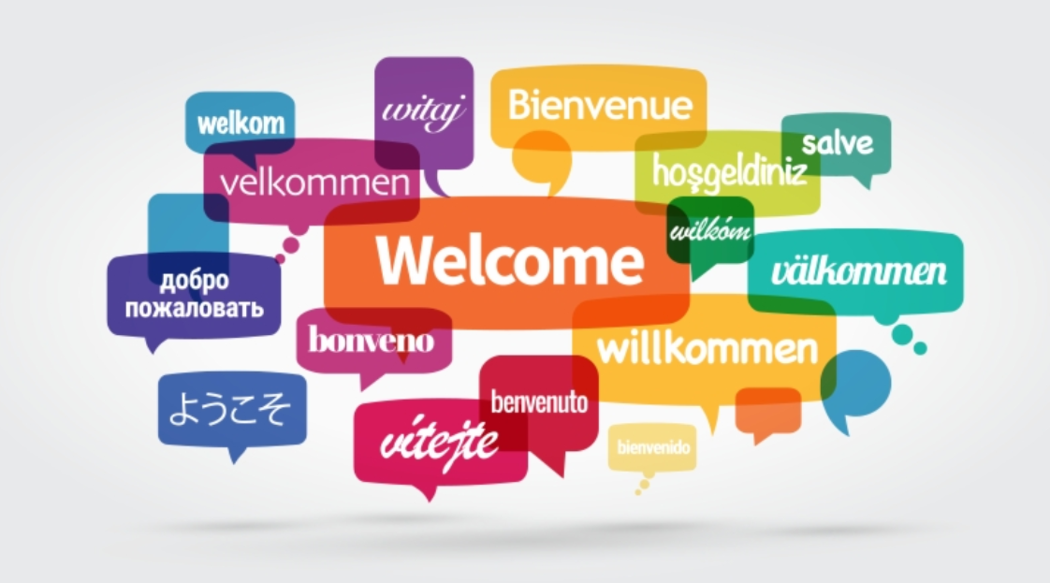
Welcome!

Slide 3
Purpose
The aim of this working group session is to:
(a) Provide an overview of Project ¡LEER!, with specific focus on proving professional development to our district partnerships;
(b) Discuss current challenges (barriers) to proving virtual professional development;
(c) Discuss effective strategies to improve communication, collaboration, and engagement of virtual professional development workshops for educators; and
(c) Identify resources to bolster learning outcomes.

Slide 4

Agenda
12:00-12:05 Introductions
12:05-12:15 About Project ¡LEER!
12:15-12:25 Project ¡LEER! professional development
12:25-12:35 Discuss effective strategies and challenges to providing virtual professional development (Small group - Breakout Session)
12:35-12:55 Share ideas from small groups (Large group)
12:55-1:00 Provide resources to bolster learning outcomes

Slide 5
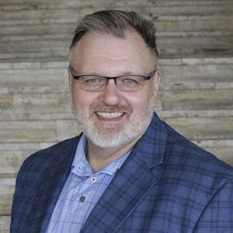
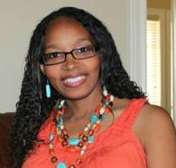
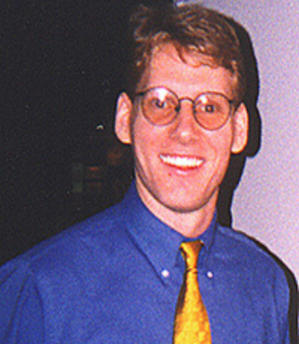
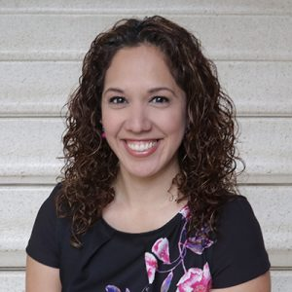
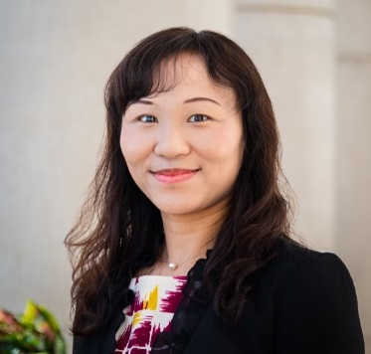

Introductions - Project ¡LEER! Staff
Dr. Mack D. Burke, Director, Baylor University
Dr. Lisa Bowman-Perrott, Co-Director, Texas A&M University
Dr. Richard Boon, Co-Director, The University of Texas at San Antonio
Dr. Kristen L. Padilla, Co-Principal Investigator, Baylor University
Dr. Fuhui Tong, Co-Principal Investigator, Texas A&M University
Ms. Virginia Reynolds, Project Coordinator, Baylor University

Slide 6


About Project ¡LEER!
Project ¡LEER! stands for:
Literacy, Language, and Social-Emotional Support for English Learners with and Without Disabilities in Inclusive Settings to Improve Reading Outcomes
Project ¡LEER! will develop and provide:
    Multi-tiered Systems of Support (MTSS)
    ClassWide Peer Tutoring
    Professional development (PD) to improve the reading outcomes of English learners with and without disabilities in grades K-12
5 Years (2021-2026)
Funded by the U.S. Department of Education, Office of English Language Acquisition

Slide 7
Project ¡LEER! Logic Model

Slide 8


Statement of the Problem (National)
Today, in the United States, a growing and ever-increasing number of English learners (ELs), are enrolled in our nation’s schools.
In fact, according to recent national data, ELs comprise 10.2% (about 5 million) of the student population in the public schools (National Center for Education Statistics, 2021).
Majority (76.5%) of these students speak Spanish/Castilian as their first and home language (Snyder et al., 2016).
Unfortunately, ELs, either due to a deficient language knowledge or poor learning skills (Goldenberg, 2011), often experience academic difficulties in the classroom, especially in the area of reading (Klingner, Artiles, & Barletta, 2006; Swanson, Orosco, Lussier, Gerber, & Guzman-Orth, 2011).
Reading (At or Above Proficient Level)
Grade 4 39%; 8 37%; 12 40% (Typically Achieving)
Grade 4 12%; 8 9%; 12 13% (Disabilities)
Grade 4 10%; 8 4%; 12 3% (ELs)
Mathematics
Grade 4 41%; 8 34%; 12 24% (Typically Achieving)
Grade 4 17%; 8 9%; 12 7% (Disabilities)
Grade 4 16%; 8 5%; 12 3% (ELs)
(NAEP, 2019)
https://www.nationsreportcard.gov/focus_on_naep/

Slide 9
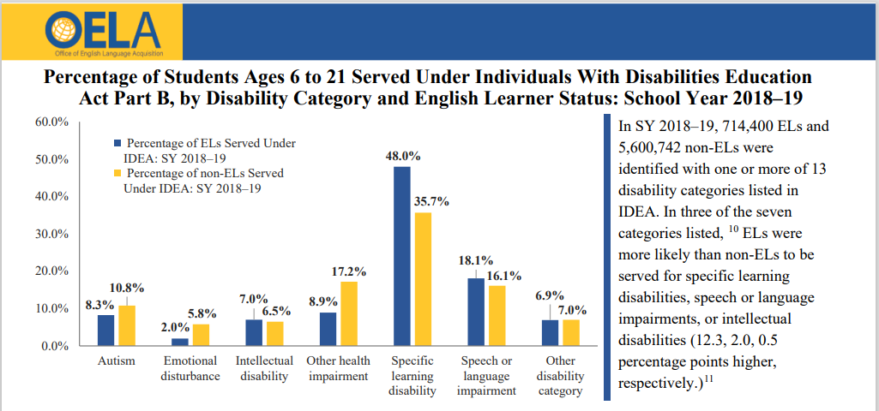
Statement of the Problem (Continued)
As a result of poor academic achievement, ELs are often referred to special education (Solari, Petscher, & Folsom, 2014).
When referred to special education, ELs are most commonly identified with a learning disability (LD; Peña, Bedore, & Gillam, 2011) and struggle in the area of reading instruction (García & Tyler, 2010; Snow, Burns, & Griffin, 1998).
Even though ELs with LD are often challenged by reading, there remains limited research related to literacy instruction and ELs with disabilities (Klingner et al., 2006).
Thus, it is important that both general and special education teachers provide effective, evidence-based practices to support ELs with LD in the inclusive classroom.
(Office of English Language Acquisition, 2021)

Slide 10
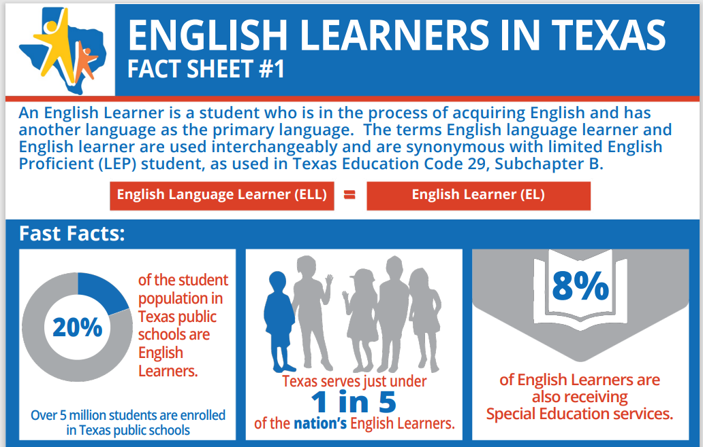
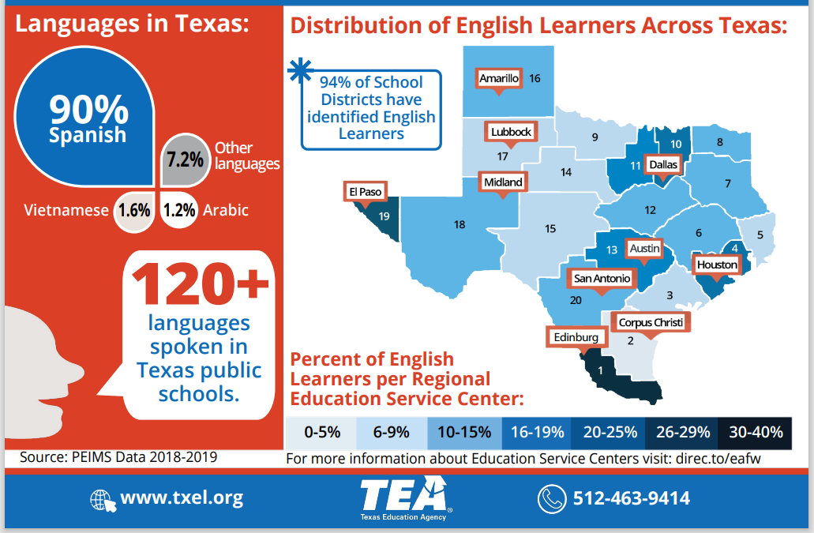
Statement of the Problem (Texas)
(Texas Education Agency [PEIMS Data], 2019)
Public Education Information Management System (PEIMS)

Slide 11
Have you engaged in virtual professional development as part of your OELA grant?
https://www.polleverywhere.com/multiple_choice_polls/swE3KlNzsurcjmM80a7ih?preview=true&controls=none

Slide 12
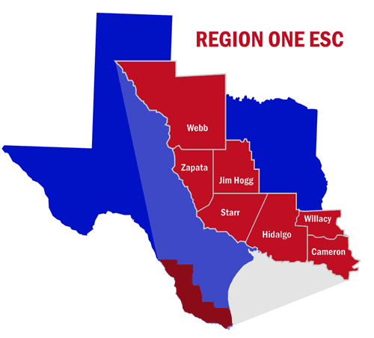
Project LEER Professional Development:
In-Service Teachers
Region One (primarily)
  Serves more than 439,000 K-12 students across 38 school districts and 10 charter schools in 8 counties
    More than 160,000 emergent bilinguals (EBs)
  Collaborate with the Region One Director of Special Education Programs, Special Education Specialists, and Bilingual Education Directors
  General and special education teachers, bilingual education teachers

Slide 13

Project ¡LEER! Professional Development: In-Service Teachers
Region One (continued)
    We provide virtual professional development by request
    In-person professional development sessions
      Special Education Directors’ Meeting (Edinberg, TX)
        Includes administrators, school psychologists, bilingual/English as a second language facilitators, educational diagnosticians, social workers
  Topics include:
    Evidence-based academic interventions (literacy)
    Behavioral supports
    Stages of second language acquisition
    Native language support
    Emergent bilingual characteristics
    Second language acquisition vs. learning disability

Slide 14



Project ¡LEER! Professional Development: In-Service Teachers
San Antonio ISD
  University High School
    Special and general education teachers
Northside ISD
  Marshall High School
    Special and general education teachers
New Caney ISD
  Multilingual Coaches and MTSS Specialists
    Through Texas A&M

Slide 15

Project ¡LEER! Professional Development: In-Service Teachers
Baylor University
  In conjunction with the Baylor Center for Developmental Disabilities
    General and special education teachers
    Head Start teachers

Slide 16

Project ¡LEER! Professional Development:
Pre-Service Teachers
UTSA
  Undergraduate students enrolled in special education course (Introduction to Special Education)
    Required (most)
    Elective
    Majors include:
      Education (e.g., early childhood – 6th grade endorsement with English as a second language certification)
      Special education
      Psychology
      Kinesiology
      Art
      Biomedical engineering

Slide 17
Project ¡LEER! Professional Development: Pre-Service Teachers
UTSA (continued)
  Undergraduate students enrolled in special education course (Introduction to Special Education)
    Career goals include:
      Bilingual teacher
      Pre-k through 3rd grade teacher
      Psychologist
      High school teacher and football coach
    Some had classroom experience

Slide 18
Virtual Professional Development Challenges
Barriers include:
Technological glitches
Participants with cameras off
Non-responses

Slide 19
Questions for Your Breakout Groups
In what ways have you engaged participants in virtual professional development activities?
https://padlet.com/embed/jxw84p01lp38o9xj
What barriers to engagement have you experienced?
(please use the chat)

Slide 20
Ideas From Your Breakout Groups
https://PollEv.com/multiple_choice_polls/NB7YTgnUVKaLKBf2JCSPx/respond

Slide 21
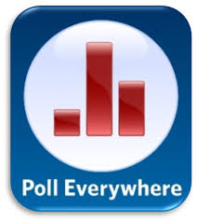
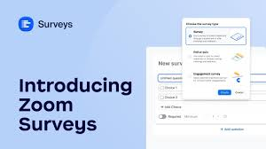


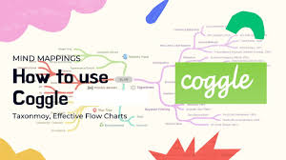
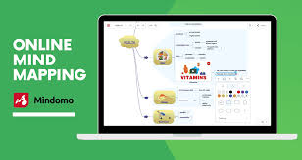
Collaborative Learning Tools
Chat: Discuss material one-on-one, respond to a follow-up question, or provide clarification during the session.
Raise Hand: Ask probing questioning to ensure learning.
Polls: Use as an ice-breaker to get to know everyone in the session. (e.g., What grade level and population of students do you serve?) (e.g., PollEverywhere or Mentimeter)
Surveys: Active prior knowledge of the material to be discussed. (e.g., What do you know about MTSS?)
Breakout Rooms: Provide small group instruction and then provide an opportunity to share-out to the larger group.
Google docs: Notetaking, brainstorming, or for working on a draft with partner.
Padlet: can be used for discussion questions, posting pictures, etc. Can even be used for a KWL chart.
Coggle or Mindomo: A tool used to create a mind map to help learners make connections of the content.

Slide 22


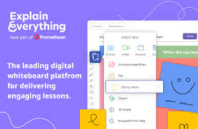

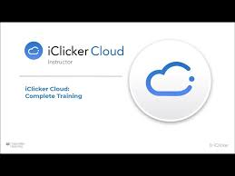

Collaborative Learning Tools (Continued)
Flipgrid: Record, edit, and share videos.
Pear Deck: Google slides add-on adds questions, games etc. to slides.
Nearpod: Create and build engaging lessons has polls, games, collaborative boards built in.
Explain Everything Whiteboard: Import existing presentations or create a new one. Also, you can create collaborative projects and interactions.
Google Jamboard: Interactive white board compatible with most Google products.
iClicker: Initiates a discussion, probes for learning, and fosters engagement during the lesson.
Quizizz or Kahoot: Pre-posttest learners knowledge before, during, and after the session.

Slide 23

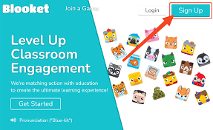

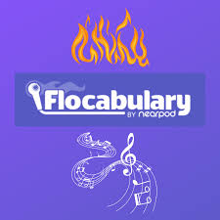
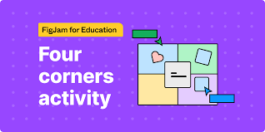
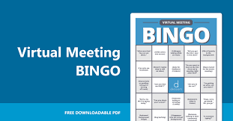
Collaborative Learning Tools (Continued)
Gimkit: A dynamic game show that challenges players to combine their knowledge, teamwork, and strategic thinking.
Blooket: An interactive learning platform that incentivizes quiz completion with engaging sub-games, catering to both collaborative group play and individual study sessions.
Google Forms: A versatile tool allowing educators to design quizzes where students must master each question before progressing, ensuring thorough understanding and engagement.
Flocabulary: A comprehensive learning platform that offers engaging activities tailored to enhance academic vocabulary and comprehension, delivering rigorous yet captivating educational experiences.
Four corners: An interactive classroom activity prompting students to physically navigate to different corners of the room in response to various questions, fostering movement and engagement.
Bingo: A classic game reimagined for education, prompting students to answer questions competitively, adding an element of excitement and challenge to learning.

Slide 24
Exit Ticket
Celeste’s Quiz
Dr. Boon, please add the link. Thanks!

Slide 25

Thank You!

Slide 26
Contact Information
Dr. Mack D. Burke, Director
Baylor University
mack_burke@baylor.edu
Dr. Lisa Bowman-Perrott, Co-Director
Texas A&M University
lbperrott@tamu.edu
Dr. Richard Boon, Co-Director
The University of Texas at San Antonio
richard.boon@utsa.edu

