Slide 1


Connecting with Your
Emergent Bilinguals:
Tips for Your Teacher Toolbox
Project LEER Professional Development Series
Part I
University High School
Waco, TX
March 1, 2024

Slide 2
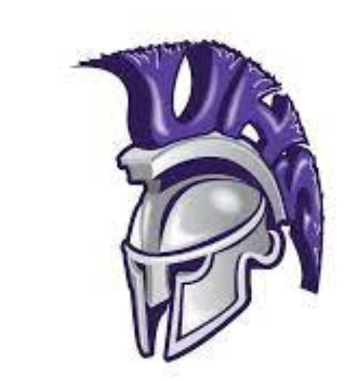
Agenda
Introductions
About Project ¡LEER!
Terminology, Characteristics, and Cultural Considerations
Tips to Aid Instruction
Future Workshops (Part II and Part III)
Questions

Slide 3
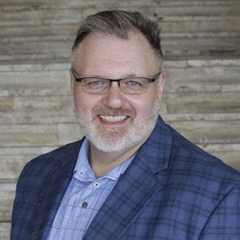
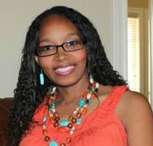
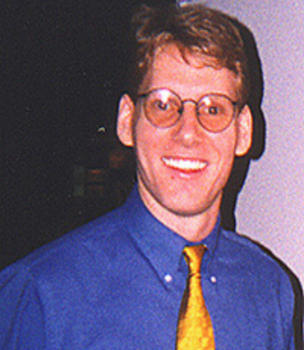
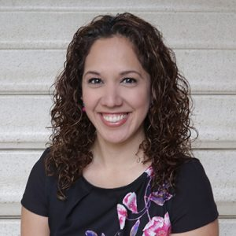
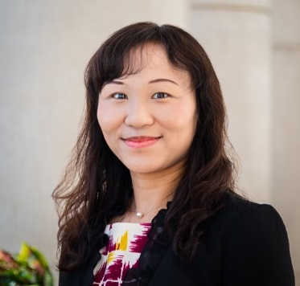

Introductions - Project ¡LEER! Staff
Dr. Mack D. Burke, Director, Baylor University
Dr. Lisa Bowman-Perrott, Co-Director, Texas A&M University
Dr. Richard Boon, Co-Director, The University of Texas at San Antonio
Dr. Kristen L. Padilla, Co-Principal Investigator, Baylor University
Dr. Fuhui Tong, Co-Principal Investigator, Texas A&M University
Mrs. Virginia Reynolds, Project Coordinator, Baylor University

Slide 4


About Project ¡LEER!
LEER stands for:
Literacy, Language, and Social-Emotional Support for English Learners with and without Disabilities in Inclusive Settings to Improve Reading Outcomes
Project ¡LEER! will develop and provide:
    Multi-tiered Systems of Support (MTSS)
    ClassWide Peer Tutoring
    Professional Development to improve the reading outcomes of English learners (ELs) with and without disabilities in grades K-12
5 Years (2021-2026)
Funded by the U.S. Department of Education, Office of English Language Acquisition

Slide 5
Terminology, Characteristics, and Cultural Considerations

Slide 6
Terminology
LEP
Limited English Proficient
EL
English learner
ELL
English language learner
EB
Emergent bilingual

Slide 7
Common Bilingual Terms and Acronyms
Students’ first language
  Referred to as…
    Native language
    Heritage language
    Ancestral language
    Home language
    L1
Students’ second language
  Referred to as…
    L2

Slide 8
Emergent Bilingual (EB) Differences
Native language
Literacy in native language
Culture
Educational background
Socioeconomic status
Prior schooling
Age began attending U.S. schools
Life experiences
View of education

Slide 9
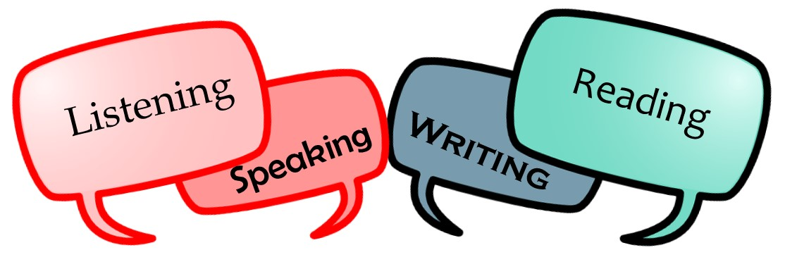
Emergent Bilinguals
English language proficiency
  Speaking, reading, writing, listening
Heterogeneous group
  (e.g., linguistically (including native language proficiency) and academically)
EBs often face the dual challenge of learning a new language while they are expected to perform in content areas

Slide 10
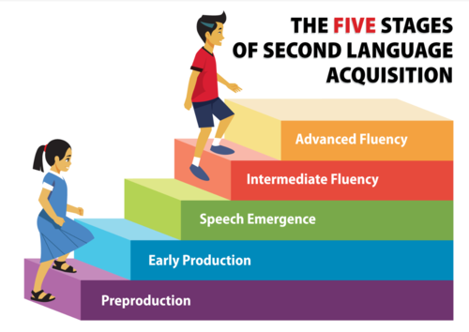
Source: Quizlet

Slide 11
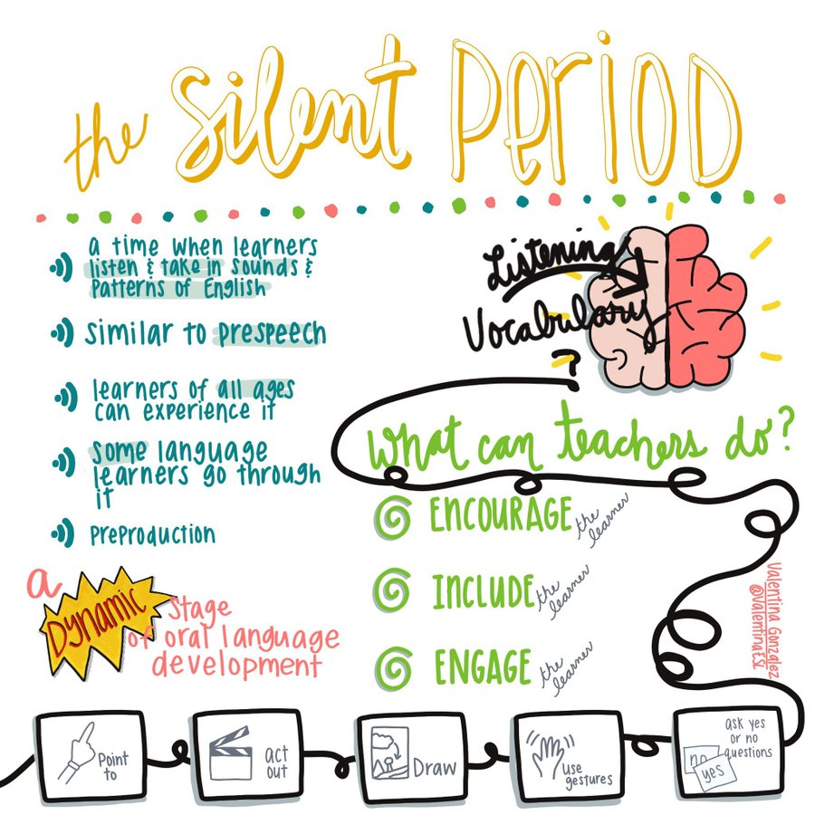
Source: Lisa Ali-Turner
Something to Remember…

Slide 12
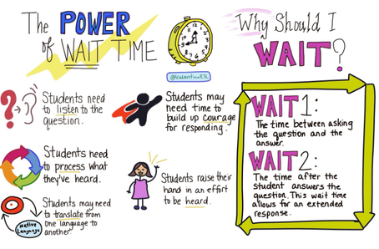
Another Recommendation…

Slide 13
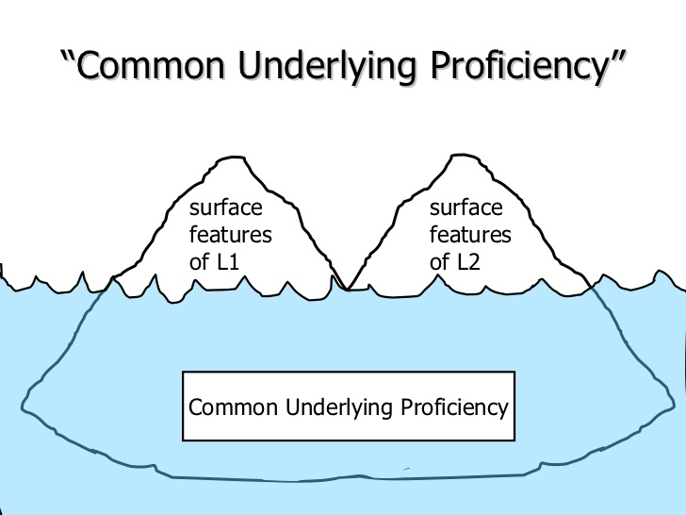
Common Underlying Proficiency (CUP)
Instruction in L1 will benefit the student in acquiring competency in L2
Literacy knowledge transfers across languages

Slide 14
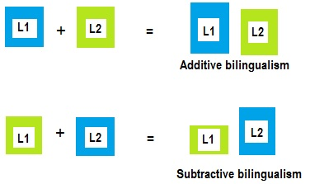
More Terminology
Additive bilingualism=>Learning L2 while maintaining L1
Subtractive bilingualism=>Learning L2 at the expense of L1

Slide 15
BICS
Basic Interpersonal Communication Skills (BICS)
  Social language
    Communication used daily in routine communicative exchanges (e.g., while dressing, eating, playing, etc.).
  Not cognitively demanding
  Social conversation with gestures
    Storytelling
    Social phone call
  Many agree that it takes 1-3 years to acquire

Slide 16
CALP
Cognitive Academic Language Proficiency (CALP)
  Academic language
    Use information acquired to make inferences and draw conclusions
  Cognitively demanding
    Math lesson (with manipulatives)
    Geography lesson with maps
    Multiple choice test
  Many agree that it takes 5-7 years to acquire

Slide 17
Affective Filter
A barrier that prevents students from learning language
  A screen of emotion that can block language acquisition or learning.
  Blocks occur when EBs are too self-conscious or embarrassed to take risks when learning.
Even with quality instruction, a student’s feelings and emotional states (e.g., high anxiety, low motivation, low self-confidence) interferes with second language acquisition and content learning.
When it “turns on,” it doesn’t allow the EB to receive what you’re teaching.

Slide 18
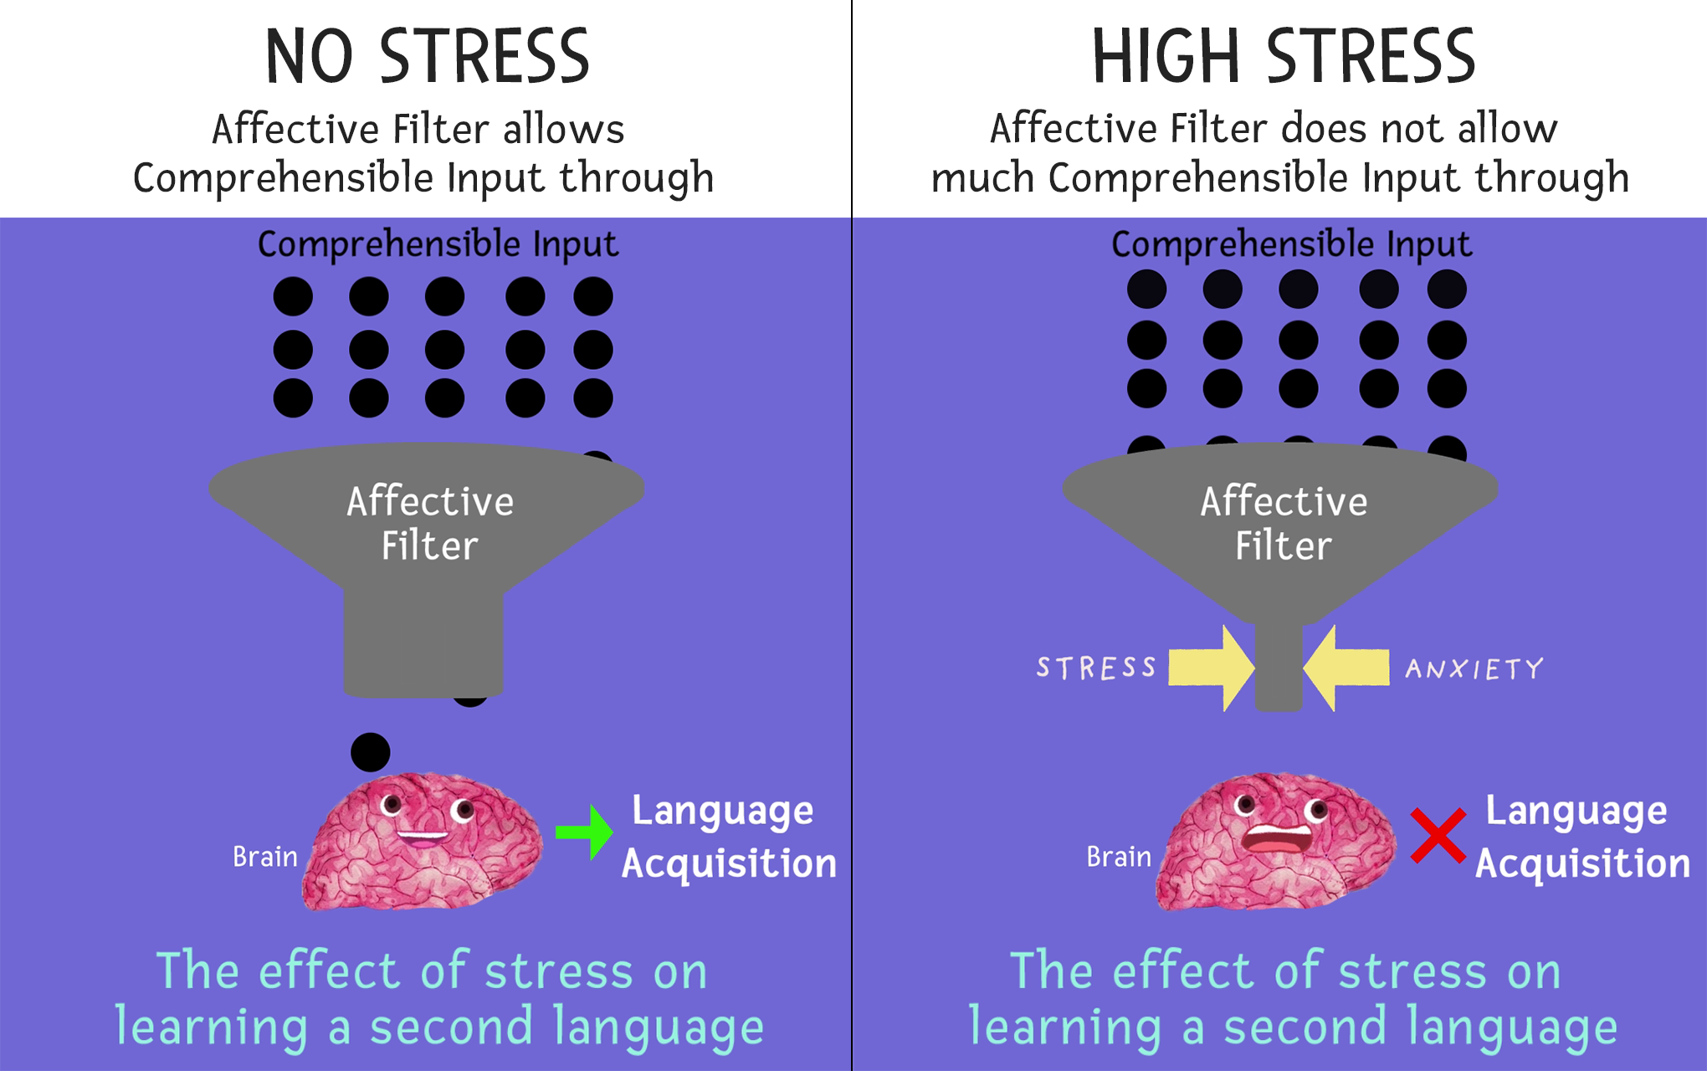
Affective Filter

Slide 19
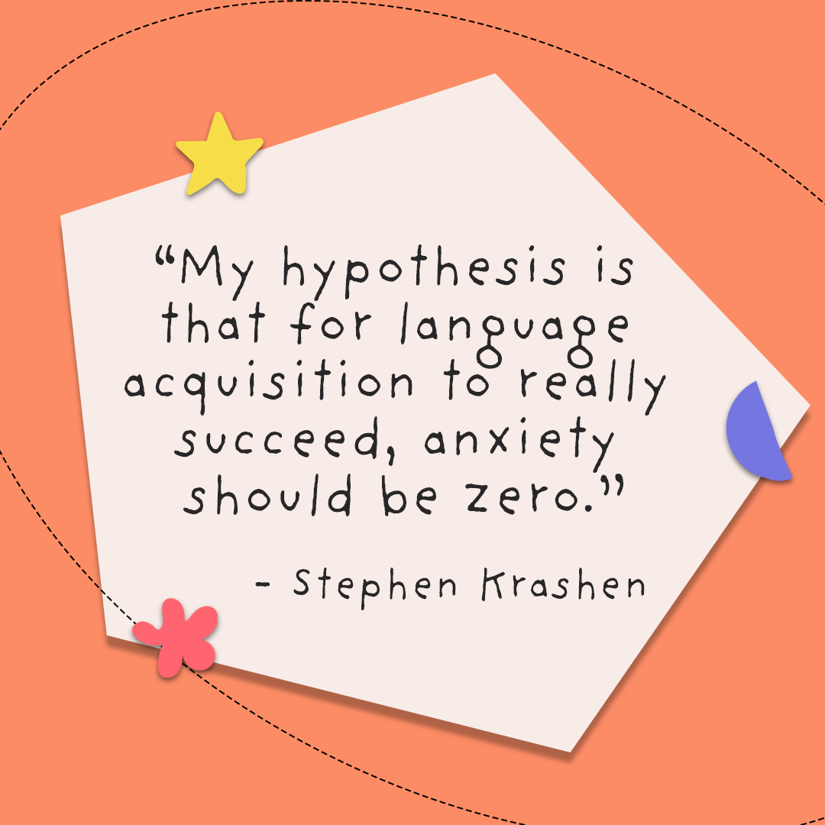
How Can I Lower My EBs’ Affective Filter?
Provide clear directions/expectations
Scaffold instruction
Provide language supports (including peers)
Set individual goals – celebrate them
Use (and extend) word walls
Use sentence starters
Connect the content to something that is relevant to them
Build confidence by using/incorporating words they already know

Slide 20
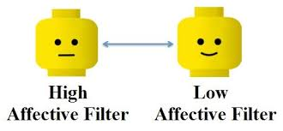
How Can I Lower My EBs’ Affective Filter?
Encourage them when they make mistakes – appreciate their effort
Provide multiple opportunities for EBs to participate
Growth mindset
Foster and encourage a sense of community
Consider using student interactions, music/songs/rhymes, and videos
Smile
Be patient with yourself

Slide 21
Culture Shock
Feeling uncertain, anxious, confused, and/or disoriented when in a new country or new surroundings.
  Not understanding school or classroom norms.
  Being perceived as rude (e.g., not making eye contact).
  Having difficulty communicating.
  Difficulty adjusting to new foods/eating routines.

Slide 22
Culture Shock
Our EBs may…
  feel frustrated, angry, hostile, sad, lonely, and/or homesick
  develop physical ailments such as stomach aches and headaches
  feel devastated by the emotional upheaval caused by moving to a new culture
  exhibit behavior such as depression or sleeplessness
  become overly aggressive or withdrawn
Each of these could result in a higher affective filter.
  This leads to a slower rate of second language acquisition.

Slide 23
Cognates
Words in two languages that share a similar meaning, spelling, and pronunciation.

Slide 24
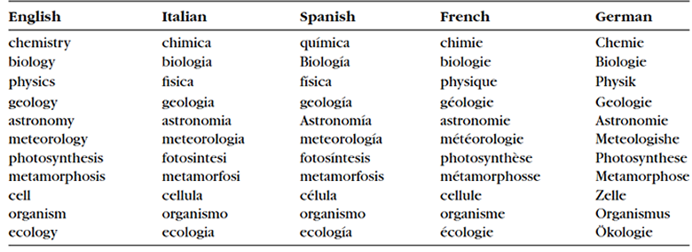
Cognate Examples

Slide 25
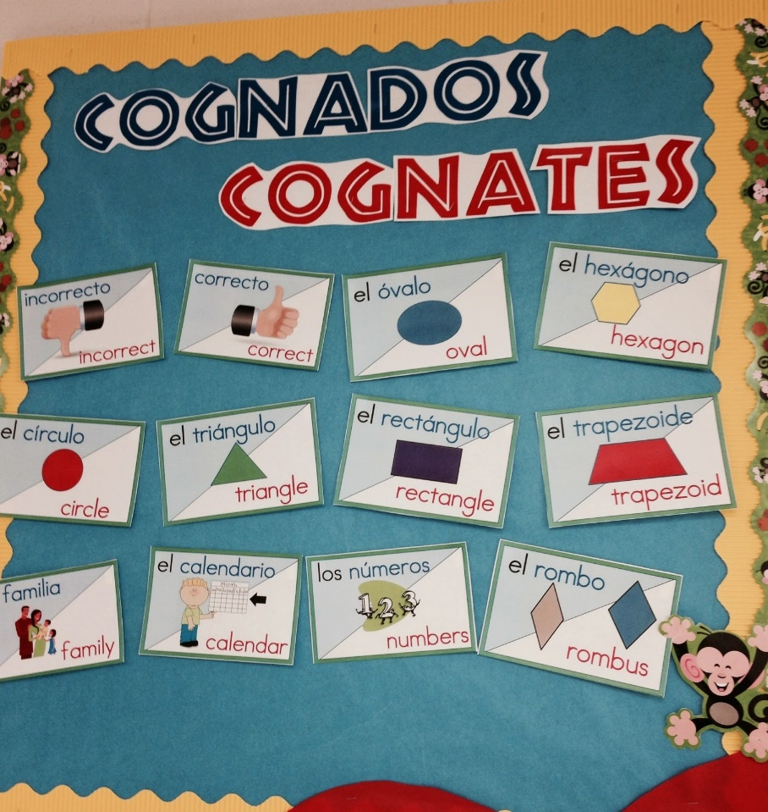
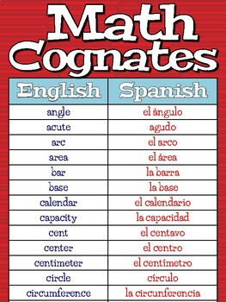
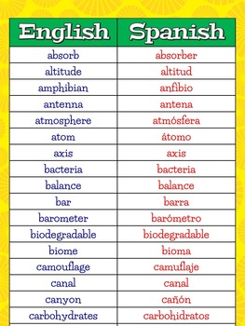
Content Area Cognates

Slide 26
More Cultural Considerations

Slide 27
Culture is Multi-faceted
Some aspect of students’ cultures are not readily visible. The iceberg graphic on the next slide illustrates this.
Getting to the know our students, their families, and possibly their communities can help better understand and teach them.

Slide 28
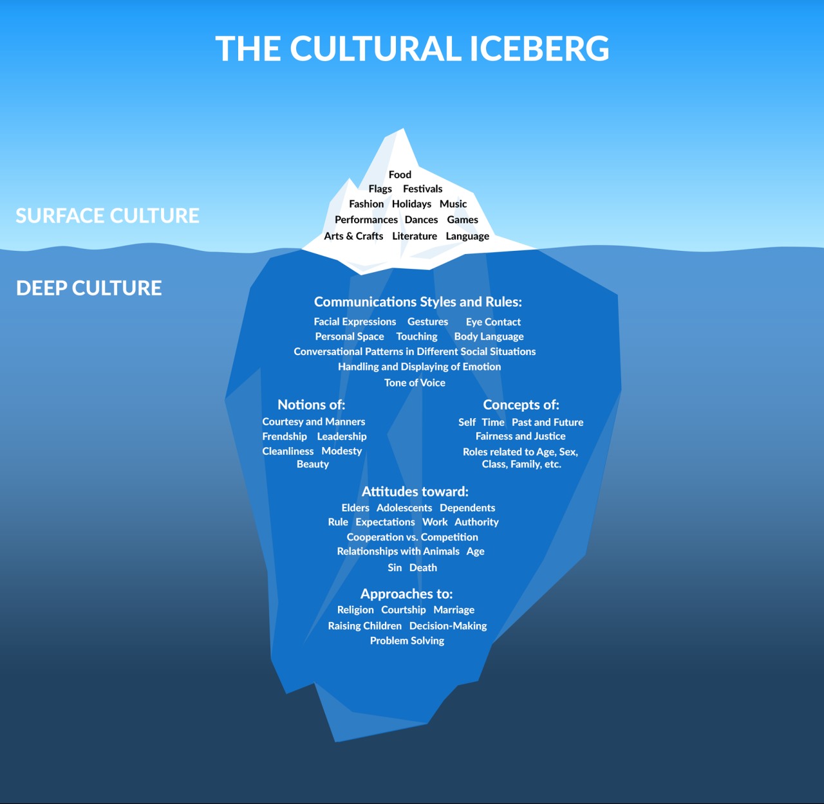

Slide 29
Tips to Aid Instruction

Slide 30
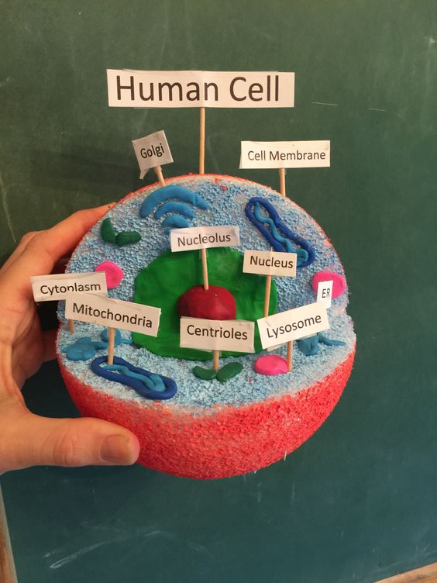
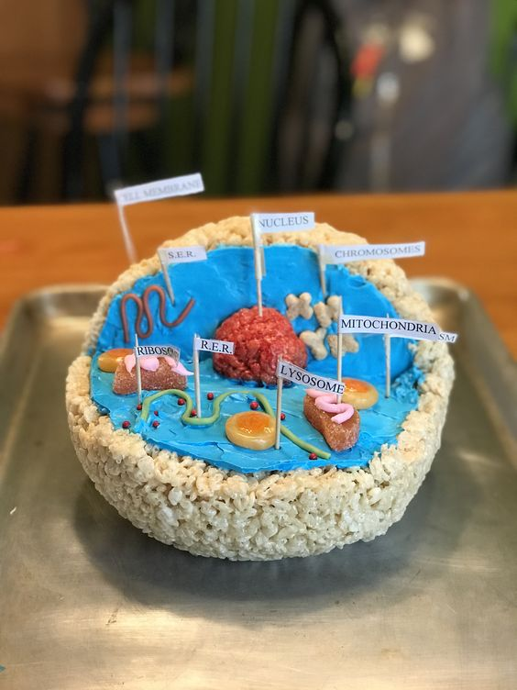
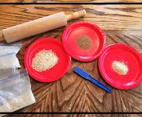
Encourage Active Learning
Visuals
Hands-on activities

Slide 31
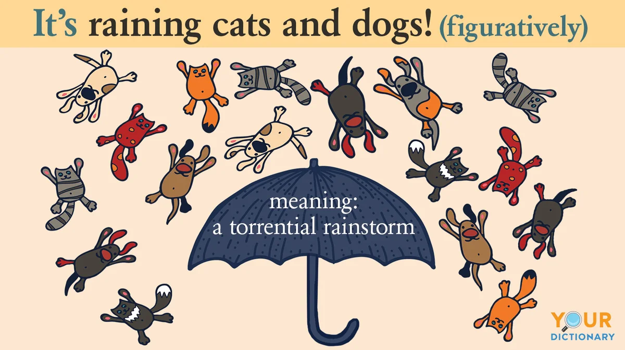
Minimize or Exclude the Use of Idioms

Slide 32
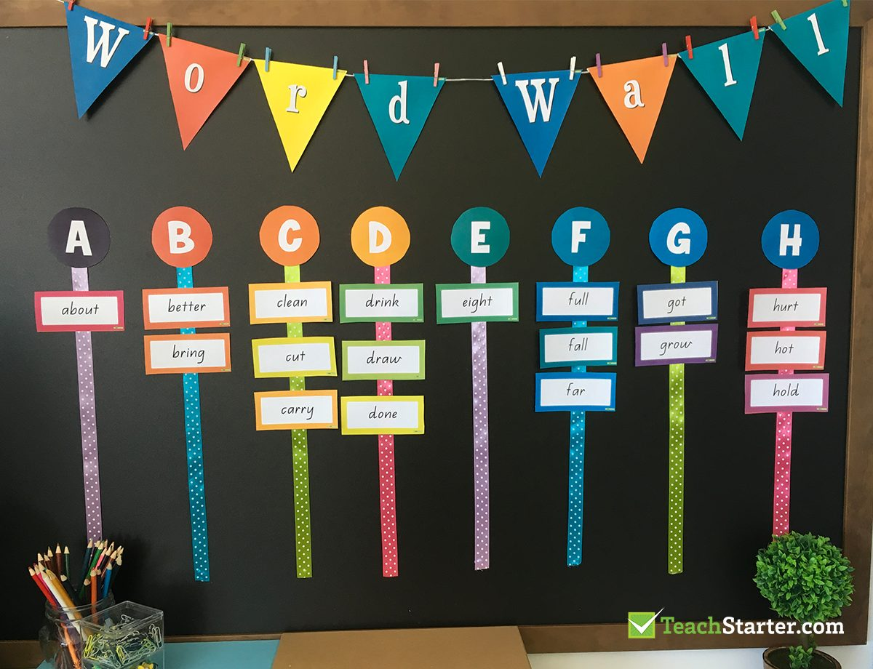
Word Wall

Slide 33
Extend the Use of Word Walls
You can ask your students to:
  Categorize the words by:
    Parts of speech
    Subject area
    Words that rhyme
    Words with multiple meanings
You can also have students write or rewrite a sentence or paragraph with words from the word wall (e.g., adjectives).
Students can:
  Keep a notebook of “word wall words” to review and study at home
  Draw or act out words
  Unscramble words

Slide 34

Thank You!
Questions?

Slide 35
Contact Information
Dr. Mack D. Burke, Director
Baylor University
mack_burke@baylor.edu
Dr. Lisa Bowman-Perrott, Co-Director
Texas A&M University
lbperrott@tamu.edu
Dr. Richard Boon, Co-Director
The University of Texas at San Antonio
richard.boon@utsa.edu

