Slide 1
CLASSWIDE PEER TUTORING (Cwpt)
Project LEER
Spring 2024

Slide 2
General Peer Tutoring Procedures
Game format
2 points (correct answer)
1 point (correct answer with error correction)
Say and write the word/answer three times
Teams (optional)
Students have partners
Tutor (teacher)
Follows along, helps with errors, gives points
Tutee (student)
Practices content, answers questions, uses the error correction procedure
Equal amount of time in each role (timer)

Slide 3
General Peer Tutoring Procedures
The ClassWide Peer Tutoring (CWPT) model uses a game format:
2 points (correct answer)
1 point (correct answer with error correction)
Error correction procedure = practice the correct answer three times
It may sound or feel funny to spell out loud 3 times, but (as I tell students) everyone will be doing it AND it will help you learn the vocabulary/content.

Slide 5
You can earn up to 300 points in each peer tutoring session. So, keep spelling until the timer goes off.

Slide 6
You can keep track of the number of times you go through the spelling list here.

Slide 7
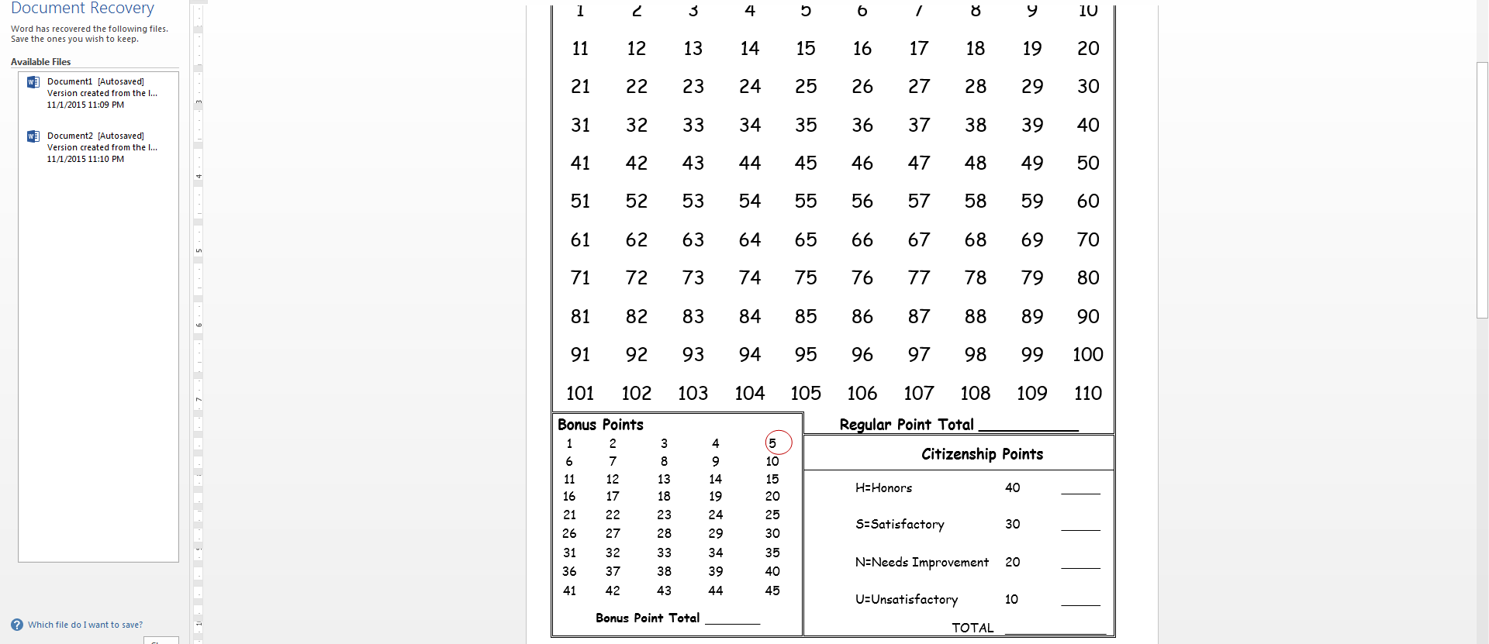
Only the teacher can give bonus points (for correctly awarding points, working well with your peer partner, and staying on-task).

Slide 8
After both of you have tutored, you will award each other points for citizenship—how well you worked together.

Slide 9
Citizenship Points
Part of class-wide self-management (CWSM)
Students earn citizenship points from their peer based on:
How well they worked with their partner
How well they followed tutoring procedures
Discuss what citizenship is:
Give examples and non-examples
Role plays with volunteers

Slide 10
Citizenship Points
Citizenship points
40=“Honors” (follow all classroom and CWPT rules)
30=“Satisfactory” (minor infraction)
20=“Needs Improvement” (spoken to several times)
10=“Unsatisfactory” (inappropriate behavior)

Slide 11
Sample CWPT Week: EXAMPLE 1
Monday: Mrs. Ramsey will give the pretest and introduce new material.
Tuesday: Day 1 of CWPT
Vocabulary review with teacher-selected content area vocabulary words (5 minutes) and study guides (8 minutes)
Wednesday: Day 2 of CWPT
Vocabulary review with teacher-selected content area vocabulary words (5 minutes) and comprehension questions (8 minutes)
Thursday: Day 3 of CWPT
Vocabulary review with teacher-selected content area vocabulary words (5 minutes) and review study guides (8 minutes), which included a review of vocabulary and comprehension questions
Friday: Mrs. Ramsey gave the posttest

Slide 12
Sample CWPT Week: EXAMPLE 2
Monday: Mrs. Ramsey will give the pretest and introduce new material.
Tuesday: Day 1 of CWPT
Vocabulary review with teacher-selected content area vocabulary words (5 minutes) and study guides (8 minutes)
Wednesday: Day 2 of CWPT
Vocabulary review with teacher-selected content area vocabulary words (5 minutes) and comprehension questions (8 minutes)
Thursday: Day 3 of CWPT
Vocabulary review with teacher-selected content area vocabulary words (5 minutes) and comprehension questions (8 minutes)
Friday: Day 4 of CWPT
Vocabulary review with teacher-selected content area vocabulary words (5 minutes) and review study guides (8 minutes), which included a review of vocabulary and comprehension questions
Mrs. Ramsey gave the posttest

Slide 13
PROPOSED MATERIALS (MARSHALL HIGH SCHOOL)

