Slide 1
ROUGH DRAFT – TITLE SLIDE HELP NEEDED Teaching Emergent Bilinguals Project LEER Professional Development Workshop
Highland High School
March 1, 2024

Slide 2
About Project ¡LEER!
LEER stands for:
Literacy, Language, and Social-Emotional Support for English Learners with and without Disabilities in Inclusive Settings to Improve Reading Outcomes
Project ¡LEER! will develop and provide:
Multi-tiered Systems of Support (MTSS)
ClassWide Peer Tutoring
Professional Development to improve the reading outcomes of English learners (ELs) with and without disabilities in grades K-12
5 Years (2021-2026)
Funded by the U.S. Department of Education, Office of English Language Acquisition

Slide 3
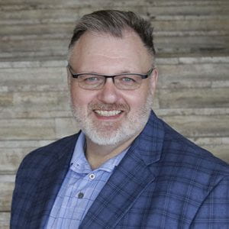
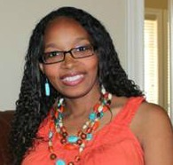
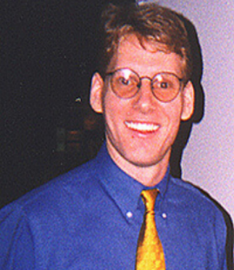
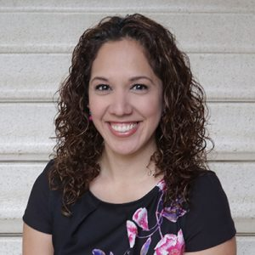
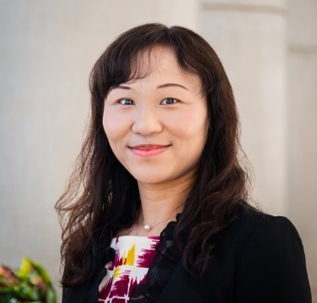
Introductions - Project ¡LEER! Staff
Dr. Mack D. Burke, Director, Baylor University
Dr. Lisa Bowman-Perrott, Co-Director, Texas A&M University
Dr. Richard Boon, Co-Director, The University of Texas at San Antonio
Dr. Kristen L. Padilla, Co-Principal Investigator, Baylor University
Dr. Fuhui Tong, Co-Principal Investigator, Texas A&M University
Ms. Virginia Reynolds, Project Coordinator, Baylor University

Slide 4
Terminology, Characteristics, and Cultural Considerations

Slide 5
Terminology
LEP
Limited English Proficient
EL
English learner
ELL
English language learner
EB
Emergent bilingual

Slide 6
Common Bilingual Terms and Acronyms
Students’ First Language
Also referred to as…
Native language
Heritage language
Ancestral language
Home language
L1
Students’ Second Language
Also referred to as…
L2

Slide 7
Emergent Bilingual (EB) Differences
Native language
Literacy in native language
Culture
Educational background
Socioeconomic status
Prior schooling
Age began attending U.S. schools
Life experiences
View of education

Slide 8
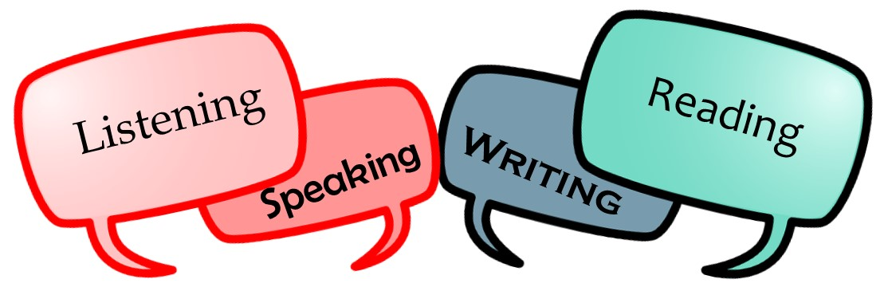
Emergent Bilinguals
English language proficiency
Speaking, reading, writing, listening
Heterogeneous group
(e.g., linguistically (including native language proficiency) and academically)
EBs often face the dual challenge of learning a new language while they are expected to perform in content areas

Slide 9
Source: Quizlet

Slide 10
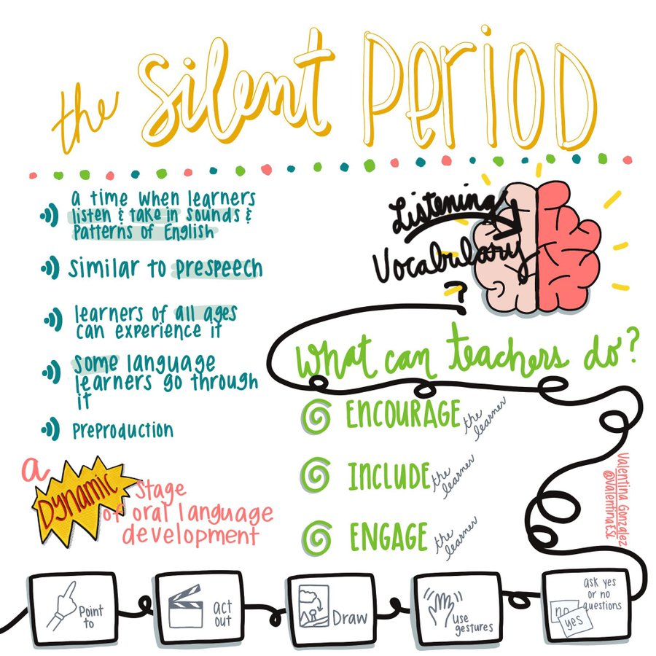
Source: Lisa Ali-Turner
Something to Remember…

Slide 11
Another Recommendation…

Slide 12
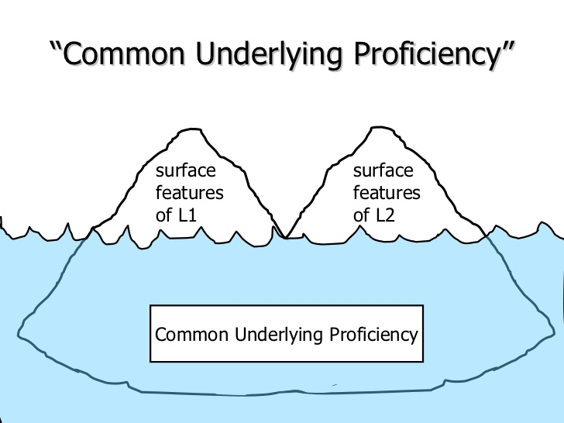
Common Underlying Proficiency (CUP)
Instruction in L1 will benefit the student in acquiring competency in L2 (Jim Cummins)
Literacy knowledge transfers across languages

Slide 13
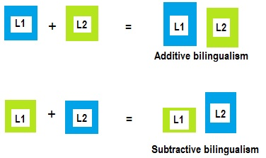
More Terminology
Additive bilingualism=>learning L2 while maintaining L1
Subtractive bilingualism=>learning L2 at the expense of L1
Formerly referred to as semi-lingualism=>low levels of competence (proficiency) in the L1 and L2

Slide 14
BICS
Basic Interpersonal Communication Skills (BICS)
Social language
Communication used daily in routine communicative exchanges (e.g., while dressing, eating, playing, etc.).
Cognitively undemanding language
Social conversation with gestures
Storytelling
Social phone call
Many agree that it takes 1-3 years to acquire

Slide 15
CALP
Cognitive Academic Language Proficiency (CALP)
Academic language
Used to use information acquired to find relationship, make inferences, and draw conclusions
Cognitively demanding
Math lesson (with manipulatives)
Geography lesson with maps
SociMultiple choice test
Many agree that it takes 5-7 years to acquire

Slide 16
Affective Filter
It is a barrier that prevents students from learning language (Stephen Krashen).
A screen of emotion that can block language acquisition or learning if it keeps the users from being too self-conscious or too embarrassed to take risks during communicative exchanges.
Even with quality instruction, a student’s feelings and emotional states (e.g., high anxiety, low motivation, low self-confidence) interferes with second language acquisition.
This filter “turns on,” and doesn’t allow the learner to receive the instructional input (information).

Slide 17
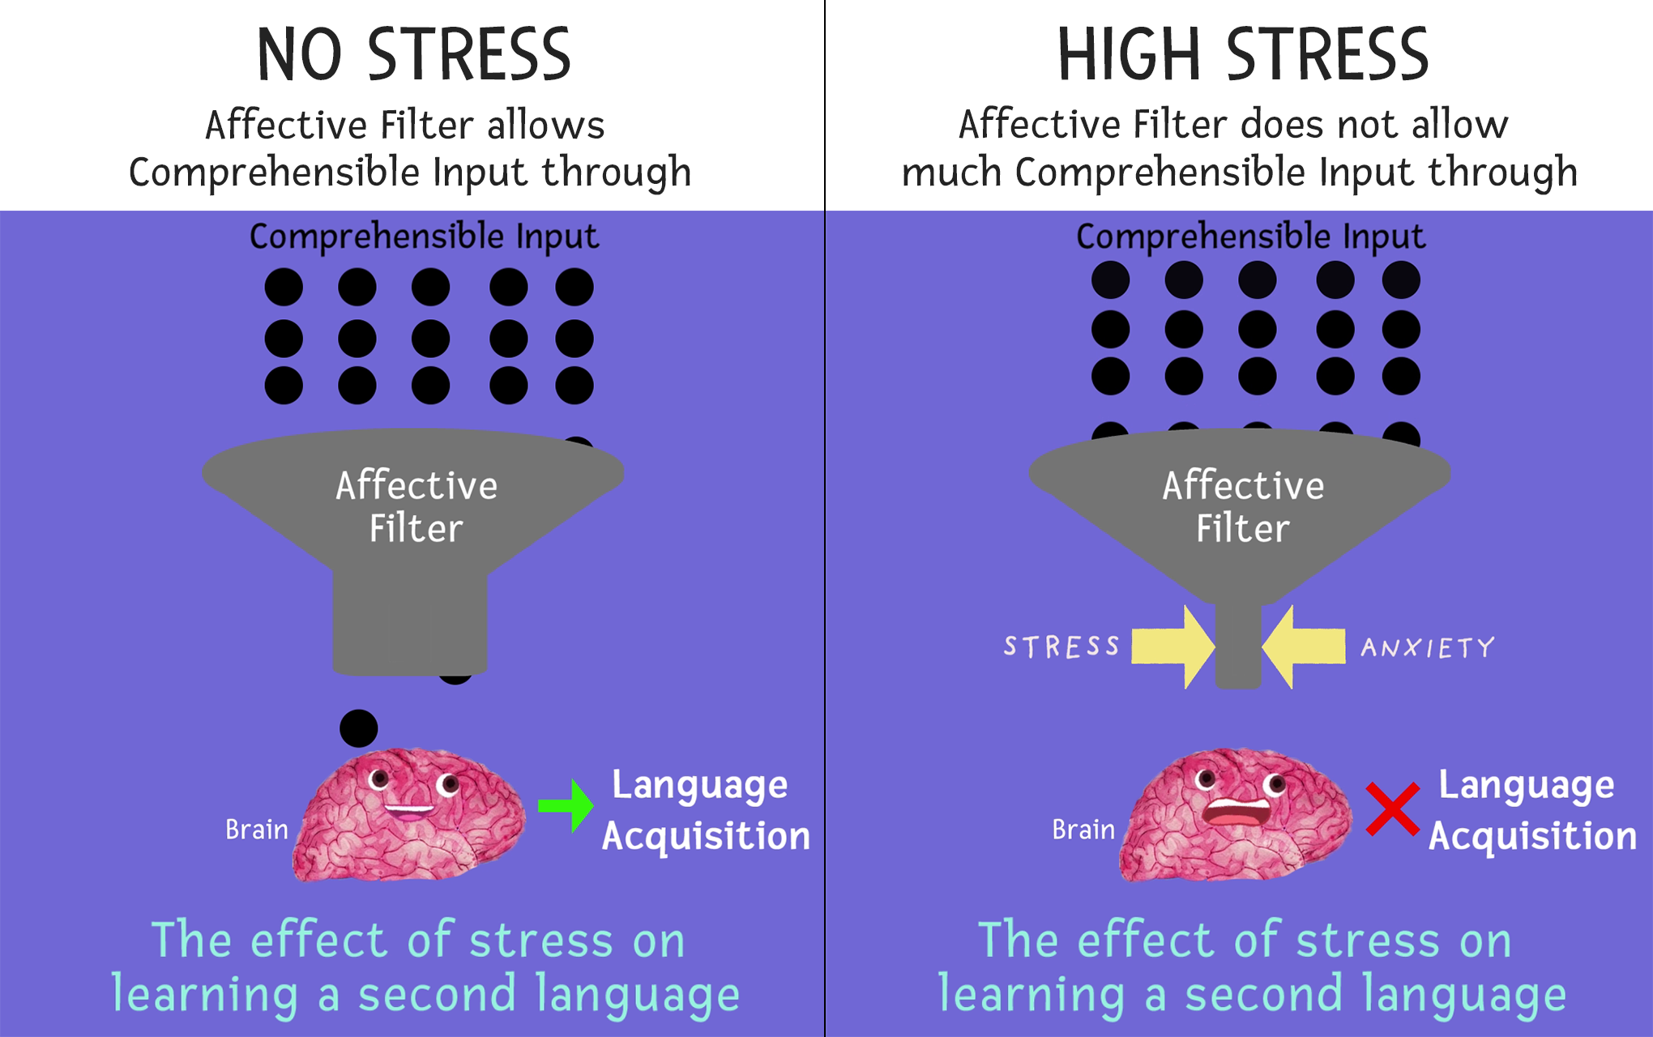
Affective Filter

Slide 18
Culture Shock
Students may…
feel frustrated, angry, hostile, sad, lonely and homesick
develop physical ailments such as stomach aches and headaches
feel devastated by the emotional upheaval caused by moving to a new culture
exhibit behavior such as depression or sleeplessness
may become overly aggressive or withdrawn
Each of these could result in a higher affective filter—which will in turn lead to a slower rate of second language acquisition.

Slide 19
Cognates
Words in two languages that share a similar meaning, spelling, and pronunciation.

Slide 20
Cognate Examples

Slide 21
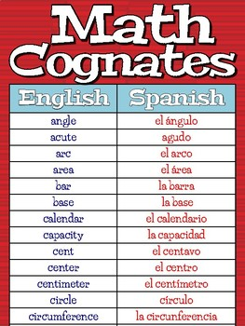
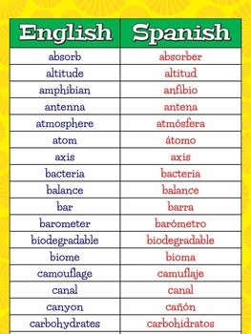
Content Area Cognates

Slide 22
Cultural Considerations

Slide 23
Considerations
Be mindful that some aspect of students’ cultures are not readily visible. The iceberg graphic on the previous slide illustrates this.
Getting to the know the student, the student’s family, and possibly their community can help better understand them.

Slide 24
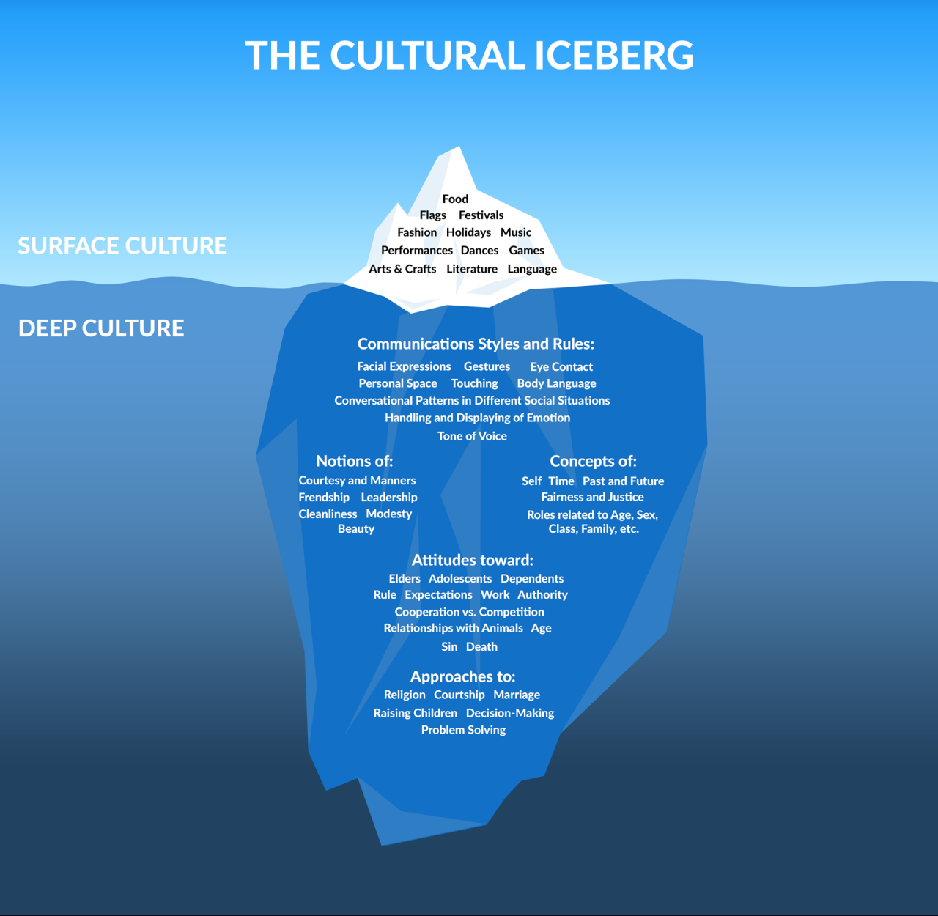

Slide 25
Tips to Aid Instruction

Slide 26
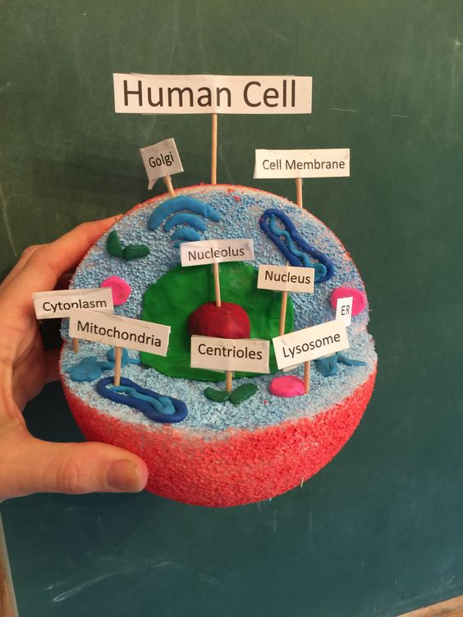
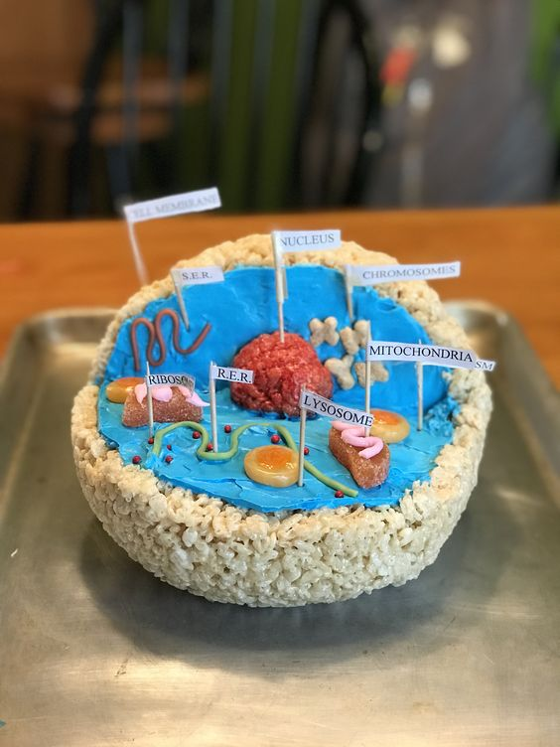
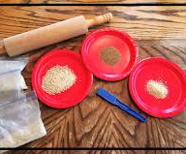
Encourage Active Learning
Visuals
Hands-on activities

Slide 27
Minimize or Exclude the Use of Idioms

Slide 28
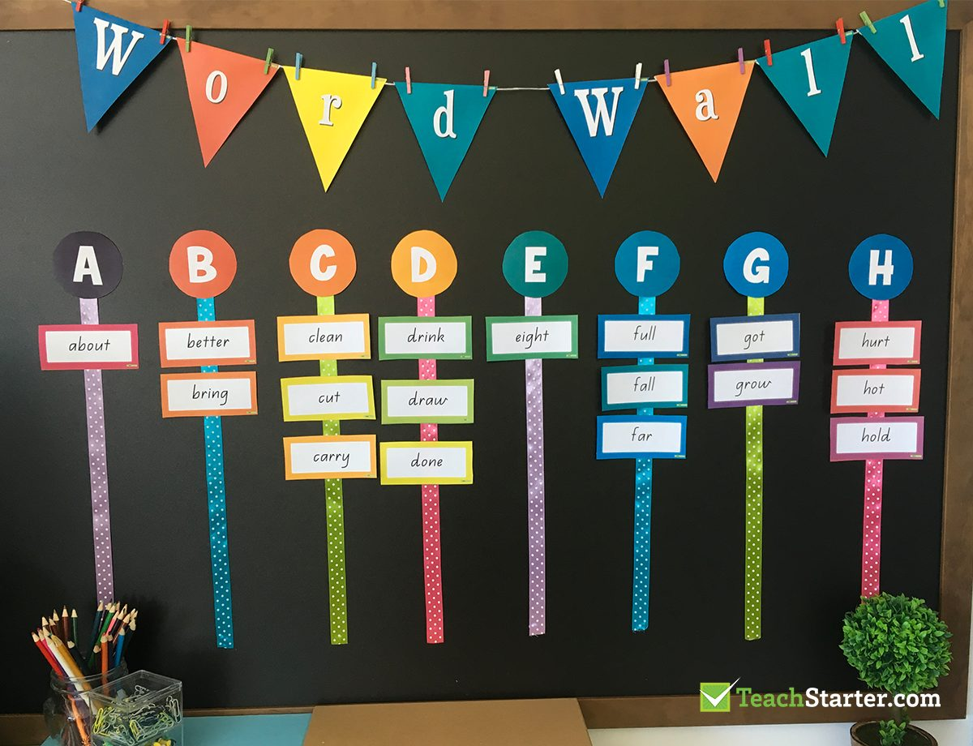
Word Wall

Slide 29
Extend the Use of Word Walls
You can ask your students to:
Categorize the words by:
Parts of speech
Subject area
Words that rhyme
Words with multiple meanings
You can also have students write or rewrite a sentence or paragraph with words from the word wall (e.g., adjectives).
Students can keep a notebook of “word wall words” to review and study at home.

Slide 30
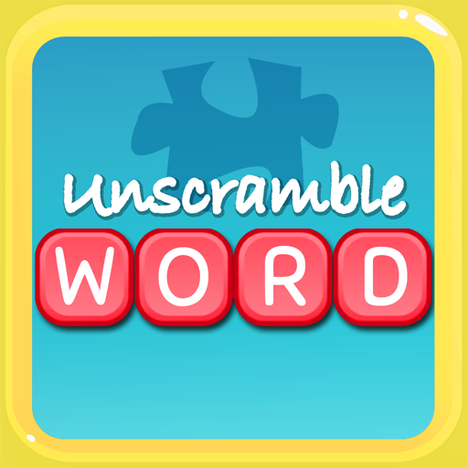
Extend the Use of Word Walls
Students can also:
Draw or act out words
Form word chains
Unscramble words

Slide 31
Thank You!

Slide 32
Contact Information
Dr. Mack D. Burke, Director
Baylor University
mack_burke@baylor.edu
Dr. Lisa Bowman-Perrott, Co-Director
Texas A&M University
lbperrott@tamu.edu
Dr. Richard Boon, Co-Director
The University of Texas at San Antonio
richard.boon@utsa.edu

